Slide 1


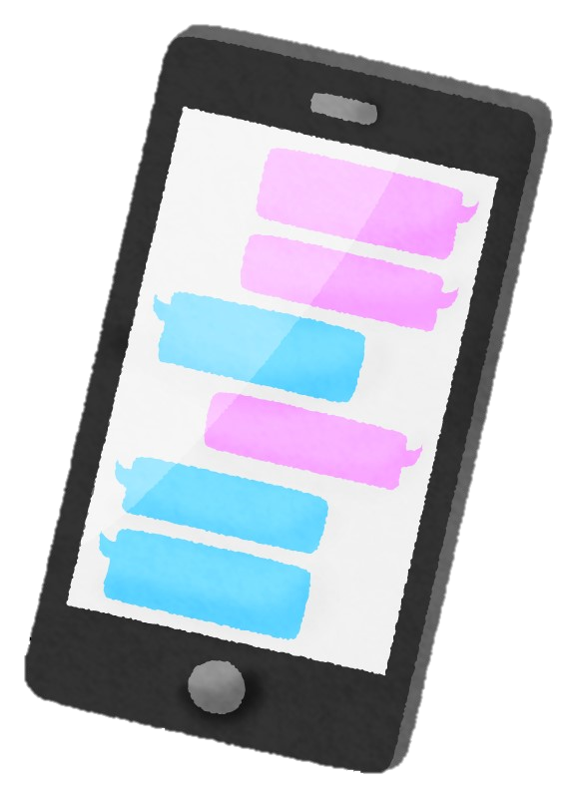
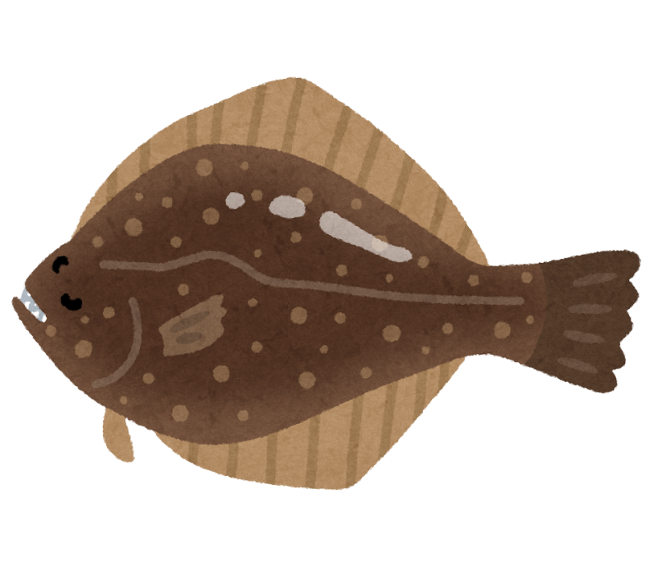
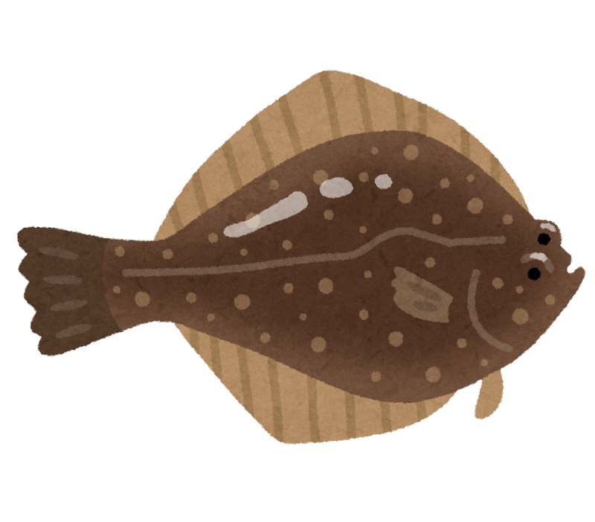
あそ
かた
遊
び
方
パソコン
キーボードにある「F5」キーを すと、 が きくなるよ！
きな になったら、 をクリックしてね。
スマートフォン・タブレット
ダウンロードして、「Microsoft PowerPoint」アプリケーションで き、
「 」または「 」ボタンを すと、 が きくなるよ！
きな になったら、 を にスライドしてね。

Slide 2

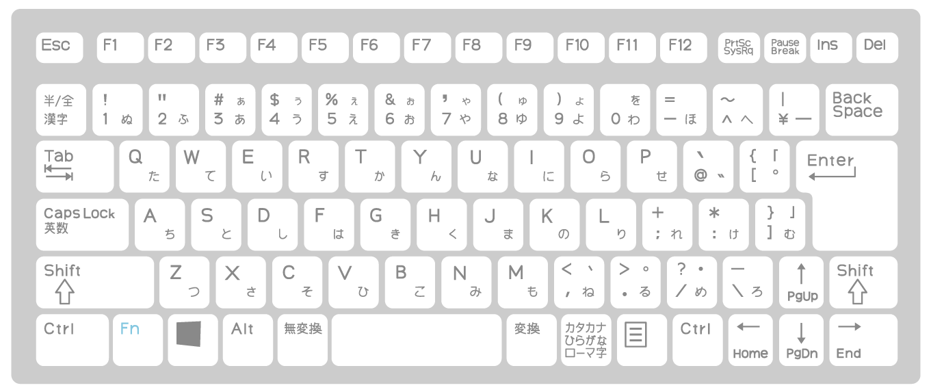

あそ
かた
遊
び
方
パソコン
に みたいときは 、
に りたいときは「 」キーを してね。
がめん
画面をクリック
BackSpace
スマートフォン・タブレット
に みたいときは を 、
のページに りたいときは を してね。
ひだり
左にスライド
みぎ
右にスライド

Slide 3
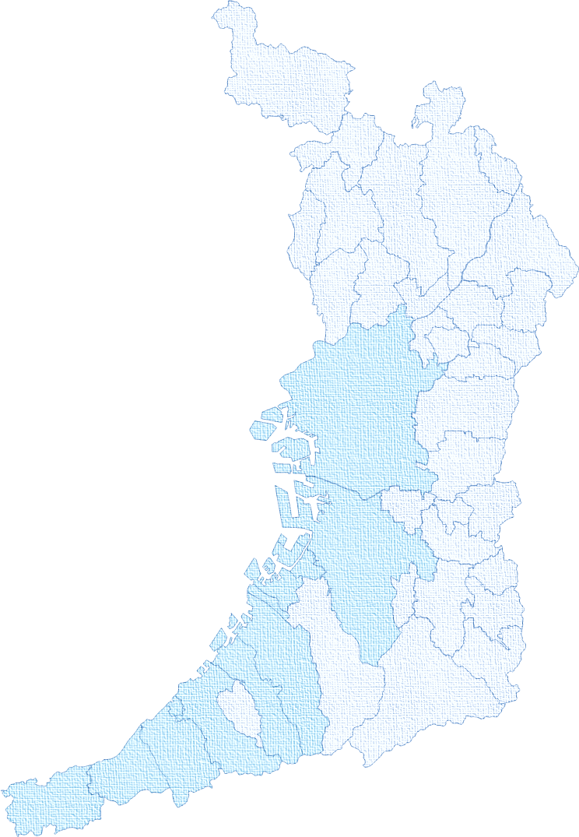

し
クイズで知ろう！
クイズで知ろう！
おお さか ぎょ ぎょう
おお さか ぎょ ぎょう
大阪の漁業
大阪の漁業
ねんぎょぎょう
ちょうさけっか
おおさかふぶん
ねんぎょぎょう
ちょうさけっか
おおさかふぶん
「2023年漁業センサス」調査結果(大阪府分)より
「2023年漁業センサス」調査結果(大阪府分)より

Slide 4




について には？
とは？
や などの で する を ったり、 てたり（ ）、 加工したりするお のことだよ。
の で
について べることになった さん。
って わずペットの漁衛門につぶやいた…。
ギョえもん
● ● ● ● ● ● ● ● ● ● ● ● ● ● ● ●
● ● ● ● ● ● ● ● ● ● ● ● ● ● ● ●
● ● ● ● ● ● ● ● ● ● ● ● ● ● ● ●
● ● ● ● ● ● ● ● ● ● ● ● ● ● ● ●
● ● ● ● ● ● ● ● ● ● ● ● ● ● ● ●
● ● ● ● ● ● ● ● ● ● ● ● ● ● ● ●
● ● ● ● ● ● ● ● ● ● ● ● ● ● ● ●
● ● ● ● ● ● ● ● ● ● ● ● ● ● ● ●
● ● ● ● ● ● ● ● ● ● ● ● ● ● ● ●
● ● ● ● ● ● ● ● ● ● ● ● ● ● ● ●
● ● ● ● ● ● ● ● ● ● ● ● ● ● ● ●
● ● ● ● ● ● ● ● ● ● ● ● ● ● ● ●
を にしている や、 、 な などを
るには、どうしたらいいんだろう・・・？
● ● ● ● ● ● ● ● ● ● ● ● ● ● ● ●
● ● ● ● ● ● ● ● ● ● ● ● ● ● ● ●
● ● ● ● ● ● ● ● ● ● ● ● ● ● ● ●
● ● ● ● ● ● ● ● ● ● ● ● ● ● ● ●
● ● ● ● ● ● ● ● ● ● ● ● ● ● ● ●
● ● ● ● ● ● ● ● ● ● ● ● ● ● ● ●
● ● ● ● ● ● ● ● ● ● ● ● ● ● ● ●
● ● ● ● ● ● ● ● ● ● ● ● ● ● ● ●
● ● ● ● ● ● ● ● ● ● ● ● ● ● ● ●
● ● ● ● ● ● ● ● ● ● ● ● ● ● ● ●
● ● ● ● ● ● ● ● ● ● ● ● ● ● ● ●
● ● ● ● ● ● ● ● ● ● ● ● ● ● ● ●
みらい
海来さん
それなら、 の をみればわかるよ！
センサスは、 を むすべての や を に に
う なんだ。
ギョえもん
漁衛門

Slide 5
について には？
の で
について べることになった さん。
って わずペットの漁衛門につぶやいた…。
ギョえもん
● ● ● ● ● ● ● ● ● ● ● ● ● ● ● ●
● ● ● ● ● ● ● ● ● ● ● ● ● ● ● ●
● ● ● ● ● ● ● ● ● ● ● ● ● ● ● ●
● ● ● ● ● ● ● ● ● ● ● ● ● ● ● ●
● ● ● ● ● ● ● ● ● ● ● ● ● ● ● ●
● ● ● ● ● ● ● ● ● ● ● ● ● ● ● ●
● ● ● ● ● ● ● ● ● ● ● ● ● ● ● ●
● ● ● ● ● ● ● ● ● ● ● ● ● ● ● ●
● ● ● ● ● ● ● ● ● ● ● ● ● ● ● ●
● ● ● ● ● ● ● ● ● ● ● ● ● ● ● ●
● ● ● ● ● ● ● ● ● ● ● ● ● ● ● ●
● ● ● ● ● ● ● ● ● ● ● ● ● ● ● ●
へ～。そんな があるんだね。 らなかったよ。
センサスについてもっと えてほしいな！
● ● ● ● ● ● ● ● ● ● ● ● ● ● ● ●
● ● ● ● ● ● ● ● ● ● ● ● ● ● ● ●
● ● ● ● ● ● ● ● ● ● ● ● ● ● ● ●
● ● ● ● ● ● ● ● ● ● ● ● ● ● ● ●
● ● ● ● ● ● ● ● ● ● ● ● ● ● ● ●
● ● ● ● ● ● ● ● ● ● ● ● ● ● ● ●
● ● ● ● ● ● ● ● ● ● ● ● ● ● ● ●
● ● ● ● ● ● ● ● ● ● ● ● ● ● ● ●
● ● ● ● ● ● ● ● ● ● ● ● ● ● ● ●
● ● ● ● ● ● ● ● ● ● ● ● ● ● ● ●
● ● ● ● ● ● ● ● ● ● ● ● ● ● ● ●
● ● ● ● ● ● ● ● ● ● ● ● ● ● ● ●
じゃあ 、 の の 調査結果からクイズを５ すよ。
に えを えてみよう！
みらい
海来さん
ギョえもん
漁衛門

Slide 6



センサスは ごとに
われているでしょうか？
① ② ３ ③ ５
ヒント！
のページの を
みてみよう！
えを る⇒

Slide 7
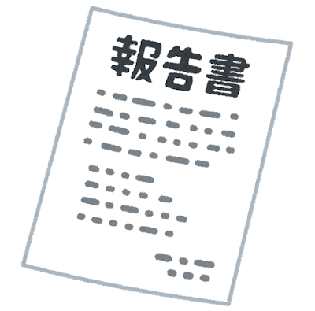
③ ５
センサスは、1949 （ 24 ）に まったんだ。
は、 の だったんだよ。
1963 （ 38 ） は5 ごとに
これまでに15

Slide 8
ヒント！
をみてみよう！
こた み
答えを見る⇒

Slide 9

漁業を仕事にしている人の年代別の人数のグラフ
ぎょぎょう し ごと ひと ねんだいべつ にんずう
にん
にん
（人）
おお さか ふ
（人）
ぜん こく
（人）
大阪府
全国
大阪府
漁業を仕事にしている人の年代別の人数のグラフ
さい い か
さいだい
さいだい
さいだい
さいだい
さい いじょう
さい い か
さいだい
さいだい
さいだい
さいだい
さいいじょう

Slide 10
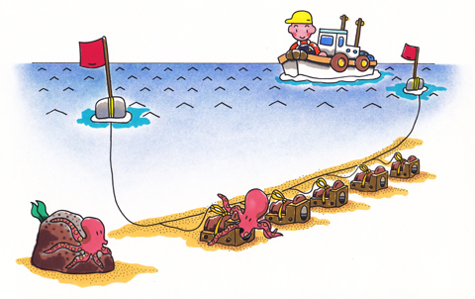
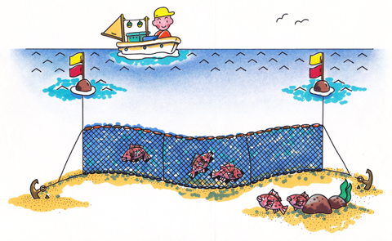
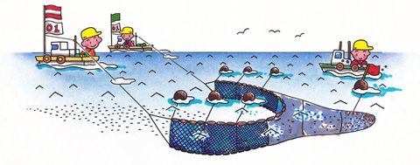
の には、
、 、たこつぼ があるよ。
それぞれ、どのイラストかわかるかな。
１
２
３
ヒント！
こた み
答えを見る⇒
をみてみよう！

Slide 11


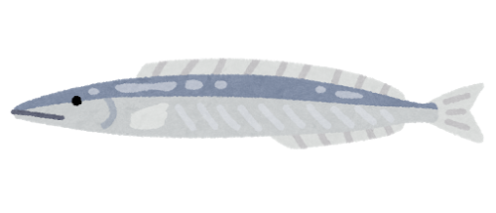

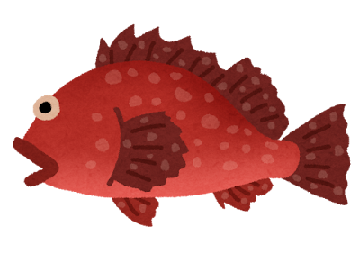
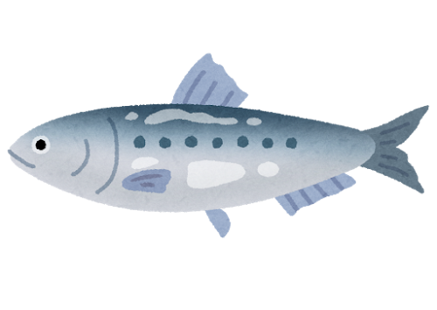

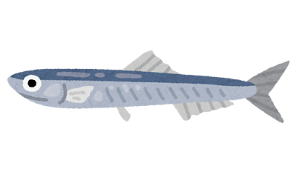
カサゴ
イカナゴ
カレイ
タコ
マイワシ
メバル
カタクチイワシ

Slide 12




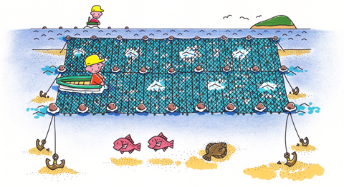
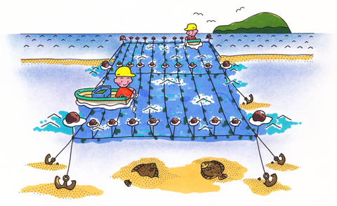
ようしょくぎょう し
養殖業って知ってる？？

Slide 13




のこ もん
残り２問！！

Slide 14





にん
ぎょぎょう しごと ひと にんずう ねん すいい
ねん
ねん
ねん
ねん
ねん
ねん
ねん
ねん
ねん
ねん
ねん
ねん
ねん
こた み
答えを見る⇒
ヒント！
をみてみよう！

Slide 15
にん
ねん
ねん
ねん
ねん
ねん
ねん
ねん
ねん
ねん
ねん
ねん
ねん
ねん

Slide 16
ぎょせん かず せき
おおさかふ
ひょうごけん
きょうとふ
★％
わ か や ま け ん
▲％
ひょうごけん
■％
きょうとふ
わかやまけん
おおさかふ
●％
ふけんごうけい
こた み
ヒント！
答えを見る⇒

Slide 17

10％
11％
54％
25％

Slide 18




しゅうりょう
クイズ終了！！

Slide 19
なに
かつ よう
何に活用されている？
● ● ● ● ● ● ● ● ● ● ● ● ● ● ● ●
● ● ● ● ● ● ● ● ● ● ● ● ● ● ● ●
● ● ● ● ● ● ● ● ● ● ● ● ● ● ● ●
● ● ● ● ● ● ● ● ● ● ● ● ● ● ● ●
● ● ● ● ● ● ● ● ● ● ● ● ● ● ● ●
● ● ● ● ● ● ● ● ● ● ● ● ● ● ● ●
● ● ● ● ● ● ● ● ● ● ● ● ● ● ● ●
● ● ● ● ● ● ● ● ● ● ● ● ● ● ● ●
● ● ● ● ● ● ● ● ● ● ● ● ● ● ● ●
● ● ● ● ● ● ● ● ● ● ● ● ● ● ● ●
● ● ● ● ● ● ● ● ● ● ● ● ● ● ● ●
● ● ● ● ● ● ● ● ● ● ● ● ● ● ● ●
みらい
海来さん
● ● ● ● ● ● ● ● ● ● ● ● ● ● ● ●
● ● ● ● ● ● ● ● ● ● ● ● ● ● ● ●
● ● ● ● ● ● ● ● ● ● ● ● ● ● ● ●
● ● ● ● ● ● ● ● ● ● ● ● ● ● ● ●
● ● ● ● ● ● ● ● ● ● ● ● ● ● ● ●
● ● ● ● ● ● ● ● ● ● ● ● ● ● ● ●
● ● ● ● ● ● ● ● ● ● ● ● ● ● ● ●
● ● ● ● ● ● ● ● ● ● ● ● ● ● ● ●
● ● ● ● ● ● ● ● ● ● ● ● ● ● ● ●
● ● ● ● ● ● ● ● ● ● ● ● ● ● ● ●
● ● ● ● ● ● ● ● ● ● ● ● ● ● ● ●
● ● ● ● ● ● ● ● ● ● ● ● ● ● ● ●
ギョえもん
漁衛門

Slide 20
なに
かつ よう
何に活用されている？
● ● ● ● ● ● ● ● ● ● ● ● ● ● ● ●
● ● ● ● ● ● ● ● ● ● ● ● ● ● ● ●
● ● ● ● ● ● ● ● ● ● ● ● ● ● ● ●
● ● ● ● ● ● ● ● ● ● ● ● ● ● ● ●
● ● ● ● ● ● ● ● ● ● ● ● ● ● ● ●
● ● ● ● ● ● ● ● ● ● ● ● ● ● ● ●
● ● ● ● ● ● ● ● ● ● ● ● ● ● ● ●
● ● ● ● ● ● ● ● ● ● ● ● ● ● ● ●
● ● ● ● ● ● ● ● ● ● ● ● ● ● ● ●
● ● ● ● ● ● ● ● ● ● ● ● ● ● ● ●
● ● ● ● ● ● ● ● ● ● ● ● ● ● ● ●
● ● ● ● ● ● ● ● ● ● ● ● ● ● ● ●
ギョえもん
● ● ● ● ● ● ● ● ● ● ● ● ● ● ● ●
● ● ● ● ● ● ● ● ● ● ● ● ● ● ● ●
● ● ● ● ● ● ● ● ● ● ● ● ● ● ● ●
● ● ● ● ● ● ● ● ● ● ● ● ● ● ● ●
● ● ● ● ● ● ● ● ● ● ● ● ● ● ● ●
● ● ● ● ● ● ● ● ● ● ● ● ● ● ● ●
● ● ● ● ● ● ● ● ● ● ● ● ● ● ● ●
● ● ● ● ● ● ● ● ● ● ● ● ● ● ● ●
● ● ● ● ● ● ● ● ● ● ● ● ● ● ● ●
● ● ● ● ● ● ● ● ● ● ● ● ● ● ● ●
● ● ● ● ● ● ● ● ● ● ● ● ● ● ● ●
● ● ● ● ● ● ● ● ● ● ● ● ● ● ● ●
漁衛門
調査結果は、日本の水産業や、漁業を仕事にしている人達のために欠かせないデータなんだね。
ちょうさけっか
にほん
すいさんぎょう
ぎょぎょう
しごと
みらい
海来さん
ひとたち
か

Slide 21

みらい
海来さん
● ● ● ● ● ● ● ● ● ● ● ● ● ● ● ●
● ● ● ● ● ● ● ● ● ● ● ● ● ● ● ●
● ● ● ● ● ● ● ● ● ● ● ● ● ● ● ●
● ● ● ● ● ● ● ● ● ● ● ● ● ● ● ●
● ● ● ● ● ● ● ● ● ● ● ● ● ● ● ●
● ● ● ● ● ● ● ● ● ● ● ● ● ● ● ●
● ● ● ● ● ● ● ● ● ● ● ● ● ● ● ●
● ● ● ● ● ● ● ● ● ● ● ● ● ● ● ●
● ● ● ● ● ● ● ● ● ● ● ● ● ● ● ●
● ● ● ● ● ● ● ● ● ● ● ● ● ● ● ●
● ● ● ● ● ● ● ● ● ● ● ● ● ● ● ●
● ● ● ● ● ● ● ● ● ● ● ● ● ● ● ●
● ● ● ● ● ● ● ● ● ● ● ● ● ● ● ●
● ● ● ● ● ● ● ● ● ● ● ● ● ● ● ●
● ● ● ● ● ● ● ● ● ● ● ● ● ● ● ●
● ● ● ● ● ● ● ● ● ● ● ● ● ● ● ●
● ● ● ● ● ● ● ● ● ● ● ● ● ● ● ●
● ● ● ● ● ● ● ● ● ● ● ● ● ● ● ●
● ● ● ● ● ● ● ● ● ● ● ● ● ● ● ●
● ● ● ● ● ● ● ● ● ● ● ● ● ● ● ●
● ● ● ● ● ● ● ● ● ● ● ● ● ● ● ●
● ● ● ● ● ● ● ● ● ● ● ● ● ● ● ●
● ● ● ● ● ● ● ● ● ● ● ● ● ● ● ●
● ● ● ● ● ● ● ● ● ● ● ● ● ● ● ●
ギョえもん
漁衛門

Slide 22




ギョえもん
漁衛門
● ● ● ● ● ● ● ● ● ● ● ● ● ● ● ●
● ● ● ● ● ● ● ● ● ● ● ● ● ● ● ●
● ● ● ● ● ● ● ● ● ● ● ● ● ● ● ●
● ● ● ● ● ● ● ● ● ● ● ● ● ● ● ●
● ● ● ● ● ● ● ● ● ● ● ● ● ● ● ●
● ● ● ● ● ● ● ● ● ● ● ● ● ● ● ●
● ● ● ● ● ● ● ● ● ● ● ● ● ● ● ●
● ● ● ● ● ● ● ● ● ● ● ● ● ● ● ●
● ● ● ● ● ● ● ● ● ● ● ● ● ● ● ●
● ● ● ● ● ● ● ● ● ● ● ● ● ● ● ●
● ● ● ● ● ● ● ● ● ● ● ● ● ● ● ●
● ● ● ● ● ● ● ● ● ● ● ● ● ● ● ●
クイズ
● ● ● ● ● ● ● ● ● ● ● ● ● ● ● ●
● ● ● ● ● ● ● ● ● ● ● ● ● ● ● ●
● ● ● ● ● ● ● ● ● ● ● ● ● ● ● ●
● ● ● ● ● ● ● ● ● ● ● ● ● ● ● ●
● ● ● ● ● ● ● ● ● ● ● ● ● ● ● ●
● ● ● ● ● ● ● ● ● ● ● ● ● ● ● ●
● ● ● ● ● ● ● ● ● ● ● ● ● ● ● ●
● ● ● ● ● ● ● ● ● ● ● ● ● ● ● ●
● ● ● ● ● ● ● ● ● ● ● ● ● ● ● ●
● ● ● ● ● ● ● ● ● ● ● ● ● ● ● ●
● ● ● ● ● ● ● ● ● ● ● ● ● ● ● ●
● ● ● ● ● ● ● ● ● ● ● ● ● ● ● ●

Slide 23




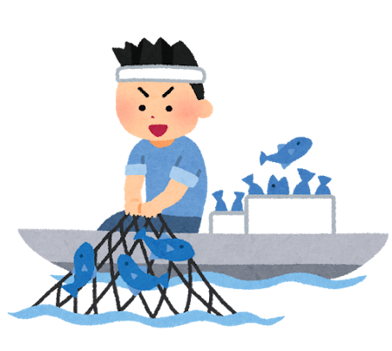
あそ
遊んでくれてありがとう！
またチャレンジしてね！

