Slide 1
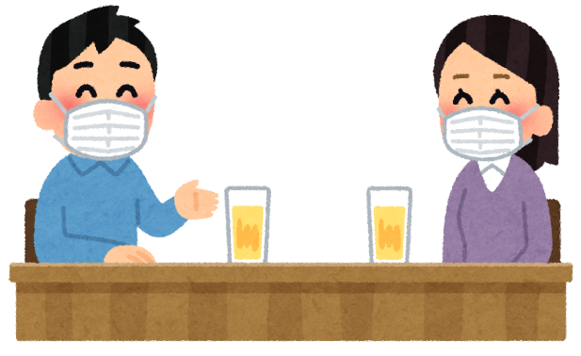
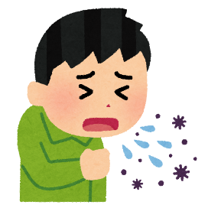
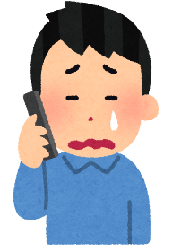
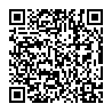
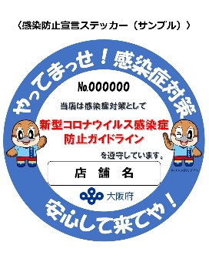
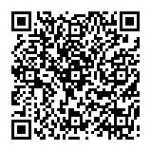
Asking for your Cooperation for Osaka’s Infection Prevention
Measures (To Students)
[August 1 to 20, 2020]
1.Refrain from a
(drinking) party of 5 or
more people
2.Stay home when you
feel sick
3.Contact a consultation
center when you have
any symptoms
List of the consultation centers
(Japanese)
4.Use restaurants that
have a “declaration of
infection prevention
sticker”
5.Use the Osaka COVID-
19 Tracing System in a
restaurant
6.Install “COCOA,” a
contact confirming App
of the national government
Read the QR code for details
(Japanese)
Osaka Prefecture Website http://www.pref.osaka.lg.jp/default.html

