Slide 1
July 3, 2020 Department of Public Health and Medical Affairs
“Osaka Model”
Revised Version

Slide 2
”Osaka Model” Revised Version
＜Basic concept＞
●Setting Osaka’s own monitoring points, monitoring them and visualizing the current status to judge the infection spread situation
● Setting caution criteria for each monitoring point to judge "signs of the infection spread“ and “situation of infection containment“, and informing the residents of the situation according to the status of each standard.
＜Monitoring points and criteria of turning on/off of the lights＞
１．The criteria of lighting yellow (raising awareness) have been changed, and the yellow light has come to express
“warning.” This has been decided based on the positive results of responses to clusters, efforts to secure hospital
beds when the infection was spreading, and the fact that residents are accustomed to a “new lifestyle.”
２．“The state of emergency (red)”guidelines have been newly set up, to inform residents that there is a possibility of
infection spread that will not be covered by the expected number of hospital beds.
３．Each guideline is being monitored and visualized on a daily basis to catch the situation of infection occurrence.
With or without “warning” (yellow light), measures such as securing hospital beds are swiftly taken in accordance
with the situation
４．Even when the “warning (yellow light)” is off, awareness-raising measures are taken to the residents in response to
the infection occurrence situation.
５．When lifting the state of emergency, etc., green light (lifting) is lit for certain period and turned off
＜Criteria of lighting＞
When all of the monitoring guidelines are met: Warning: yellow State of emergency: red
Lifting of Warning/State of emergency: green（ turned off after being lighted for a certain period)
1

Slide 3
Revised Points
＜revision (1) ＞
-Shift the criteria of “request for self-restraint/lifting of self-restraint” to the criteria of “Warning/a state of emergency/lifting of a
state of emergency” to residents
＜ revision (2) ＞
-Set the monitoring point ①“The increasing rate of cases with unknown transmission route from the previous week” as the combination with ② “The number of cases with unknown transmission route”
-Raise the criteria of monitoring points ① and ② to “2 or more” and “10 and more” respectively to ensure early detection of “a sign of infection spread” when there is no surge in number of infections
＜ revision (3) ＞
-Replace the criterion of monitoring point ③ “Positive rate at the first PCR test” with “Total number of new positive cases for 7 days”
-Ensure early detection of “sign of infection spread,” by setting the criterion as “120 persons or more as well as the half and more of them occur in
the latter 3 days”
＜ revision (4) ＞
-Set the monitoring point for “lifting” to the residents as “new positive cases per 100,000 persons for the last 1 week should be less than 0.5,” which is one of the lifting criteria shown by the national government.
＜ revision (5) ＞
-Set the monitoring point of ”a state of emergency” to the residents as the “Occupancy rate of hospital beds for severe symptom patients.”
-Set the criterion for the above as “the case when the rate reaches over 70% within 25 days counting from the day the “Warning” (yellow light ) was
turned on
＜ revision (6) ＞
-Continue daily monitoring, referring to the “positive rate at the first PCR test”
-Continue daily monitoring, referring to the ratio of cases with unknown transmission route (the number of unknown transmission
route /total number of new positive cases)
2

Slide 4
Revised “Osaka Model” Monitoring Points and Criteria（Draft）
To the residents
Analyses items | Monitoring points | Warning criteria | State of emergency criteria | Criteria for lifting of Warning and a state of emergency
(1)Community spread situation | ①Increasing rate of the 7 day- moving average of cases with unknown transmission route in the new positive cases ②7 day-moving average of the number of cases with unknown transmission route | ① 2 and more at the same time ②10 and more | ― | ②Less than 10 person
(2)Increase in new positive cases | ③Total number of new positive cases for 7 days | 120 and more at the same time Half of them and more occur in latter 3 days | ― | ―
 | ④Number of new positive cases per 100,000 persons for the last 1 week | ― | ― | Less than 0.5 person
(3) Hospital bed availability | ⑤Occupancy rate of hospital beds for severe symptom patients | ― | 70% and more （within 25 days counting from the day the “Warning” (yellow light ) was turned on | Less than l60％
【Referred point】 ⑥7 day-moving average of the positive rate at the first PCR test |  | ― | ― | ―
【Referred point】 ⑦Ratio of cases with unknown transmission route in the total number of new positive cases |  | ― | ― | ―
revision (1)
revision(2)
revision (3)
revision(4)
revision (5)
revision (6)
＜Things to be taken into account＞
○ When the condition shown by the national government (2 new positive cases per 100,000 persons for the last 1 week) is met,
Osaka coronavirus control headquarters will decide if the Warning (yellow) light should be turned on or not. This is because the
early detection of “sign of infection spread” might be delayed due to the ease of the caution criteria.
○ If the national government declares a state of emergency, the Osaka coronavirus control headquarters meeting will decide if
“a state of emergency (red)” light should be turned on or not.
3

Slide 5
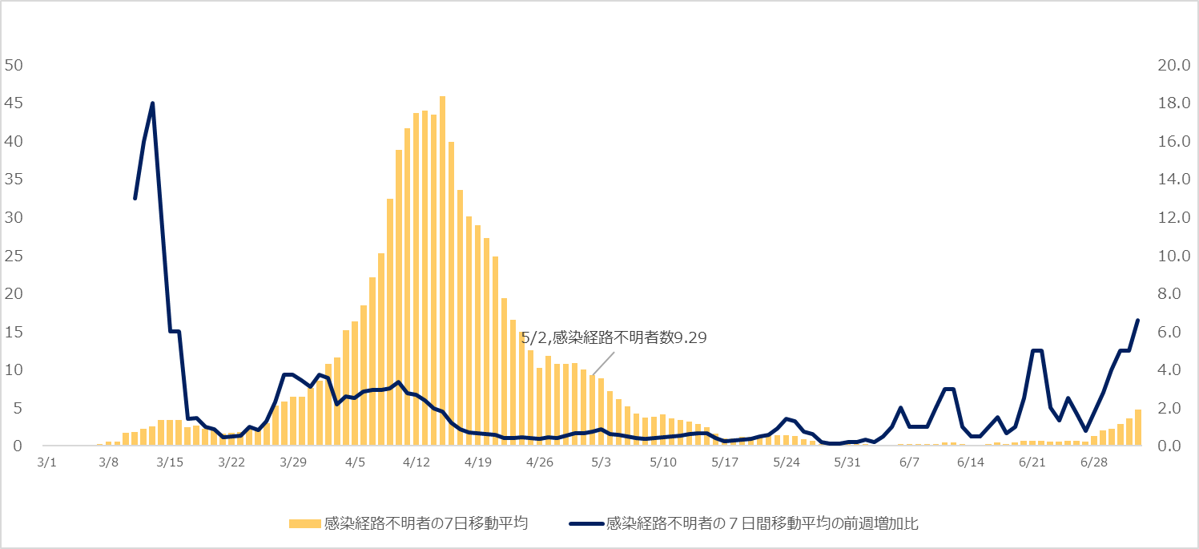
Monitoring Point ① Increasing rate of 7 day- moving average of cases with unknown transmission route in the new positive cases from the previous week ② 7 day- moving average of cases with unknown transmission route
Caution criterion: 10 and more cases with unknown transmission route
Lifting criterion: Less than 10 cases with unknown transmission route
Caution criterion:
2 and more increase rate from the previous week
The number of cases with unknown transmission route on May 2: 9.29
7 day-moving average of cases with unknown transmission route
The increasing rate of 7 day- moving average of cases with unknown transmission route
from the previous week
4

Slide 6
Monitoring Point ③Total number of new positive cases for 7 days
※70 cases in latter 3 days
March 30: 8
March 31: 28
April 1: 34
Caution criterion:120 and more new positive cases for 7 days in total, at the same time, the half and more of them occur in the latter 3 days
※
3月1日＝March1 4月1日＝April1 5月1日＝May1 6月1日＝June1 7月1日＝July1
5

Slide 7
Monitoring Point ④ Number of new positive cases per 100,000 persons for the last
1 week
【Reference】2.5（Number of new positive cases per
100,000 persons for the last 1 week):
Base date to request for social cooperation
（Informed by the Ministry of Health, Labour and
Welfare on June 19, 2020）
Lifting criterion
Number of new positive cases per 100,000 persons: Less than 0.5
※
3月1日＝March1 4月1日＝April1 5月1日＝May1 6月1日＝June1 7月1日＝July1
6

Slide 8
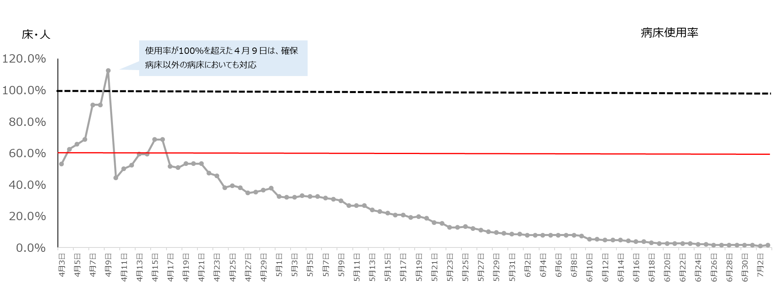
Monitoring Point ⑤ Occupancy rate of hospital beds for severe symptom patients
Occupancy rate of hospital beds
The beds other than reserved ones were also used for severe symptom patients on April 9 when the occupancy rate of beds surpassed 100%
Lifting criterion: Less than 60%
解除の基準 60％未満
※
3月1日＝March1 4月1日＝April1 5月1日＝May1 6月1日＝June1 7月1日＝July1
7

Slide 9
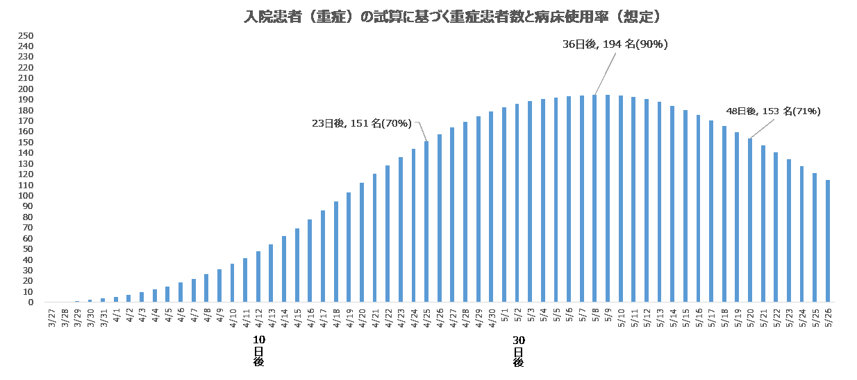
【Reference】 Monitoring Point ⑤ Occupancy rate of hospital beds for severe symptom patients
-Partly revised from the Osaka coronavirus control headquarters material issued on June 12, 2020
-Provisional number of hospitalized patients was calculated by applying situation of infection cases in Osaka (starting on March 27) to the spread situation in Tokyo
The expected number of severe symptom patients and the occupancy rate of hospital beds based on the provisional number of hospitalized patients with severe symptoms
After 36 days: 194 cases (90%)
Occupancy rate 100%
215 beds
使用率100%
215床
After 48 days: 153 cases (71%)
After 23 days: 151 cases (70%)
Occupancy rate 70%
151 beds
使用率70%
151床
After X days
０日
20日後
40日後
50日後
Expected occupancy rate of hospital beds is to be surpass 70% after 25 days from the day when the caution criterion was met,
but not to be surpass 100%.
8

Slide 10
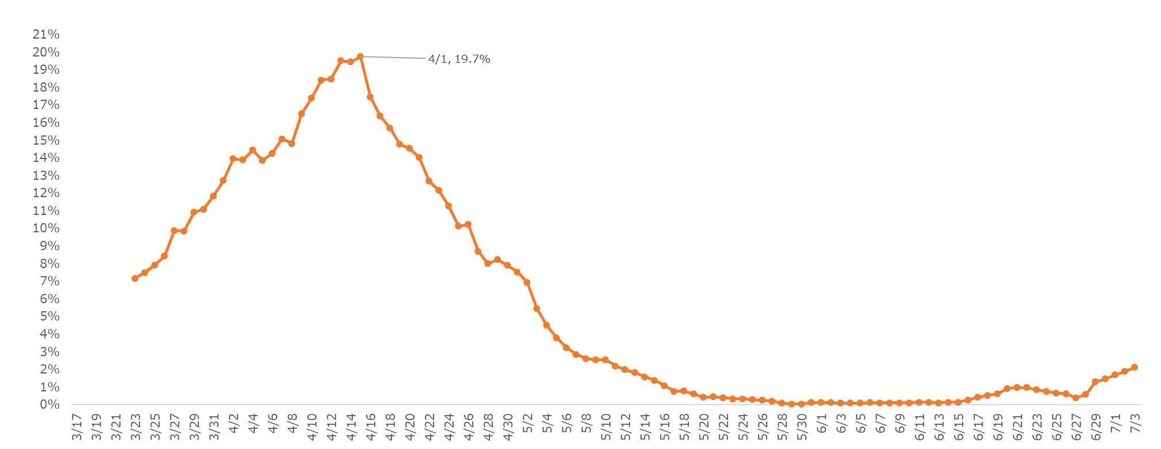
【Reference】 Monitoring Point ⑥Positive rate at the first PCR test
9

Slide 11
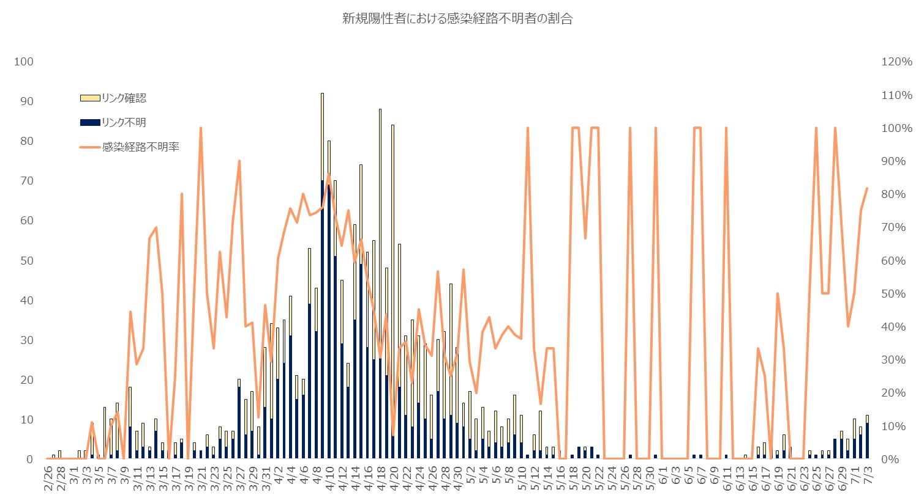
【Reference】⑦Ratio of cases with unknown transmission route in the total number of new positive cases
The ratio of cases with unknown transmission route in the new positive cases
Transmission route confirmed
Transmission route unknown
Ratio of cases with unknown transmission route
10

