Slide 1
Criteria to move on to the Yellow Stage(Warning)2
When either of the following criteria is met, we move on to the Yellow Stage 2
（Decided at the 22nd meeting of the Osaka Novel Coronavirus-control Headquarters on July 28）
① When the occupancy rate of beds for either severe or slight/mild symptom patients reaches
the following criteria:
・Beds for severe symptom patients ：Approx. 35％
・Beds for slight/mild symptom patients ：Approx. 50％
② When measures such as facility use restriction, etc. are taken together with the national government
and other large cities after discussions, even though the criteria of ① are not met.
【Current infection situation】
〇 The number of test positives has a tendency to increase and the occupancy rate of hospital
beds for sever symptom patients reaches about more than 35%
＜ the occupancy rate of hospital beds for sever symptom patients ＞
Nov. 15 | Nov. 16 | Nov. 17 | Nov. 18 | Nov. 19
32.0％ | 35.0％ | 33.5％ | 35.0％ | 36.9％
Move on to the Yellow Stage(Warning 2), in accordance with ①

Slide 2
Requests based on the Response Policy at the Yellow Stage(Warning)
① Areas: Entire Osaka Prefecture
② Period: During the Yellow Stage 2(From November 21 to December 5, 2020)
*subject to change depending on the infection spread situation, such as when the occupancy rate of
hospital beds for sever symptom patients reaches about more than 50%
③ Details: Based on the relevant law
●Calling on residents
Request:
・Refrain from parties and drinking sessions joined by “Five or more people ※１”,
or lasting “ Two or more hours” ※１ family, infants and children, the elderly and care-givers, etc. are NOT included
・To those who have a high risk of aggravation (the elderly, people with underlying diseases ※２, etc.), refrain from
nonessential and non-urgent outings※３
※２ people with diabetes, heart failure, respiratory disease(COPD, etc.) , dialysis patients and patients taking immunosuppressant or anticancer agent, etc.
※３ the essential cases to maintain the lives, such as going to medical institutions, shopping for food, clothes and daily necessities, necessary commuting,
walk and exercise outside are NOT included
・To the elderly, family members who have daily contact with the elderly and staff members working in elderly
and medical facilities, etc., avoid visiting places with high risk of infection and get leave and be tested as soon
as possible when having any symptoms
・Eat and drink without chatting
・Make sure to wear a mask (even when you talk while eating and drinking)
・Ventilate and moisturize
・Refrain from visiting eateries with entertainment services or offering alcohol, which don’t comply with
the guidelines determined for each industry (or don’t have a “COVID-19 safety sticker”).
・Avoid “Three Cs” where droplets of saliva can scatter

Slide 3
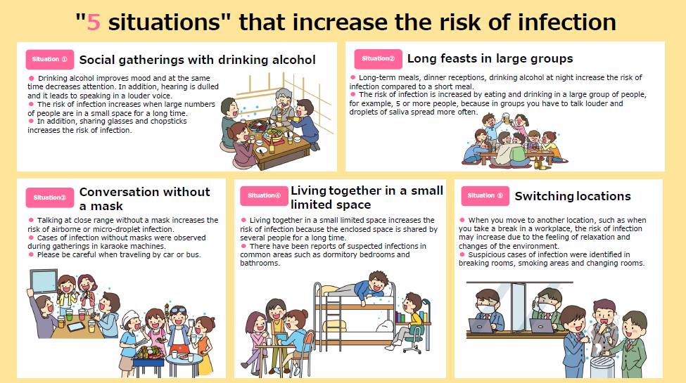
Excerption from the suggestion of government’s coronavirus subcommittee
(Attached)

Slide 4
●Holding events (including ones hosted/co-hosted by Osaka Prefecture)
To event organizers:
Request to thoroughly comply with the guidelines determined for each industry and take thorough infection tracing measures such as using “COCOA” (the national government’s contact confirming App) and Osaka COVID-19 Tracing System, and making a participant list
The regulations are as the attached sheet, provided the industry-specific guidelines are revised and necessary infection prevention measures are thoroughly taken
When holding an event that requires traveling across the nation or an event with over 1,000 participants, consult Osaka Prefecture beforehand about the holding conditions of the event
The regulations are subject to change in accordance with the national government, if the nationwide spread of infections or clusters at events occur and the national government
changes the industry-specific guidelines or criteria for the capacity and number of
participants
It is being considered to request to refrain from holding events if appropriate infection prevention measures or risk countermeasures are not taken or prepared

Slide 5
Attached Sheet
Period | Capacity Conditions |  | Upper Limit of Participants
From November 21 to the end of November, 2021 | NO loud shouts or cheers, etc. are expected classical music concerts, plays, dance, traditional performances, ceremonies, exhibitions, etc. | Loud shouts or cheers, etc. are expected concerts of rock or popular music, sports events, public competitions, events at live music clubs or night clubs | ①Facilities with capacity of more than 10,000 people ⇒50％ of venue’s Capacity ②Facilities with capacity of 10,000 or less people ⇒5,000 people Both “Capacity conditions” and “Maximum number of participants” must be met.
 | 100% or less （an appropriate space must be secured if there are no seats.） | 50% or less(※1) （an enough space must be secured if there are no seats.）
From December 1 to the end of December, 2021 For the time being | NO loud shouts or cheers, etc. are expected classical music concerts, plays, dance, traditional performances, ceremonies, exhibitions, etc. Eating and drinking will happen while no utterance is expected | Loud shouts or cheers, etc. are expected concerts of rock or popular music, sports events, public competitions, events at live music clubs or night clubs | ①Facilities with capacity of more than 10,000 people ⇒50％ of venue’s Capacity ②Facilities with capacity of 10,000 or less people ⇒5,000 people Both “Capacity conditions” and “Maximum number of participants” must be met.
 | 100% or less （an appropriate space must be secured if there are no seats.） | 50% or less(※1) （an enough space must be secured if there are no seats.）
※1 There must be a vacant seat between different groups. Among the same group of less than 5, vacant seats are not necessary and in that case, capacity condition of 50% can be exceeded.
※2 Events whose participants have meals can be categorized as “NO loud shouts or cheers, etc. are expected”, provide necessary infection prevention measures are taken and no utterance is expected during the events.
”
 | Exhibitions, Regional Events, etc. | Nationwide festivals, outdoor music festivals, etc.
Classification of Events | •Entrance/exit control and appropriate behavior in the area can be secured •Participants can move freely •Participants can be identified by the list of participants | •Entrance/exit control and appropriate behavior in the area are difficult to be secured •Participants can move freely •Difficult to identify the participants by the list etc.
Possible Event Examples | •Exhibitions (number of participants can be controlled) •Regional events | •Nationwide/wide-area fireworks displays, outdoor music festivals, etc.
Requirements for Holding Events | Following requirements must be met for the time being, - For events where loud shouts/cheers or singing are expected, ensure up to 50% of venue's capacity, or one meter enough physical distance between individuals is secured if the capacity is not specified. - For events other than mentioned above, ensure up to 100% of venue's capacity, or enough distance where "3Cs" and physical contacts can be avoided if the capacity is not specified. provided that the guidelines for infection prevention are thoroughly complied with. | Following requirements must be met for the time being, One meter enough (social/physical) distance between individuals must be secured. If it is difficult, careful judgement about holding an event or not is required.
※For more details, please refer to the national government’s notification dated on November 12, 2020

Slide 6
●Facilities（including ones owned by Osaka Prefecture)
The following are requested to facility owners
1. Request employees, etc. to refrain from parties and drinking sessions joined by “five or more people”,
or lasting “ two or more hours”
2. Encourage employees, etc. to get leave and be tested as soon as possible when having any symptoms
3. Comply with the guidelines determined for each industry (or don’t have a “COVID-19 safety sticker”)
4. At restaurants, note the following points
・use partitions
・wear a mask/face shield while you talk (even when you talk while eating and drinking)
・sit diagonally opposite
・check whether the room is ventilated appropriately with CO2 sensor system
5. Refrain from chatting without wearing a mask in breaking rooms, smoking areas and clothing rooms
6. Refrain from visiting eateries with entertainment services or offering alcohol, which don’t comply with
the guidelines determined for each industry (or don’t have a “COVID-19 safety sticker”)
7. Take infection tracing measures such as using “COCOA,” (the national government’s contact confirming App),
Osaka COVID-19 Tracing System, and making a participant list

Slide 7
●Strongly requested points based on above
〈Elderly and medical facilities〉
Request staff members and those who are related to the service of the facility to refrain from
parties and drinking sessions joined by “five or more people”, or lasting “ two or more hours”
2. If staff members have any slight symptoms, encourage them to get leave and make them be tested
3. Request staff members, those who are related to the services of the facility, inpatients and guests
from outside to take thorough infection prevention measures (wearing a mask, sanitizing fingers, etc.)
4. Even when it is cold, appropriate moisturizing and ventilation(check with CO2 sensor system)
is required.
5. Refrain from chatting without wearing a mask in breaking rooms, smoking areas and clothing rooms
6. Refrain from visiting eateries with entertainment services or offering alcohol, which don’t comply with
the guidelines determined for each industry (or don’t have a “COVID-19 safety sticker”)

Slide 8
〈Economic communities〉
1. Request employees, etc. to refrain from parties and drinking sessions joined by “five or more people”, or lasting “ two or more hours”
2. If employees, etc. have any slight symptoms, encourage them to get leave and be tested
3. Promote teleworking.
Promote rotation of shifts, staggered working hours and bike-commuting even at the workplaces
that require commuting
4. Even when it is cold, appropriate moisturizing and ventilation(check with CO2 sensor system)
is required
5. Refrain from chatting without wearing a mask in breaking rooms, smoking areas and clothing rooms
6. Refrain from visiting eateries with entertainment services or offering alcohol, which don’t comply with
the guidelines determined for each industry (or don’t have a “COVID-19 safety sticker”)
7. Comply with the guidelines determined for each industry
8. Encourage staggered year-end and New Year holidays

Slide 9
〈Universities, etc. 〉
1. Request students to refrain from parties and drinking sessions joined by “five or more people”,
or lasting “ two or more hours”
2. If students have any slight symptoms, encourage them to get leave and be tested
3. Even when it is cold, appropriate moisturizing and ventilation(check with CO2 sensor system) is required
4. To students who have daily contact with the elderly, avoid the places with high infection risk
5. Take thorough infection prevention measures in a dormitory and during club or circle activities
6. Refrain from visiting eateries with entertainment services or offering alcohol, which don’t comply with
the guidelines determined for each industry (or don’t have a “COVID-19 safety sticker”)

Slide 10
Conditions on “Go To Eat Campaign” set by Osaka Prefecture
As infection prevention measures, Ministry of Agriculture, Forestry and Fisheries have decided
〇 Coupons and points can be used by a group of 4(not include children) or less people
〇 Request governors to consider further measures based on the local infection situation
immediately
Osaka Prefecture’s condition
〇 when you use restaurants :
Coupons and points can be used by a group of 4 or less people
family, infants and children, the elderly and care-givers, etc. are NOT included
・Coupons and points can NOT be used by a group of 5 or more even if the group is divided
into small groups of 4 or less by tables or partitions
・Coupons that have been already issued can NOT be used by a group of 5 or more

