Slide 1
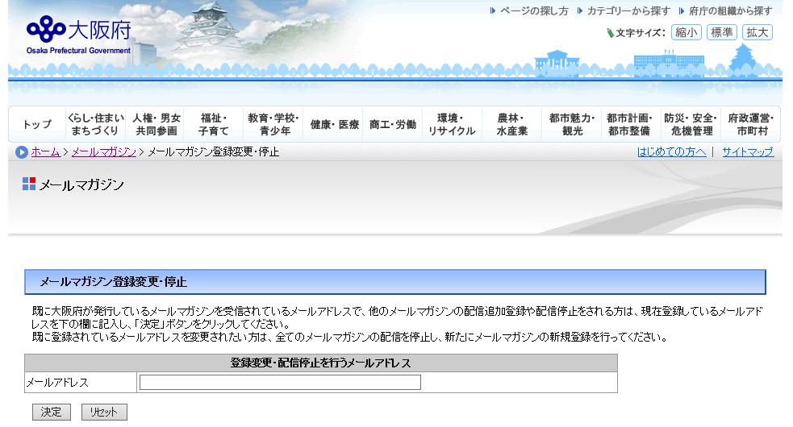
How to unsubscribe from the Osaka Global Email Newsletter
■Step 1
Click the link below.
https://www.mailmaga.pref.osaka.lg.jp/mailmaga/web_sec.php
When you see the page below, enter the mail address which you wish to deregister,
and click 「決定」.
② Click 「決定」
① Enter the mail address
you wish to deregister.
１

Slide 2
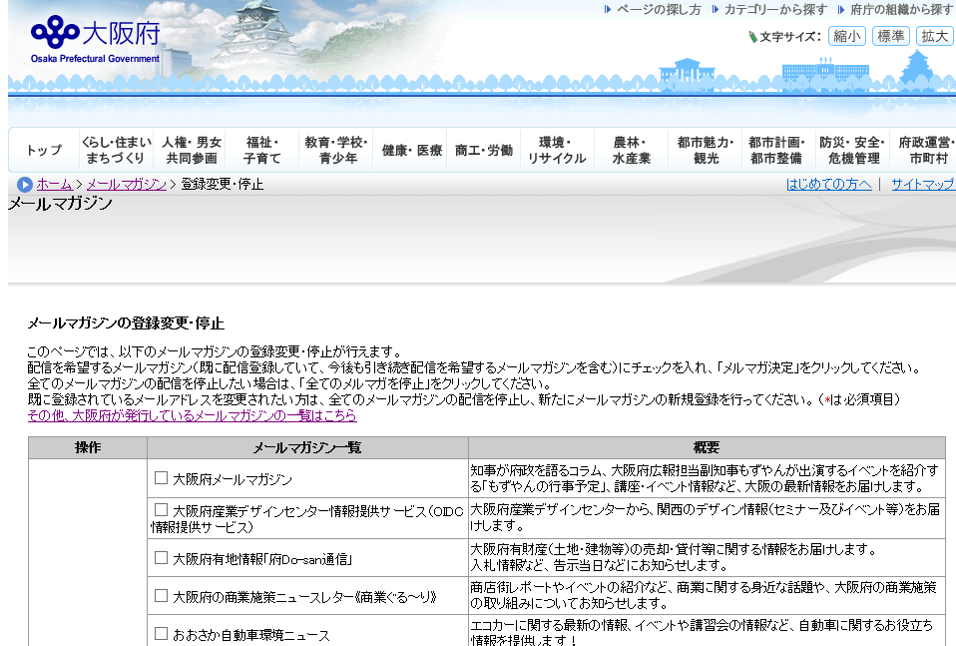
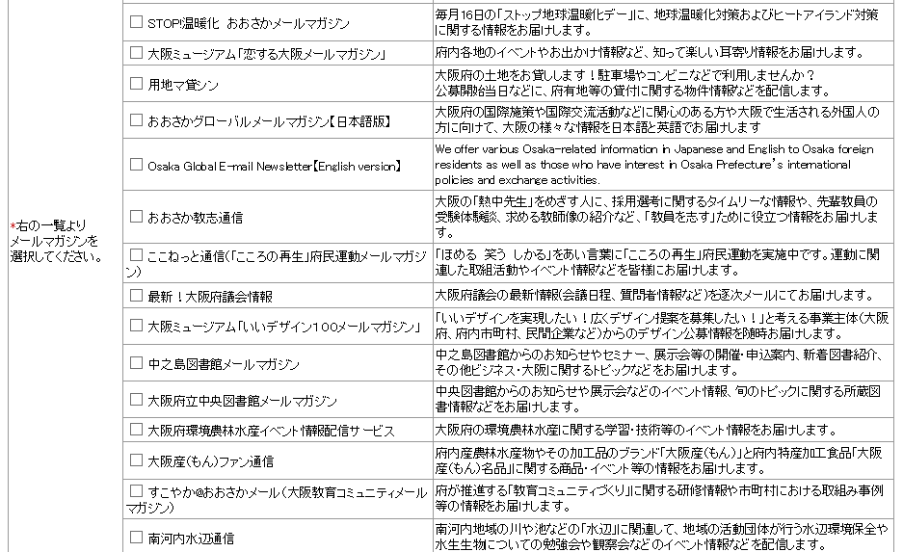
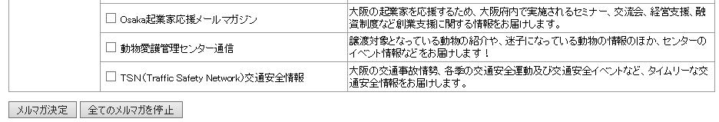
■Step 2
Click 「全てのメルマガを停止」 when you see the page below.
※You will unsubscribe from all the newsletters issued by Osaka Prefecture. You will have to
re-register for any newsletters to which you wish to continue to subscribe.
Click 「全てのメルマガを停止」 .
2

Slide 3
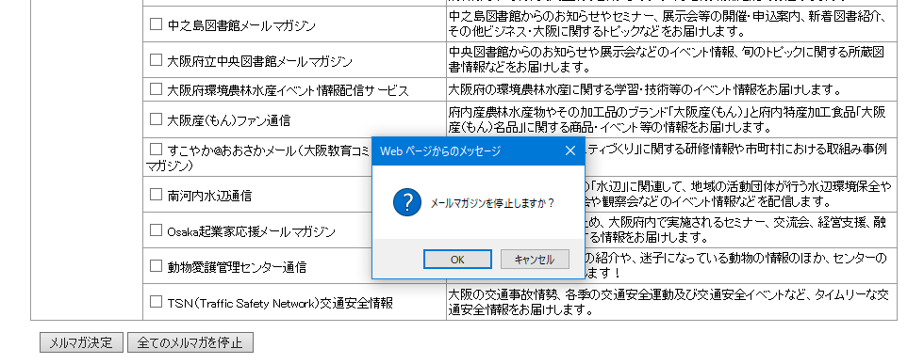
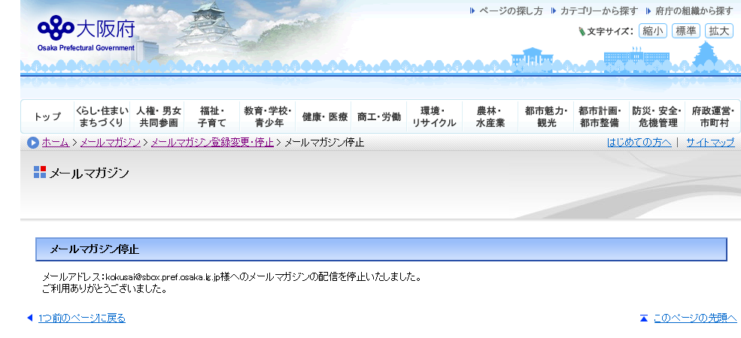
■Step 3
Click 「OK」 on the pop-up below.
■Step 4
The page below shows you have successfully unsubscribed from the newsletter.
３

