Slide 1
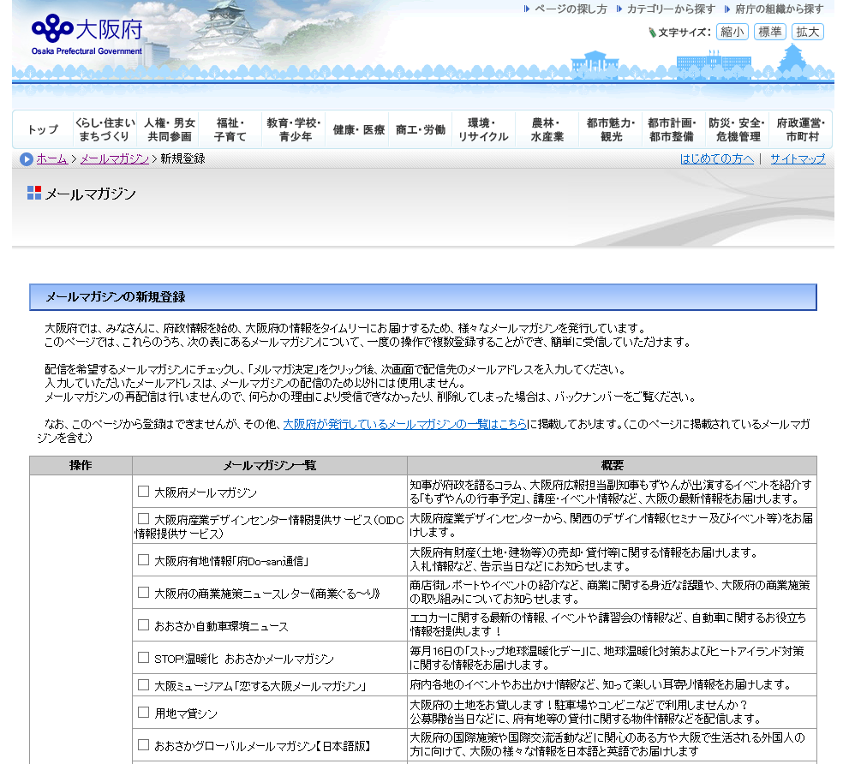
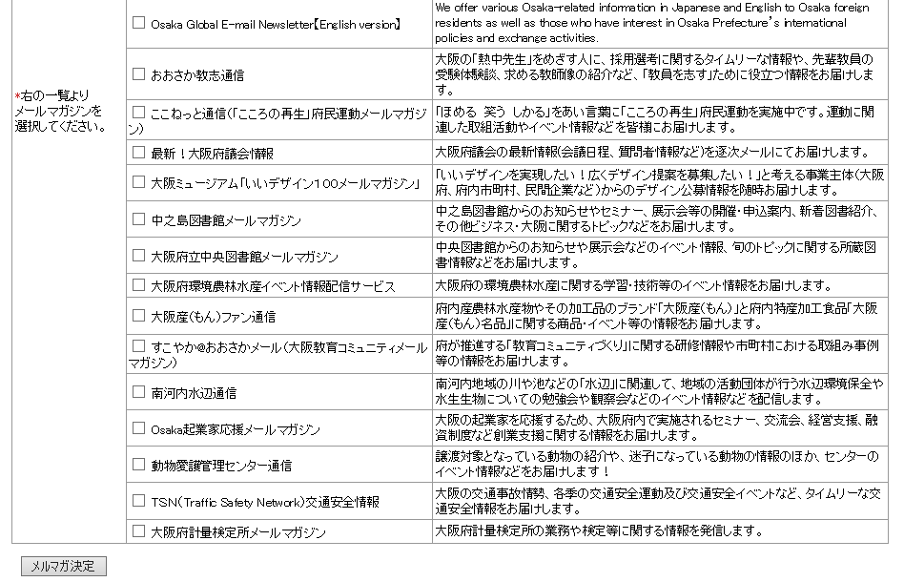
How to subscribe to the Osaka Global E-mail Newsletter
■Step 1
Click the link below:
https://www.mailmaga.pref.osaka.lg.jp/mailmaga/web_new.php
When you see the page below, check the box of the newsletter to which you wish to subscribe (☑)
and click 「メルマガ決定」.
※「おおさかグローバルメールマガジン」 is the Japanese version of “Osaka Global E-mail Newsletter”
Click 「メルマガ決定」 after choosing newsletters to which you wish to subscribe.
１

Slide 2
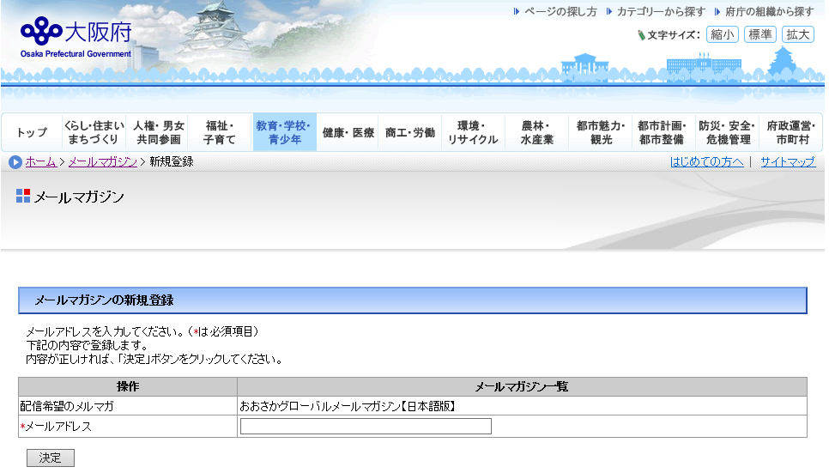
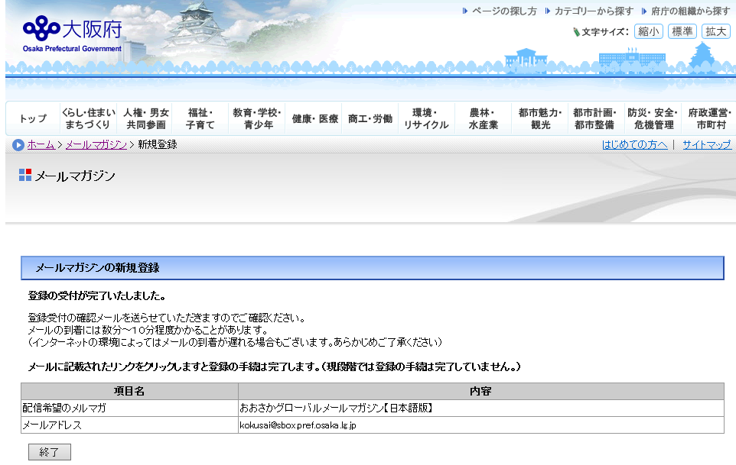
■Step 2
When you see the page below, enter the mail address which you wish to register,
and click 「決定」.
② Click 「決定」
① Enter the mail address
you wish to register.
■Step 3
You will receive a confirmation email after the page below is shown. (It may take several
minutes to around 10 minutes to receive the mail.)
*You can click 「終了」.
２

Slide 3
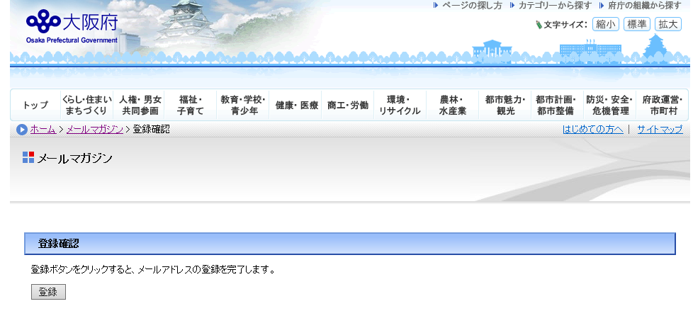
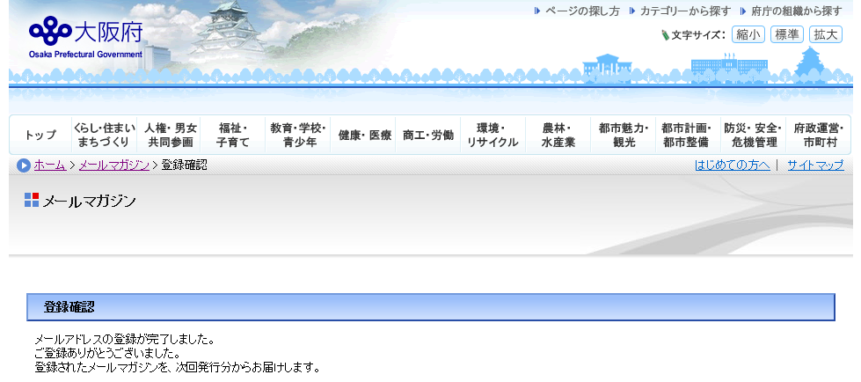
■Step 4
When you click the link in the confirmation email, the page below will be shown. Click 「登録」
Click 「登録」
■Step 5
The page below shows you have successfully subscribed to the Osaka Global E-mail Newsletter.
３

