Slide 1
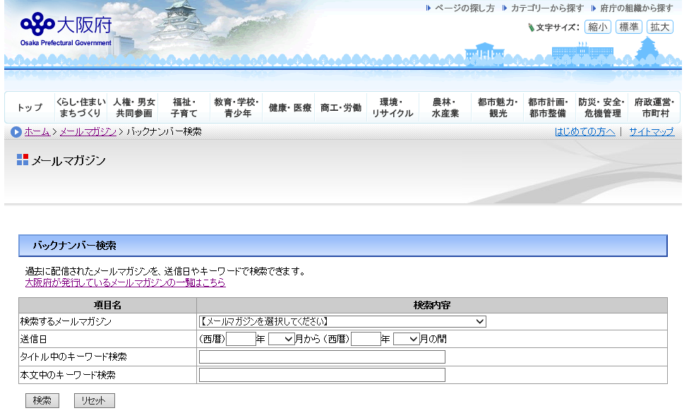
How to search the back numbers of the Osaka Global E-mail Newsletter
■Step 1
Click the link below
https://www.mailmaga.pref.osaka.lg.jp/mailmaga/web_search.php
Enter the information you wish to search in the table (① to ④) and click 「検索」.
①
②
③
④
Click 「検索」
① (Essential) Choose either one of them.
・ 「おおさかグローバルメールマガジン」（Osaka Global E-mail Newsletter Japanese version）
・ 「Osaka Global E-mail Newsletter」
② （Voluntary ）Enter the delivered date.
Ex.：（西暦）2020 年 １月から（西暦）2020年12月の間
＝ From January,2020 to December, 2020
③ (Voluntary) Enter the key word of the title in the box
④ (Voluntary) Enter the key word of the article in the box.
１

Slide 2
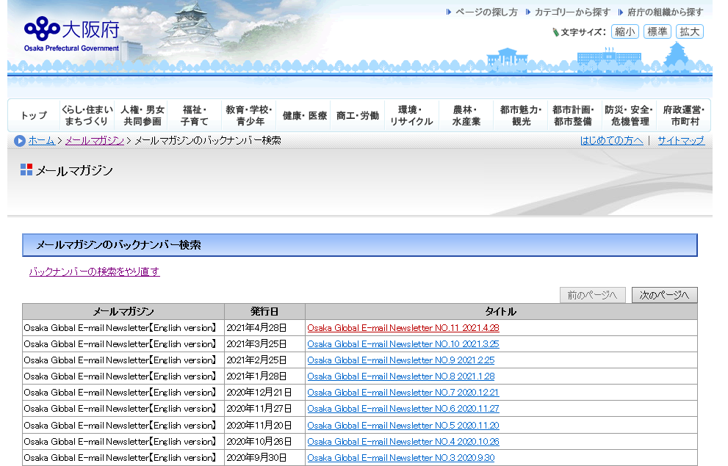
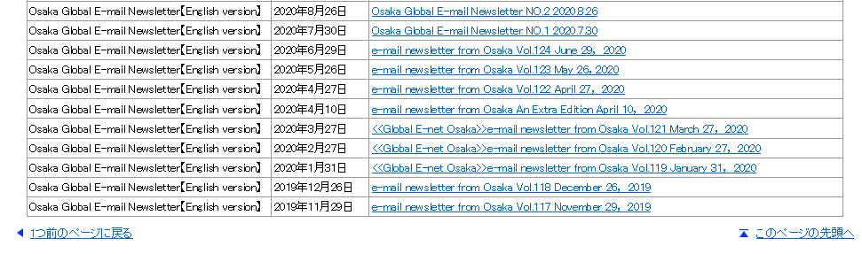
■Step 2
Search results are shown as follows:
２

