Slide 1
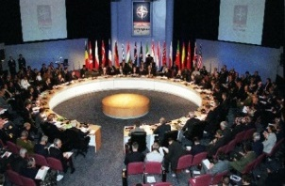
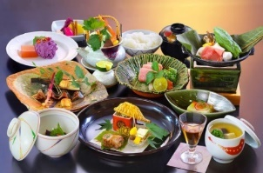

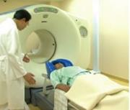
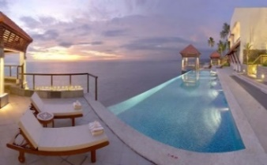
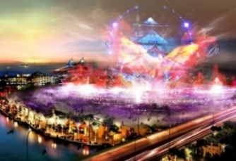
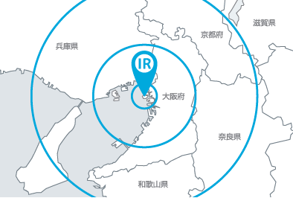
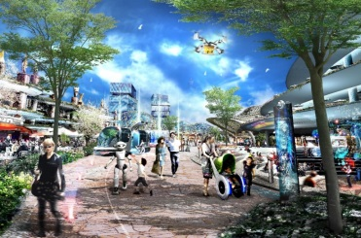
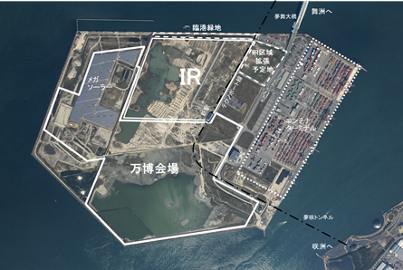
Osaka IR Fundamentals Plan [Outline Version]
Current Status of Osaka and the Direction of the IR Plan
Final Vision of the Osaka IR
For the further growth of Osaka
Functions and facilities essential for the Osaka IR
◆ Current status and issues
The continuous population decrease and the aging society have given cause for anxiety over a decline in demand and labor force.
◆ Direction of the IR Plan
Under the circumstances where global tourism demand continues to increase, it is necessary to promote stay-type tourism and construct world-level MICE facilities to ensure that inbound tourism is incorporated into Japan’s economic growth.
Focus on growing and promising industries for the future expansion of markets, etc.
(1) Function as a world-class all-in-one MICE hub
<International Convention Center and Exhibition Facilities>
◆ Globally-competitive all-in-one MICE hub
Integrated construction of accommodations, entertainment and commercial facilities and other facilities necessary for inviting MICE events
◆ Construction of Japan’s largest complex MICE facilities
[Capacity] International convention center:
Maximum room capacity of 6,000 people or more;
up to 12,000 people throughout the facility
Exhibition facility: Exhibition area of 100,000 square meters or more
◆ Strengthen the MICE promotion and invitation organization through
concerted efforts of “All Osaka” including governments and business groups
Develop tourism into a key industry, which has a lot of needs and potential and generates large economic effects.
Maximum use of the potential of
Osaka and the Kansai region
Historical/ cultural attributes | Abundant tourism resources in Osaka and the Kansai region
Economic attributes | Large population and economy of Osaka and the Kansai region; concentrated industrial clusters covering a wide range of sectors
Geographical/ locational attributes | Located in the center of the Kansai region; functioning as a hub with fully developed transportation infrastructure
Construction of an international tourism hub centered on an IR in Osaka
(2) Function as a hub that creates and promotes attractions
<Attractions Enhancement Facilities>
◆Promoting the attractions of Osaka, Kansai, and Japan through effective ways
Construct facilities that allow people to freely enjoy works related to Japanese
tradition, culture and art, and promote these accordingly.
◆Development and creation of the content showcasing Osaka, Kansai, and Japan with the Osaka IR serving as the base
“IR” as a project built and run by private entities making maximum use of the wisdom and ingenuity of the private sector
(3) Function as a tourism gateway to Japan
<Tourist Destination Promotion and Orientation Facilities>
*Activate the Osaka Bay Area by locating the Osaka IR in Yumeshima with its high potential.
◆ Sending off tourists to other destinations through joint efforts with
every region in Japan, including Osaka, Kansai and Western Japan
◆ Creation of new tourism originating from the Osaka IR that takes advantage of
the strengths of Osaka and the Kansai region
Creation of new tourism including features such as wellness tourism, sports, and foods, which encourages “various lifestyles that promote good mental, emotional, and physical health”
Final Vision of the Osaka IR
Basic concept
World-class growth-oriented IR
Serving as an engine for sustainable economic growth
in Osaka and the Kansai region
◆ Direction of IR growth
Spatial growth and expansion
(4) Construction of accommodation facilities responding to highly-developed and diversified user demand <Accommodation Facilities>
◆ World-class IR that is intended to serve as an engine for economic growth by attracting people, goods, and investments from around the world, targeting a wide range of visitors from the world, such as business people and families, among others
◆ Growth-oriented IR constantly evolves not only after completion of initial investments but even 50-100 years into the future, through cutting-edge facilities, functions, and services offered
Growth and
development
through time
IR
that creates
dreams
and
futures
IR
that
generates
expansion and
relationships
◆ Construction of world-class accommodation facilities in terms of
capacity and quality
[Capacity] Total number of guest rooms: 3,000 or more
◆ Provision of facilities and services that can meet different needs of guests
including business people, families, and the wealthy class
Value creation which makes use
of its potential
IR
that utilizes
“Yumeshima”
Function as a unique entertainment hub, creation of resort space <Visitor Entertainment Facilities>
◆ Provision of entertainment that can be experienced only in Yumeshima
Offer unique entertainment as a symbol of Osaka IR which is unprecedented in the world and can be enjoyed by everyone.
◆ Provision of an urban-type resort space which offers extraordinary experiences and entices people from around the world, as well as high quality facilities and services which allow people to enjoy an extended stay
◆ Creation of an impactful space that can serve as a new landmark of Osaka
Construction of buildings with innovative designs and a comfortable space by making good use of a vast expanse of the land surrounded by the sea.
Envisioned business model of the Osaka IR
(All figures are approximate calculations)
◆ Land area: Approx. 49 ha
◆ Investment amount: 930 billion yen
◆ Size of facilities: Total floor area of 1 million square meters
◆ Number of visitors/year: 15 million visitors/year
◆ Annual gross revenue: 480 billion yen/year
Efforts for enhancing the attractions of the Osaka IR
Total number of users: 24.8 million/year
Users of non-gaming facilities: 18.9 million/year
Users of gaming facilities: 5.9 million/year
◆ Realization of a smart city that provides a comfortable and
convenient space as well as high quality services by utilizing
cutting-edge technologies
Offer “an experimental field of future society” in which cutting-edge technologies
are introduced and demonstrated, enabling people to experience them.
◆ Development of globally minded human resources responsible for the next generation
Non-gaming revenue: 100 billion yen/year
Gaming revenue (GGR): 380 billion yen/year
<Toward the sustainable growth of Osaka and Kansai>
Setting up a consultative body consisting of governments, local communities, and IR operators
Realization of a positive cycle through continuous investments for making the facilities and services more attractive
Realization of a city where visitors can enjoy a safe stay
Work on non-structural/structural measures such as cooperating with IR business operators and relevant organizations, and establishing a fire department in Yumeshima to create a city where visitors can stay with peace of mind.

Slide 2

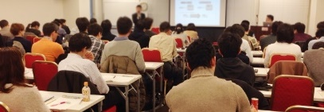

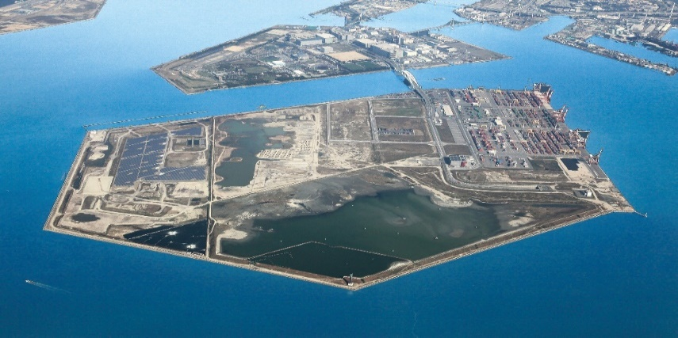
Osaka IR Fundamentals Plan [Outline Version]
Concerns and Efforts to Minimization
Effects of the IR
Concerns and efforts to minimize them
Comprehensive measures for concerns
developed by evolving advanced global cases
◆ Advancement of tourism and regional economies with benefits to public interest
Location of the world-class growth-oriented IR
Increase in visitors such as business people and families, and increase in inbound foreign visitors
Increase in international conventions and large-scale exhibitions
Increase in tourism spending per person
Economic ripple effect and job creation effect produced by newly generated demand
Ripple effect to various industries
Improvement of attractions and international competitiveness
◆ Basic philosophy
Minimize concerns by taking such measures as may be necessary for maintaining good security, local public morals and environment, in addition to attempts of containing gambling addiction and other addictions.
Implement all possible measures developed by learning from further evolving advanced cases overseas, while keeping close coordination among the national government, prefecture and municipalities, and IR operators with their respective roles allocated appropriately to minimize concerns, based on regulatory measures specified by laws and regulations of Japan and responsibilities to be imposed on IR operators.
Economic ripple effect (during construction) | 1.24 trillion yen | Economic ripple effect (during operations) | 760 billion yen/year
Job creation effect (during construction) | 75 thousand people | Job creation effect (during operations) | 88 thousand people/year
*Economic ripple effect in the Kinki area
Measures against gambling addiction and other addictions
⇒ Economic ripple effect of 2 trillion yen is expected up until the initial year of operation (during construction + during operations); thereafter, it would create an economic ripple effect of 760 billion yen each year.
◆ Basic philosophy
Establish comprehensive and seamless measures that combine advanced global cases with Osaka’s own measures (Osaka model), as measures for prevention and recovery from addiction, corresponding to the onset, progression, and recurrence stages and become a leader in the field of measures against addiction.
Implement effective measures steadily based on a propulsion program to be prepared in line with the national Basic Plan for Promoting Countermeasures for Gambling Addiction and an IR Area Development Plan to be prepared according to the provisions of the IR Development Act.
◆ Regional promotion and development
Creating new bustle by revitalizing the Bay Area development
Increase jobs through the expansion of job opportunities and the creation of high-quality jobs, etc.
Promotion of the local economy through the expansion of business opportunities and a large ripple effect to local businesses, etc.
Contribution by IR operators to the local society for regional development
◆ Ripple effect to Kansai, Western Japan, and other areas of Japan
Ripple effect of attracting visitors into Kansai, Western Japan, and other areas of Japan, as well as into Osaka Prefecture
Creation of a fully-developed transportation network by stimulating various traffic access, etc.
◆ Use of tax payments from casinos and entry levy
▶ Wide use for improving resident welfare and a sustainable growth
(Examples)
Child raising, education, welfare, tourism promotion, promotion of culture, art, and sports, measures against concerns, and promotion of local economy, etc.
Revenue prospects of the prefecture and the city
(preliminary calculation)
⇒ 70 billion yen/year
<Envisioned initiatives>
Initiatives by Osaka Prefecture, Osaka City, and relevant organizations
Required measures for IR operators
by Osaka Prefecture and Osaka City
Strengthening of comprehensive counseling and support functions for addiction problems
Setting up of a consultative organization which includes IR operators as its members with the purpose of building a public-private-partnership system from the viewpoint of “responsible gaming”
Construction of a network consisting of academic institutions in Osaka and Kansai, seeking to formulate an advanced area of studies on addiction
Promotion of studies on advanced measures against addiction using ICT/AI technologies
among others.
Implementation of preventive measures such as warnings and alerts issued by behavioral tracking against addiction using ICT technology
Building a self-exclusion system such as setting an upper limit of amount of money/time player spent in a casino
Establishing a consulting system that is available for 24 hours 365 days of the year
Provision of various services, including notification of risk
and facilitation of wholesome gambling behavior
among others.
Payments from casinos:
57 billion yen/year
Revenue from entry levy:
13 billion yen/year
*Separately, 15 billion yen/year as tax revenue.
Facilitation of Local Citizens’ Understanding
Towards Consensus Building
◆ Basic philosophy
Clarification of targets: all citizens of Osaka prefecture and municipalities, local businesses, university students as leaders of the next generation, and others ⇒ offering appropriate information according to the interests of the targeted group
Briefing according to the stages of the process: (1) Basic matters of the IR → (2) Content for the public bidding and selection of operators and preparation of the IR Area Development Plan → (3) Content for the building of local consensus on a proposed IR Area Development Plan
Efforts by Osaka Prefecture and Osaka City to offer correct information on the Osaka IR and facilitate local citizens’ understanding
Measures for security and local public morals and environment
◆ Basic philosophy
IR operators, police, prefecture and municipalities implement initiatives for maintaining good security, local public morals and environment, in close coordination with each other by playing their respective roles.
Osaka Prefecture and Osaka city enhance police forces by setting up a police station in Yumeshima as well as increasing the number of police officers.
In addition, IR operators voluntarily establish a reliable crime-prevention and security system.
<Specific efforts>
Offer information to all citizens of
Osaka Prefecture and municipalities
(seminars, lecture meetings, etc.)
Offer information to university students
and other youth, women, local businesses, and others
Use of public relations tools, holding of public hearings, etc.
<Process toward consensus building>
<Envisioned initiatives>
Consul-
tative
Council
Public hearing
Resolution
by the assem-blies
Anti-money laundering
Elimination of business intervention by organized crime groups, etc.
Rigorous regulation to prevent organized crime group members from entering into casinos
Enhancement of the police force such as the setting up of a police station in Yumeshima
Schedule
Enhanced response to foreign visitors such as arrangement for interpreters
Promotion of crackdown on foreigners illegally overstaying in Japan
2018 | 2019 | 2020 | 2021 | 2022～2023 | 2024～
(Fiscal
year)
Promotion of measures against international terrorism such as
information collection, guard and security system
(National
government)
Enactment
of the IR
Development
Act
(National government)
Formulation of the
Basic Policy
Formulation of the Implementation Policy;
Public bidding and selection of operators;
Preparation of the IR Area Development Plan;
Holding of public hearings;
Resolution by the assemblies;
Filing an application for certification of the IR Development
Plan, Certification of the IR Development Plan(※1);
The execution of Implementation Agreement;
Land delivery and starting of construction works(※2) , etc.
Intensified measures toward youth such as regulation of youth entry into casinos
Start
Of
Operation
Implementation of patrols
Promotion of measures for crime prevention
Deployment of private security guards and installation of security cameras
IR Development
Development of traffic safety facilities and the road traffic environment
Implementation of adequate traffic controls
※1 The schedule of the national government is assumed. ※2 The timeline depends on the proposal of the operator.

