Slide 1
Requests Based on the Pre-Emergency Measures
① Area: ※Refer to the next page regarding each area’s situation
Areas under the pre-emergency measures : 33 cities
(Osaka, Sakai, Kishiwada, Toyonaka, Ikeda, Suita, Izumiotsu, Takatsuki, Kaizuka, Moriguchi,
Hirakata, Ibaraki, Yao, Izumisano, Tondabayashi, Neyagawa, Kawachinagano, Matsubara, Daito,
Izumi, Minoh, Kashiwara, Habikino, Kadoma, Settsu, Takaishi, Fujiidara, Higashiosaka, Sennan,
Sijyonawate, Katano, Osakasayama, and Hannann)
Other areas: 9 towns and 1 village
(Towns: Shimamoto, Toyono, Nose, Tadaoka, Kumatori, Tajiri, Misaki, Taishi and Kanan;
Village: Chihaya-akasaka)
② Period: From July 12 to August 22, 2021 (During the pre-emergency measures)

Slide 2
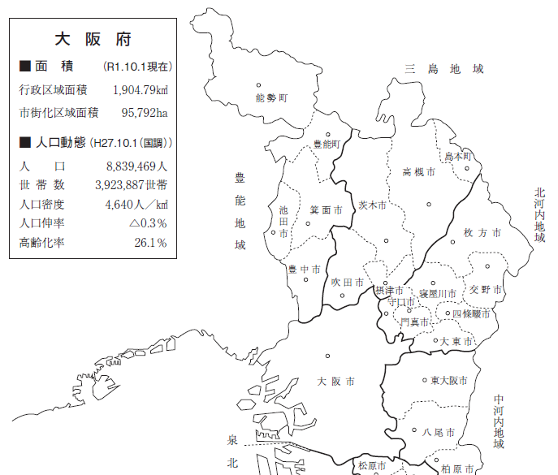
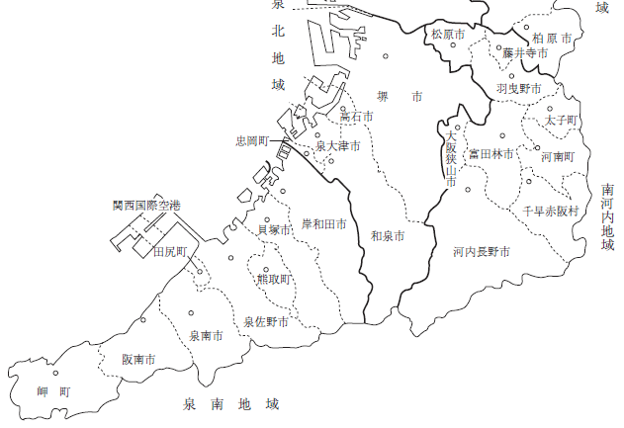
Situations of Municipalities in Osaka Prefecture
◆Population per municipality, the number of dining establishments approved by the Food Sanitary Act, and the number of positive cases
◆Cities account for over 98% in all items.
能勢町
豊能町
島本町
【Situations of municipalities in Osaka Prefecture】
 | Population ( May 1, 2021) | Number of approved dining establishments (May 31, 2021) | Number of positive cases (July 1 to 7) | Number of positive cases (Cumulative number as of July 7)
Designat-ed cities | 3,577,176 | 69,600 | 493 | 52,966
Other cities | 5,051,324 | 40,211 | 301 | 47,486
Total of cities | 8,628,500 （98%） | 109,811 （99%） | 794 （99%） | 100,452 （99%）
Total of towns and villages | 174,556 （2%） | 1,099 （1%） | 8 （1%） | 1,096 （1%）
Total of all | 8,803,056 | 110,910 | 802 | 101,548
忠岡町
太子町
河南町
千早赤阪村
田尻町
熊取町
岬町
引用：大阪府 市町村ハンドブック

Slide 3
③ Details
●Calling on residents (based on the relevant law)
〇Refrain from non-essential outings
〇Refrain from non-essential travel across prefectures as much as possible, in particular,
between the areas under the state of emergency
〇Refrain from using restaurants that don’t take thorough infection prevention measures
〇 Refrain from going to restaurants, etc. after shortened business hours
〇 Dine in a group of 4 or less ※１ and with a mask ※２
〇 Refrain from drinking on the street or in a park
〇 Be tested as soon as possible when having any symptoms
※１ Family members, infants and helpers for the elderly and people with disabilities are NOT included
※２ This is not applied if diseases, etc. make wearing a mask difficult

Slide 4
●Requests to Universities（based on the relevant law)
○ Thoroughly inform students that they must refrain from coming to school and attending any
activities in case they have any symptoms such as fever.
○ Make students refrain from following behavior
・Joining club activities that have a risk of causing infection clusters, any activities where many
people gather, and dining in a large group before/after the activity
・Making a trip (including a camp) and holding a drinking party at their/their friend’s home
○ Thoroughly call attention of students about infection prevention measures in their dormitory
●Requests to Economic communities（based on the relevant law)
○ Promote teleworking of over 70% of employees
〇 Even when commuting, strongly promote measures to reduce human contact such as staggered
working hours and bike-commuting
〇 Refrain from conversation without a mask in a resting room, a smoking room, and a locker room
〇 Comply with the guidelines of each industry

Slide 5
● Holding events (including ones hosted (co-hosted) by Osaka Prefecture
(based on the relevant law)
Organizers are requested to obey the following rules in entire Osaka Prefecture
①Capacity Conditions ※１ |  | ②Maximum number of people ※１ | Shortening business hours
Without loud voice※２ classical music concerts, theaters, dance performances, traditional stage performances, entertainment /amusement stages, lectures, ceremonies, exhibitions, etc. | With loud voice※２ rock/popular music concerts, sporting events, legal gambling, character shows, events held in music clubs/night clubs, etc. | 5,000 persons | until 9:00pm ※４
up to 100% (When without seats, take enough distance) | up to 50％※３ (When without seats, take enough distance）
※１ Meet the smaller condition of ① or ② above (both conditions should be met.)
When ② is not set, enough distance between people (1m) should be secured.
※２ These events are just examples. Each actual event is to be judged which category it belongs to, based on the possibility of
occurrence of loud voice or cheering. Any events with dining are to be treated as “with loud voice,” however, the events
without speaking (in movie theaters, etc.) are to be treated as “without loud voice.”
※３ Make a space of one seat between different groups; however, you don’t have to do so within the same group (limited to 5
persons) That means the capacity rate might exceed 50%.
※４ Offering food and beverages: Areas under the pre-emergency measures: until 8:00pm; Other areas: until 9:00pm
（Offering alcohol (including the carried-in): Areas under the pre-emergency measures :11:00am to 7:00pm;
Other areas: 11:00am to 8:00pm）
Alcohol can be offered only when eateries take infection prevention measures according to each business style such as:
・Comply with guidelines of each industry ・Meet 4 national criteria (see page 7) ・Accept only a group of four persons or less
（What to be requested when holding an event)
◆Take thorough infection tracing measures such as using “COCOA” (the national government’s contact confirming
App) or Osaka COVID-19 Tracing System, or making a participant list
◆When holding an event that requires traveling across the nation or an event with over 1,000 participants, consult
Osaka Prefecture beforehand about the holding conditions of the event, such as the rate of capacity.

Slide 6
● Facilities （ including the ones owned by Osaka Prefecture ）
Requests to dining establishments
Facilities | Request details
 | Under the pre-emergency measures(based on the relevant law) | Other areas(based on the relevant law)
【Eateries】 restaurants（including pubs), cafes(excluding delivery/take-out services) 【Amusement facilities】 cabarets, night clubs, Internet cafes/comic cafes ※1 ( limited to the ones approved by the Food Sanitation Act) 【Wedding facilities】 Those which are approved by the Food Sanitation Act) | ○Shorten business hours (until 8:00pm） ○Refrain from offering alcohol（including the carried-in by users)in principle, HOWEVER, alcohol can be offered in the following facilities: -Those which have the Gold Sticker - Among the above, those which accept only individual customers and a group of four persons or less in principle※4 (11:00am to 7:00pm) ○Refrain from using Karaoke(★) | ○Shorten business hours（open until 9:00pm） ○Refrain from offering alcohol （including the carried-in by users) in principle, HOWEVER, alcohol can be offered in the following facilities: -Those which have the Gold Sticker※3 - Among the above, those which accept individual customers and a group of four persons or less in principle ※4 (11:00am to 8:00pm) ○Refrain from using Karaoke(★)
※3
※1 Facilities where a number of people are expected to stay over night, such as Internet cafes or comic cafes, are not requested to shorten business hours, however, entry control, limited offering of alcohol, and refraining from Karaoke use are requested
※２ Karaoke boxes are NOT included in the above request of (★), However, they are requested to refrain from offering alcohol.
（When the Karaoke equipment is not used, alcohol can be offered provided they comply with the above conditions of offering alcohol.）
※3 ❶Facilities with the Gold Sticker OR ❷Facilities applying for the Gold Sticker（Refrain from offering alcohol before application.)
※Those which offer alcohol must conduct self-confirmation based on the prevention measures checklist beforehand, in addition to the application for the sticker.
※4 Excluding family members living together
【When doing business, you are requested to take following measures】(based on the relevant law)
・Raise thorough awareness of users about dining with a mask and decline those who don’t obey the rule without right reasons ・Set up acrylic board
・Encourage employees to have a PCR-test ・Control the number and order of people entering the facility ・Ban people with symptoms from entering
・Set the disinfection equipment ・Disinfect and ventilate the facility ・Set CO2 sensors ・Comply with guidelines of each industry

Slide 7
Gold Sticker System
Reference
Outline
New Certification System established to make infection-resistant society by further promoting infection prevention measures in dining establishments so that residents can use them in the safe and secure environment
To whom
Dining establishments（Other than Takeout-only shops)
Criteria
Own Criteria established by Osaka Prefecture in addition to the
4 national criteria
（It is required to meet all the criteria including the following examples)
（Ex） ・Set up acrylic board（Keep distance between seats）
・Disinfect hands and fingers
・Promote wearing a mask except while eating
・Thorough ventilation and setting a CO2 sensor
・Recommend that employees with any symptoms should
use “Smart phone test center for restaurants”
・Assign a “COVID-19 countermeasure leader”
※Please see further information about each item above on the website of Osaka Prefecture
７

Slide 8
● Facilities
Request to facilities other than dining establishments (based on the relevant law)
Categories | Facilities | Request details
 |  | Facilities with more than 1000㎡ in the area under the pre-emergency measures
Commercial facilities | big-box stores, department stores, shopping centers（including underground malls), etc. （Retailers that offer daily necessities or essential services for daily lives are excluded） | 【Business Hours】 Until 9:00pm 【Other】 Entry control (Request NOT based on the law)
Amusement facilities | mah-jong game parlors, pachinko parlors, game centers, etc.
Entertainment facilities | private movie theaters, “soap land” where one can bathe with entertainment services, shooting saloons, horse parlors, ticket counters for bike race outside the stadium, etc.
Service businesses | luxurious bath houses, nail salons, esthetic salons, relaxation salons, etc.

Slide 9
● Facilities (including the prefectural facilities)
Request to facilities other than dining establishments (based on the relevant law)
Categories | Facilities | Request details
 |  | Facilities with more than 1000㎡ in the area under the pre-emergency measures ※２
Sports/amusement Facilities ※1 | gymnasiums, skating rinks, swimming pools, indoor tennis clubs, judo/kendo training halls, bowling alleys, sports gyms, hot yoga/ yoga studios, baseball stadiums, golf courses, athletics stadiums, outdoor tennis ground, golf practice ranges, batting cages, theme parks, amusement parks, etc. | 【Maximum number of people/ capacity conditions】 Same as the conditions of event holding 【Business hours】 ・Until 9:00pm 【Other】 Entry control, etc. (Request for cooperation Not based on the law)
Museums, etc. | museums, art museums, etc.
Theaters, etc. | theaters, halls, movie theaters, variety theaters
Entertainment facilities | clubs with live music ※1
Meeting/exhibition facilities | auditoriums, exhibition halls, cultural halls, multipurpose halls, etc.
Hotels and inns | hotels, inns（meeting spaces ONLY）
※１：Facilities that are approved to run eateries are requested same restraint as that of eateries, in addition to the requests regarding event holding.
※２: When holding events in the facilities mentioned here or facilities other than the mentioned area, comply with the requirements of holding events (see page 5). At the occasions other than the event holding (private exercises or sporting activities without spectators in the sporting facilities), comply with the 【Maximum number of people/capacity conditions】 described above

Slide 10
Pre-Emergency Measures Call Center
Osaka Prefecture has established the pre-emergency measures Call Center to respond to inquiries
from residents and business operators about the request based on the relevant law
【Outline】
Days & Hours：Monday to Friday: 9:30am to 5:30pm
Tel： 06-7178-1398 (Japanese only)
※FAQ will be soon available on the website of Osaka Prefecture
10

