Slide 1
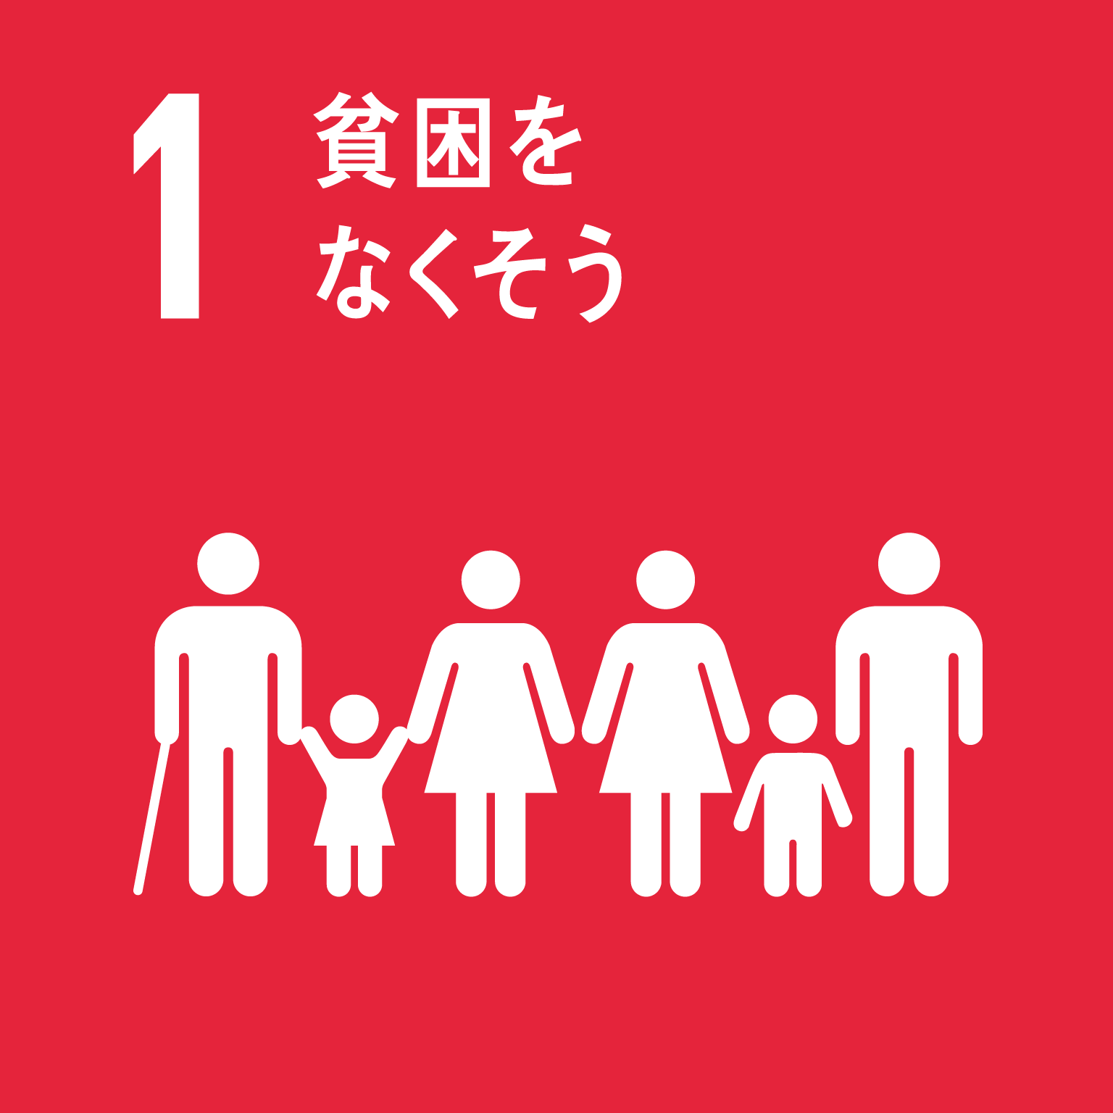
FY 2022 Osaka Prefecture's SDGs Initiatives
Osaka SDGs Action Charter
We are working on the 2030 Agenda for Sustainable Development (SDGs), which aims to realize a sustainable society that leaves no one behind.
As a local prefecture of Expo 2025 Osaka-Kansai, we support the philosophy of the Expo and will work toward the theme of the Expo, "Designing Future Society for Our Lives. "We aim to achieve the 17 goals of the SDGs.
1. We value the irreplaceable "life" and act with consideration for local communities and the
environment.
2. We envision an attractive Osaka where we want to live in 2030, and act consciously starting
with what we can do.
3. While valuing encounters and connections with people, we learn from each other and act in
cooperation.
The “Osaka SDGs Action Charter” was formulated with the aim of making all stakeholders, including citizens of the prefecture and companies and organizations in the prefecture, aware of the SDGs and leading them to concrete actions. (January 22, 2021)

Slide 2
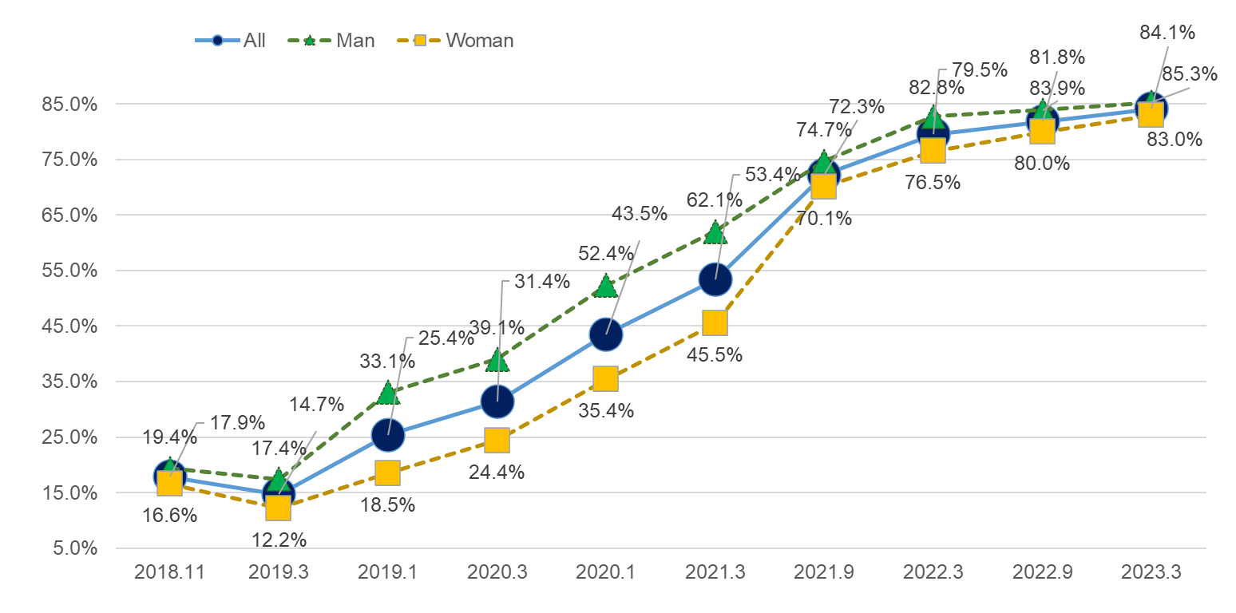
Awareness of SDGs in Osaka Prefecture
Awareness of all citizens is 84.1% (as of March 2023)
* Awareness of SDGs is the total of “I know SDGs” and “I have heard the word SDGs and have seen the logo”.
Utilizing Osaka Prefecture's web questionnaire (Osaka Q Net) to conduct a survey of residents' awareness of SDGs(Target conditions: men and women over the age of 18, sample size: 1,000 people)

Slide 3
Direction of efforts
〇 As the venue of Expo 2025 Osaka-Kansai , we formulated the "Osaka's Vision for SDGs " to create new initiatives throughout Osaka, aiming for an "SDGs advanced city" that contributes to achieving the SDGs at the forefront. (March, 2020)
〇 We formulated the “Osaka SDGs Action Charter” (January, 2021) to spread SDGs-conscious behavior, and started the “My SDGs Declaration Project” to encourage each citizen to take concrete actions (February, 2021).
〇 As awareness of the SDGs steadily rises, we will promote activities to deepen stakeholders’ understanding and promote cooperation in line with the role of Osaka Prefecture as set forth in the Osaka's Vision for SDGs .
◆Role of Osaka Prefecture in the “Osaka's Vision for SDGs ”
Share SDGs with various stakeholders such as citizens, companies, and local governments.
⇒Aiming for further penetration of the SDGs, we will discover new stakeholders who were not familiar with the SDGs and
lead them to concrete actions.
(2) Link various stakeholders’ initiatives to achieve SDGs
⇒We will collaborate with the Kansai SDGs Platform, administrative agencies, the business community, financial
institutions, etc., and utilize their respective networks to match stakeholders and create new initiatives.
(3) Contribute to achieving SDGs as a stakeholder, by Osaka Prefecture itself
⇒We will further enhance and strengthen the proactive efforts of each department within the Osaka Prefectural
Government, and develop a wide range of measures that can only be realized by working on the SDGs.
(4) Promote “urban development that embodies the SDGs” from both hard and soft aspects
⇒We will promote the transformation of social systems and values ​​in line with the principles of the SDGs in order to realize sustainable growth of Osaka, affluence of citizens, and safety and security.

Slide 4
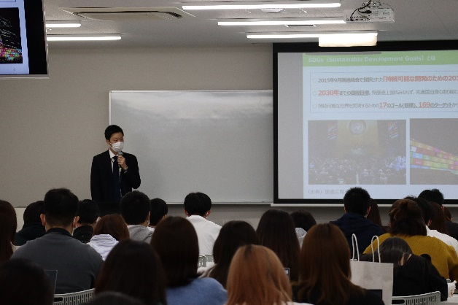
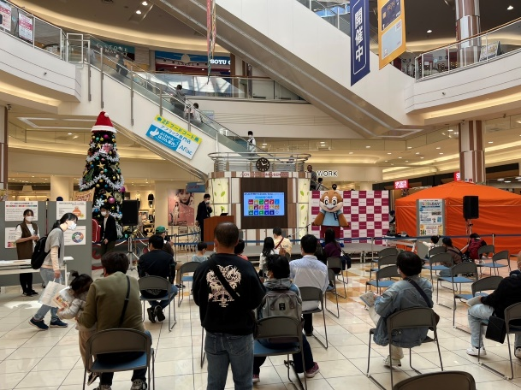
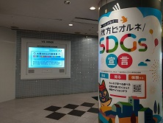
Main Initiatives in 2022
1. Further penetration of SDGs: Promoting specific actions
〇 Fostering momentum among citizens, companies, and organizations
①Lectures on SDGs for universities and various organizations
Kindai University (April.7),
Ritsumeikan University (April.28, May.12),
Osaka Seikei University (May.20),
Konko Yao Junior and Senior High School (May.21),
Osaka Metropolitan University (June.13),
Moriguchi City: Corporate Seminar (July.26),
Fukushima Women's Association (July.27)
Urban Development Department: New employee training (April.6)
Nagai Park designated manager (October.5),
Ricoh Japan Co., Ltd. (October.19),
Yamato University (October.24)
(public corporation) Osaka Institute of Architects (Nov.25),
Osaka University of Commerce (Dec.8),
Osaka Junior College for the Elderly (Dec.16)
Green Purchasing Network (Dec.20),
Fujiidera City Executive Staff Training (Jan.20)
Osaka Prefectural Housing Corporation (March.24)
②SDGs event in collaboration with other stakeholders
Yoshimoto Kogyo (Warai Mirai Fes 2022, April.29)
Gamba Osaka (THINK ECO SDGs Smile Match, Sep.10)
Ministry of Commerce, Industry and Labor (Joint company information session, Sep.15)
Osaka Chamber of Commerce and Industry (Carbon Neutral Challenge Fair, Oct.12)
AEON MALL Rinku Sennan (Enjoy learning about SDGs while answering the SDGs DAY quiz!, Nov.3)
LaLaport EXPOCITY (EXPO Cultural Festival 2022, Nov.23)
Policy Planning Department (Immigration and Settlement Event, Jan.29)
SDGs Lecture
PR activities
PR activities

Slide 5
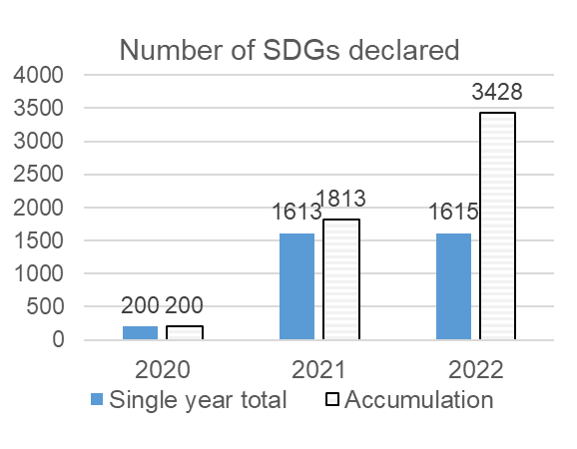
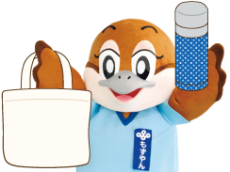
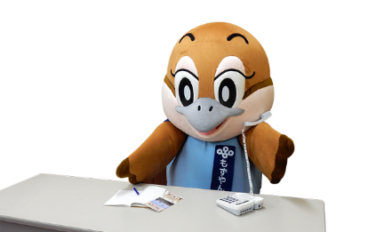
Main Initiatives in 2022
1. Further penetration of SDGs: Promoting specific actions
〇 Promotion of My SDGs Declaration Project（started in February, 2021）
My SDGs Declaration Project
In line with the purpose of the “Osaka SDGs Action Charter,” this is a project in which citizens, companies, organizations, and other stakeholders declare their own actions to achieve the SDGs, with Osaka Prefecture encouraging them.
By introducing the contents of the declaration on the prefectural website, we will foster momentum for achieving the SDGs throughout Osaka.
■Total number of project participants: 3,428
(Companies/Organizations: 319, Individuals: 3,258)
■Number of tax returns this fiscal year: 1615
(Companies/Organizations: 170, Individuals: 1,445)
Declaration example
Know what's in your fridge and buy only what you need.
Use reusable bag, water bottles and containers.
Create a workplace environment where everyone can work comfortably.

Slide 6
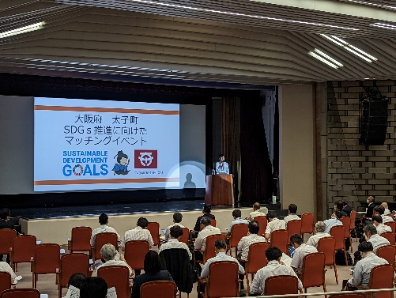
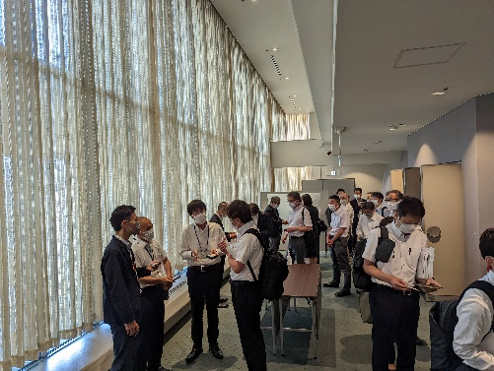
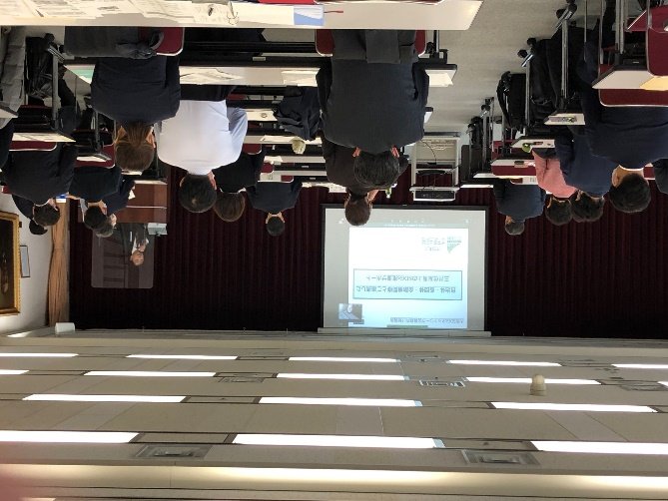
Main Initiatives in 2022
2. Efforts to connect stakeholders
〇 Matching support between local governments and companies
①Local government issue presentation type matching event
Local governments present their own issues to companies.
Matching with companies with know-how
(implemented in cooperation with the Osaka Chamber of Commerce and Industry)
Theme: Carbon neutrality
Date: September 14, 2022
Participating municipalities: Hirakata City, Hannan City, Taishi Town
Participating companies: 68 companies
②Corporate know-how proposal type matching event
Companies propose their own know-how to members of the Osaka SDGs Network (*).
Search for matching with local governments that wish to cooperate.
Date: January 16, 2023
Speakers: (1) Regional Revitalization Secretariat, Cabinet Office
(2) Kao Group Customer Marketing Co., Ltd.
(3) Mitsui Sumitomo Insurance Co., Ltd.
(4) Yoshimoto Kogyo Holdings Co., Ltd.
Osaka SDGs Network
By strengthening cooperative relationships with local governments, economic organizations, government-affiliated organizations, and financial institutions that lead SDGs initiatives, we aim to promote collaboration among members and promote initiatives that match the characteristics of each region.
◆Network Participating Organizations
Municipalities in the prefecture (43 municipalities), National-affiliated organization (1 organization) ,
Economic organizations (24 organizations) , Financial institutions (18 companies)

Slide 7
Main Initiatives in 2022
3. Promotion of initiatives within the prefecture
〇 SDGs Future City
Osaka Prefecture and Osaka City were selected the Cabinet Office's “SDGs Future City and Local Government SDGs Model Project” in 2020, and are proceeding with initiatives based on the “SDGs Future City Plan ”.
①Efforts of each department described in the SDGs future city plan
②Local Government SDGs Model Project : “Osaka Blue Ocean Vision” Promotion Project
（The main effort : Establishment of a New PET Bottle Collection/Recycling System in Collaboration）
・Participating regions: 79 regions in Osaka Prefecture
・Amount of PET bottles collected: 652 tons
Departments | Initiatives | Related goals
Department of Policy and Planning | SDGs promotion project | All
Department of Welfare Department of Welfare | Osaka Eemachi Project （Supporting each other in the community and creating opportunities for seniors to thrive） | ③⑪
 | Measures for Child Poverty | ①
Department of Public Health and Medical Affairs | Extending healthy life expectancy （“Kenkatsu 10 (10 Osaka Wellness Actions),” the “Osaka Kenkatsu Mileage, Asmile”） | ③⑪
Department of Commerce, Industry and Labor | Support for Creating and Nurturing SDGs Businesses （SDGs-related business matching , SDGs Business Support Fund ） | ⑧⑨
Department of Environment, Agriculture, Forestry and Fisheries | Plastic-waste reduction | ⑫⑬⑭
 | Promotion of reusable water bottles and containers | ⑫
 | Public Water Supply Spot Installation Project | ⑫
 | Promotion of Food Loss Reduction Measures | ①⑫
Secretariat | Efforts to Make Prefectural Schools “Smart Schools” | ④

Slide 8
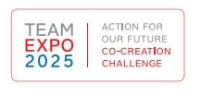
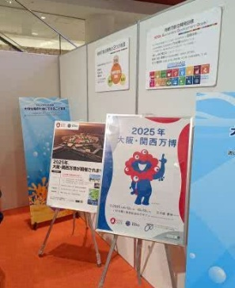
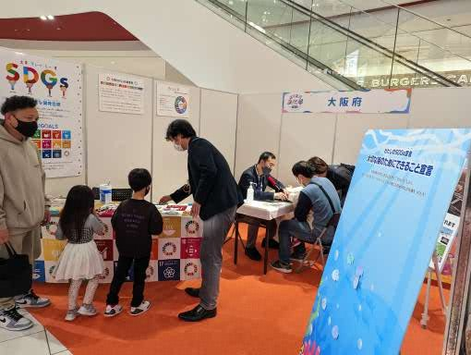
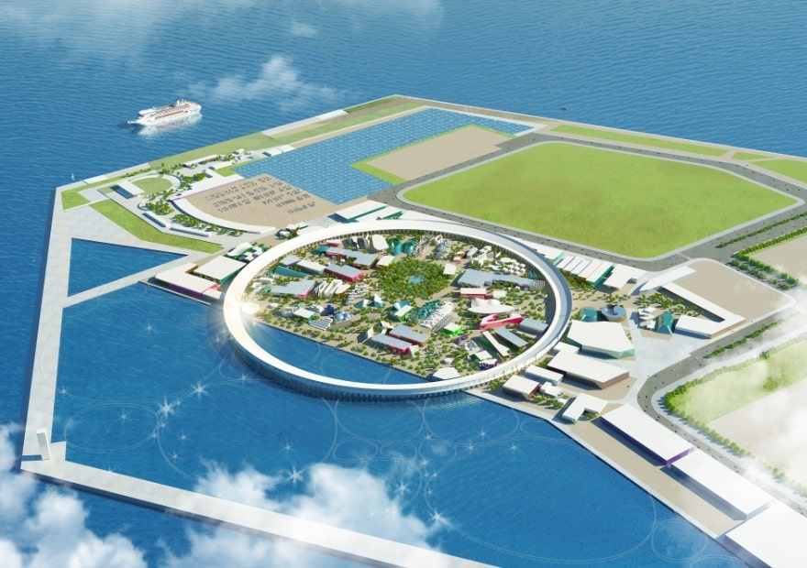
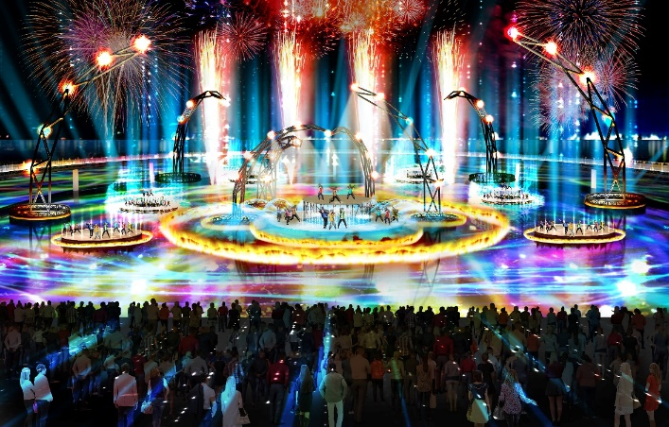
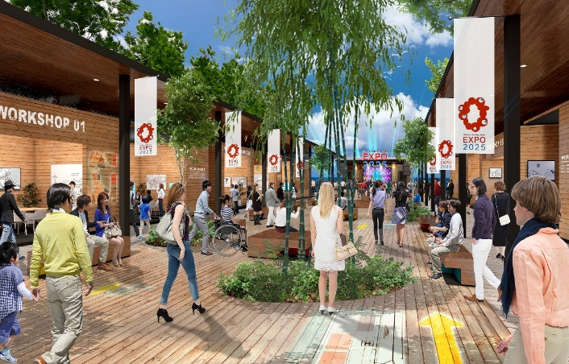
Main Initiatives in 2022
4. Urban development that embodies SDGs
〇 “TEAM EXPO 2025” Program / Co-Creation Challenge
In order to aim to achieve the SDGs at the Expo,
we registered “My SDGs Declaration Project” as a co-creation challenge.
* Co-creation challenge：Each action to realize the future we envision
(Team activities that are proactively taking action
toward the future or are about to take action
toward the realization of the theme of the Osaka/Kansai Expo,
“Designing Future Society for Our Lives.")
〇 Cooperation with Expo 2025 Osaka-Kansai
・PR for Osaka-Kansai Expo and SDGs at Warai Mirai Fes 2022
(sponsored by Team Kansai) (repost) (April 29)
・PR for Osaka-Kansai Expo and SDGs at EXPO Cultural Festival 2022
(sponsored by LaLaport EXPOCITY) (repost) (November 23)
We will continue to collaborate with the efforts of Expo 2025 Osaka-Kansai and aim to realize the "SDGs-advanced city" as a legacy of the Expo.

