Slide 1
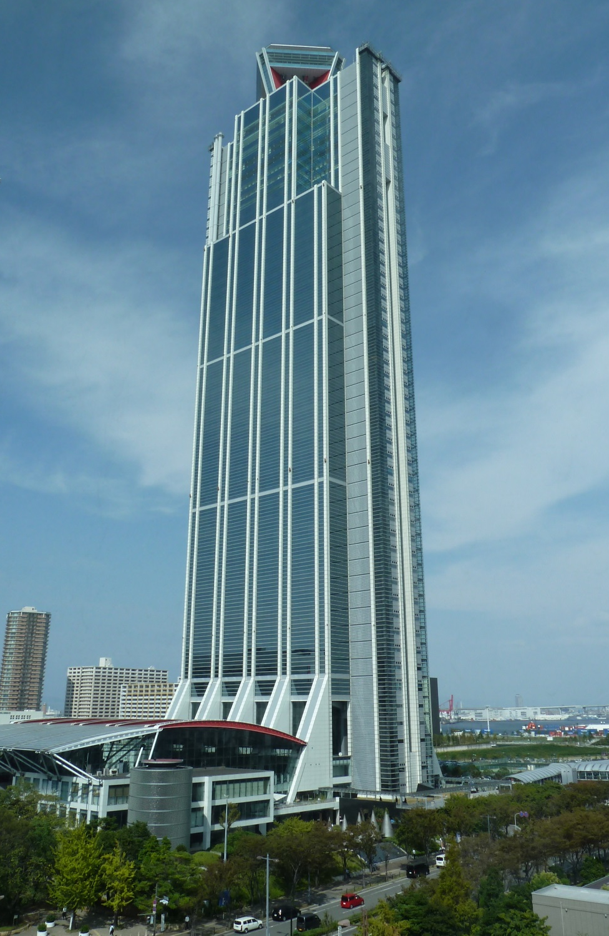

Osaka Prefectural Government Sakishima Building
（Sakishima Cosmo tower）
Governmental Maintenance Division,
Department of General Affairs
Osaka Prefectural Government

Slide 2
Table of Contents
1. History of Sakishima Building
2. Outline of the Building
・Location/Area
・Occupancy Status
・Facilities
・Security
3. Looking for New Tenants
4. Contact Information

Slide 3
history of sakishima building
・1995 Constructed by WTC Inc. Construction Cost:
120 billion yen
・2010 Purchased by Osaka Prefectural Government for
8.5 billion yen
・2015 Started looking for new tenants on floors
1 to 3 (Restaurants and shops only)
・2017 Started accepting applications for new tenants on floors 7 to 17 on June 12th.
(offices, shops and hotels etc. are accepted)

Slide 4
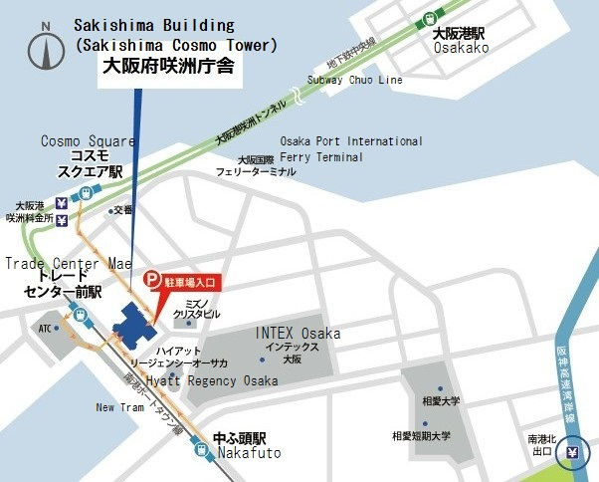
Location/Area

Slide 5
Location/Area
Access By Train
・ About 600 meters southeast from Cosmosquare station,
Chuo Subway Line.
・ There is a direct access through ATC(Asia and Pacific
Trade Center) building (about 100 meters from the
station) from Trade Center Mae Station, New
Tram(Nanko Port Town Line)
Approx. 30 min
From Umeda
Approx. 30 min
From Namba
Approx. 35 min From Tennoji

Slide 6
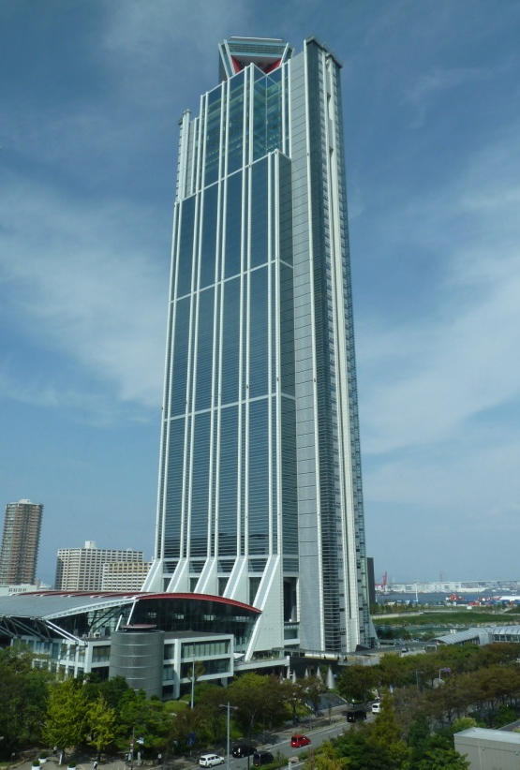
Location / Area
Site Area・・・ Approx. 20,000 m²
Total Floor Area・・・ Approx. 149,300 m²
Building Area・・・ Approx. 11,000 m²
One Standard Floor Area・・・ Approx. 1,600 m²

Slide 7

Location / Area
55 Floors
Above Ground
3 Floors
Under Ground

Slide 8
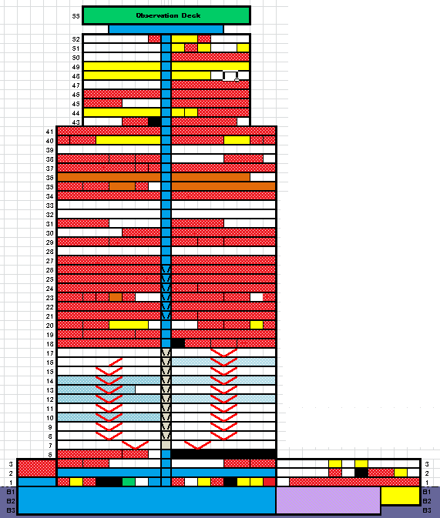
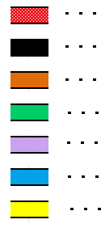
Occupancy
Status
Osaka Prefectural Government
Outsourcing companies
Osaka Prefectural Police
Observation Deck
Parking
Public Space
Private Companies
Floors 7 to 17
For New Tenants

Slide 9
Facilities
Structure・・・Above ground: Steel Structure
Under ground: Steel Reinforced Concrete Structure
Elevator・・・ 24 (to Tenant floors)
2 (to the Observation Deck only)
2 (for Cargoes)
Water・・・ Gravity-Fed Water System
Electricity・・・ Extra High Tension Power Receiving
3 Lines of 22KV Spot Network System
Air conditioning・・・ District Central Heating and Cooling system

Slide 10
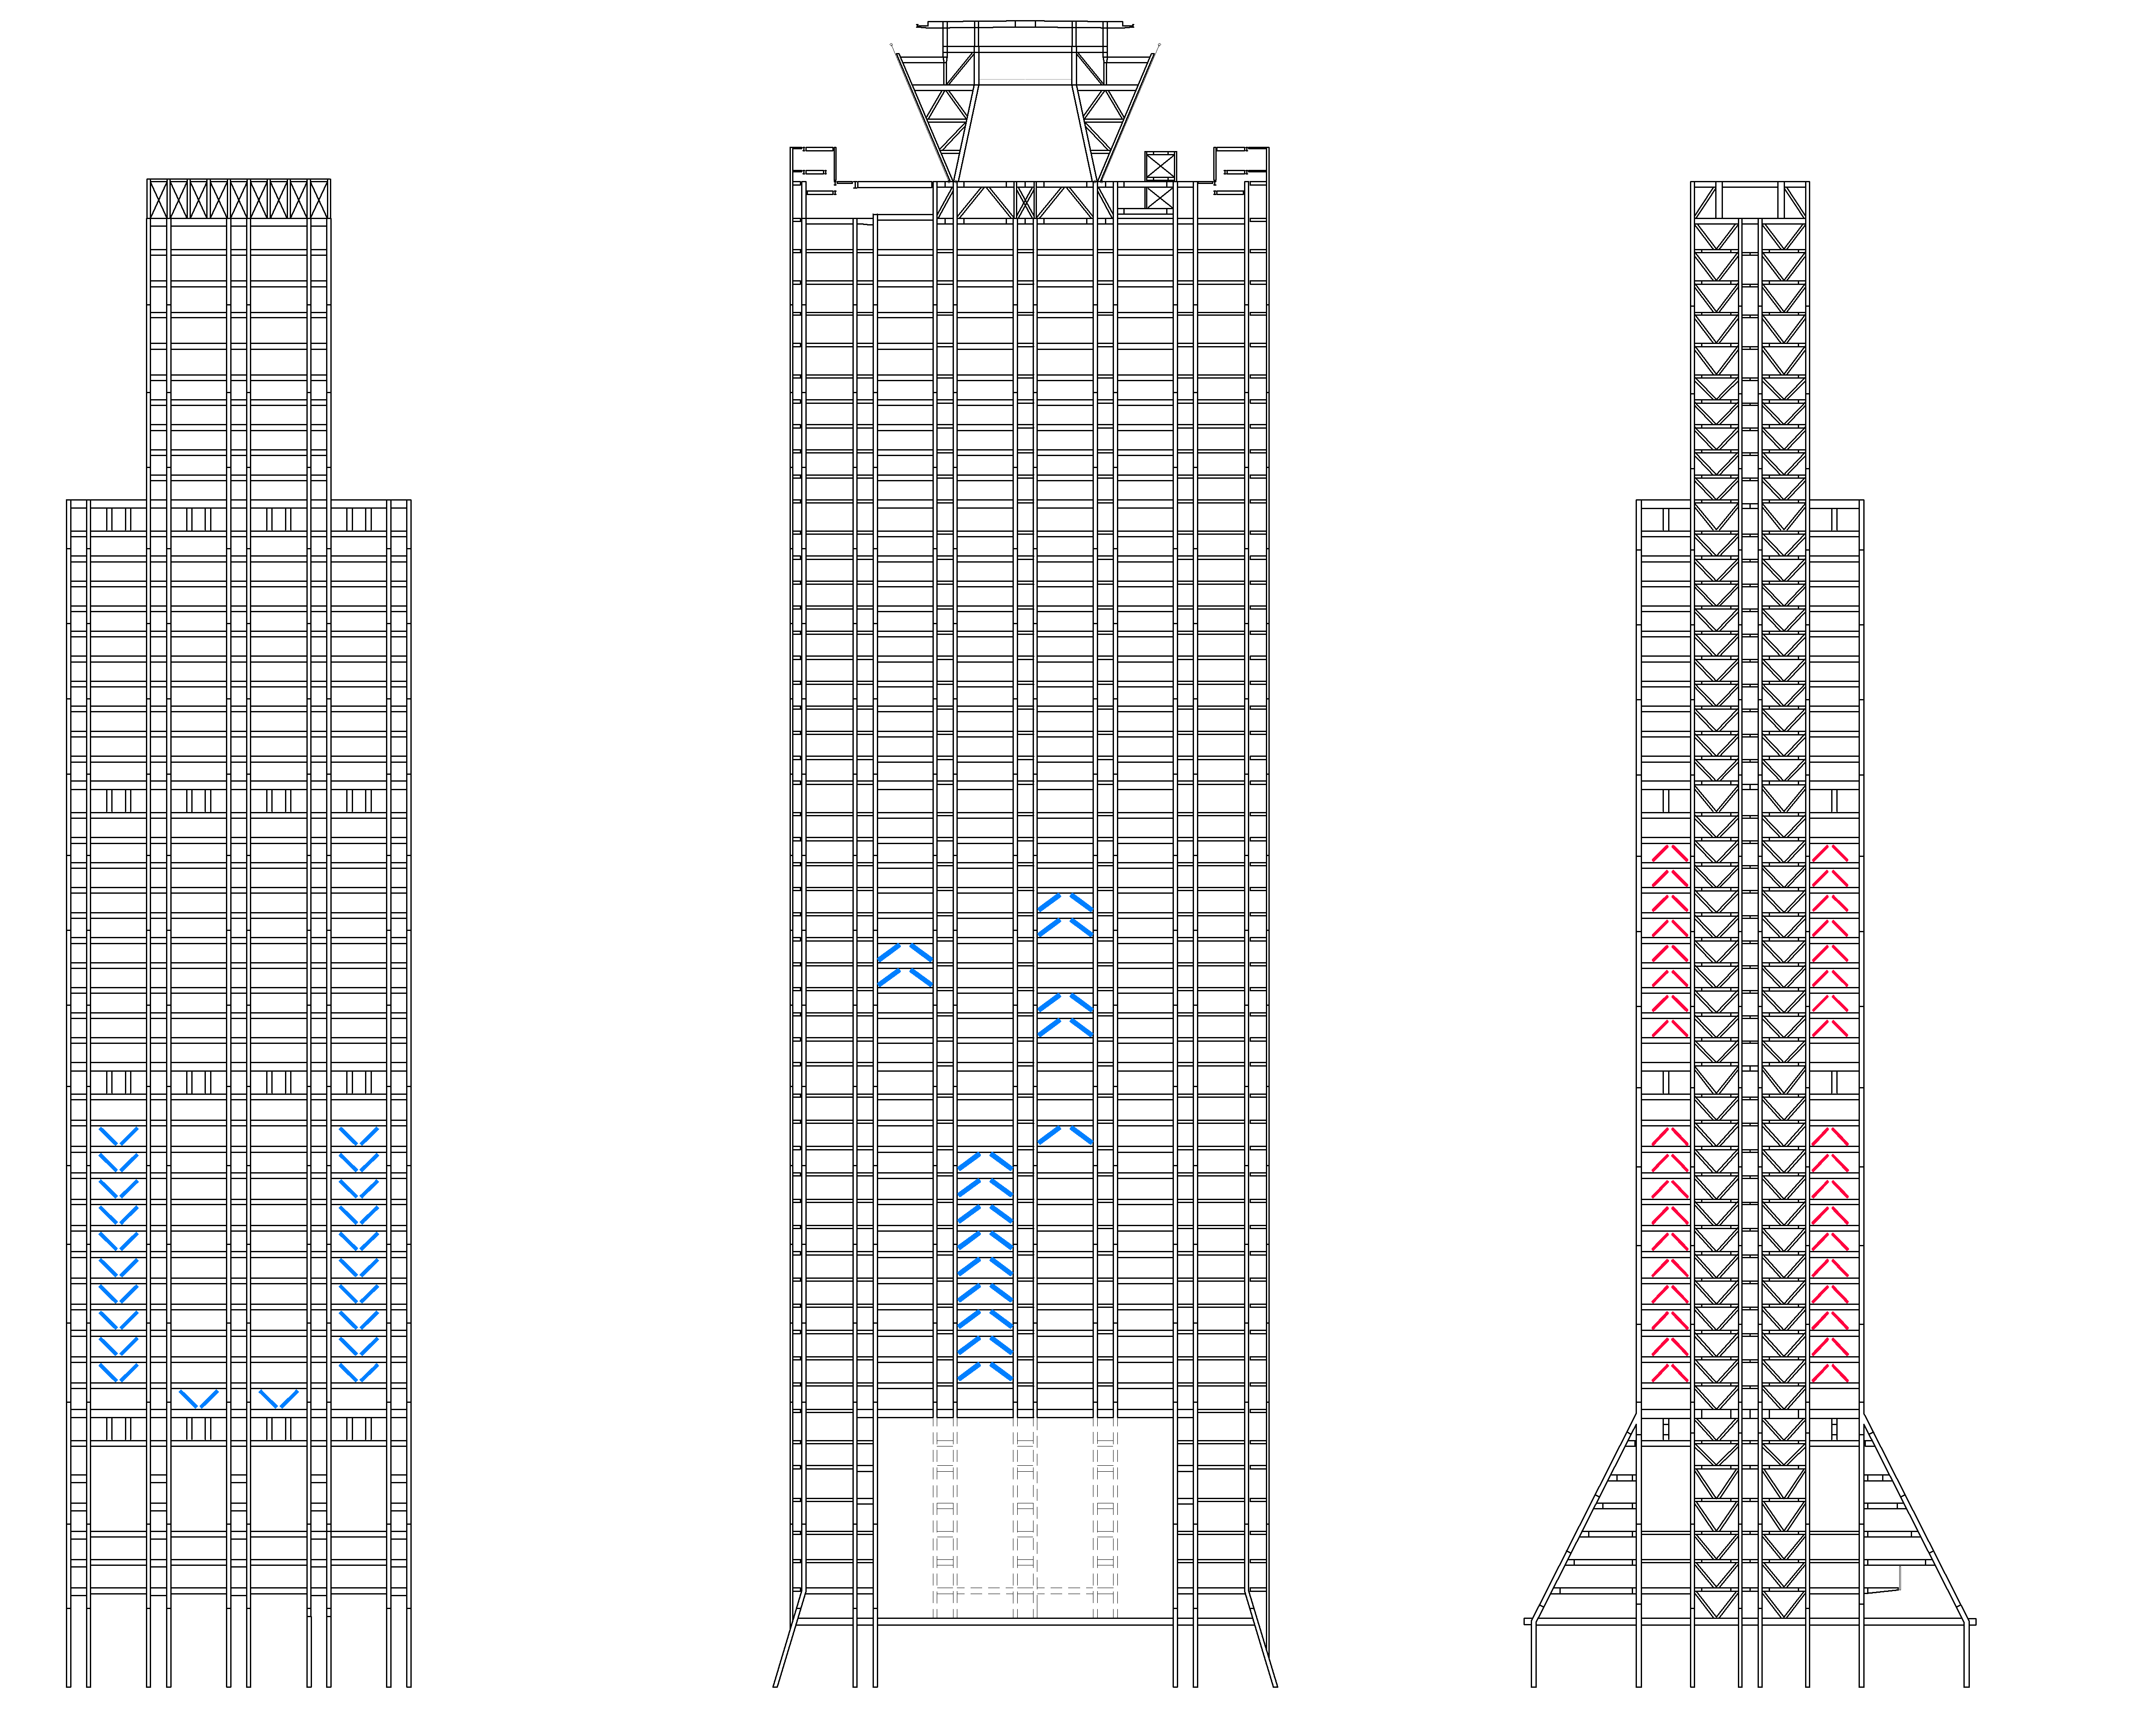
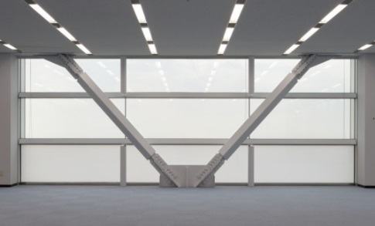
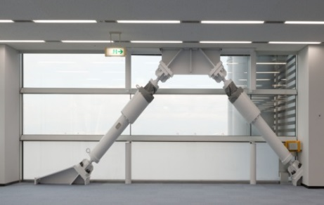
Safety
Earthquake Resistance
292 of Vibration Control Dampers have been equipped.
Additional dampers will be equipped to improve safety
next year or later.

Slide 11
Safety
Disaster Prevention System
Sprinklers, Fire Hydrants, Emergency Broadcasting System, etc.
Security System
Security Cameras, Electronic Lock System, etc.
Barrier- free facilities
Evacuation Chairs, Accessible restrooms, etc.
Other Equipment
AED

Slide 12
Looking For New Tenants
Osaka Prefectural Government started accepting applications for new tenants on floors 7 to 17 of Sakishima Building on June 12th.
1. Floors for Rent: Floors 7 to 17(11 floors and approx.
16,000m² of floor space in total).
2. Use: Various purposes such as offices, shops and
hotels are accepted.
3. Areas for Rent: Renting all or some of the floors is
welcome.

Slide 13
Looking for New Tenants
4. Contract: Fixed term lease contract.
5. Selection Process:
1. When there is only one applicant for a zone:
The applicant will be selected.
2. When there are several applicants for one or all renting zone(s):
The applicant who applies for the largest total floor space and
offers the highest rent price for that space will be selected.
6. Rent Currency: Only Japanese yen is accepted.
For further details, please visit our website. (Japanese only)
http://www.pref.osaka.lg.jp/yodo/koubojyouhou/sakishima_koubo_6_8.html

Slide 14
Contact Information
Governmental Maintenance Division,
Department of General Affairs
Address: Sakishima Building (Sakishima Cosmo Tower)
43th floor
Nankou Kita 1, Suminoe-ku, Osaka City,
Osaka Prefecture Japan
Tel: 06-6210-9298
Fax: 06-6615-6124
E-mail: Choshakanri-g09@sbox.pref.osaka.lg.jp

