Slide 1
Needs Survey relating to International Schools for Highly Skilled International Professionals Outline
March, 2024
Osaka Prefecture, Osaka City
(Survey Contractors: Hankyu Hanshin Properties Corp.)

Slide 3
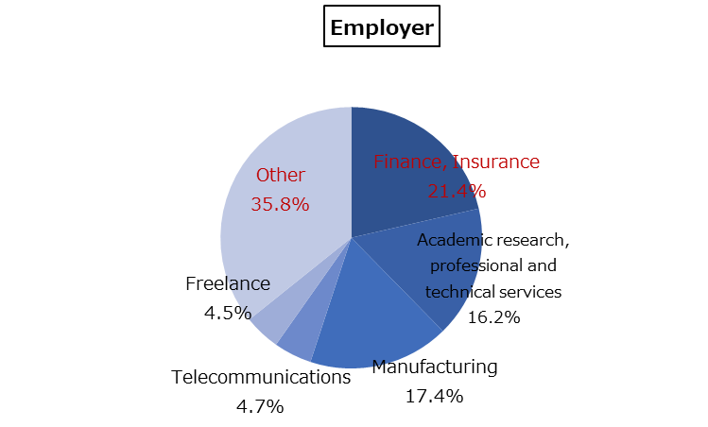
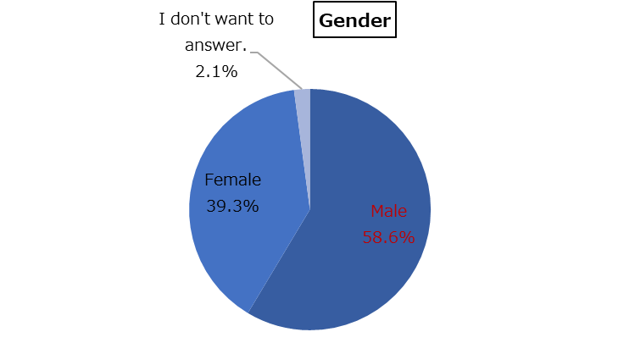
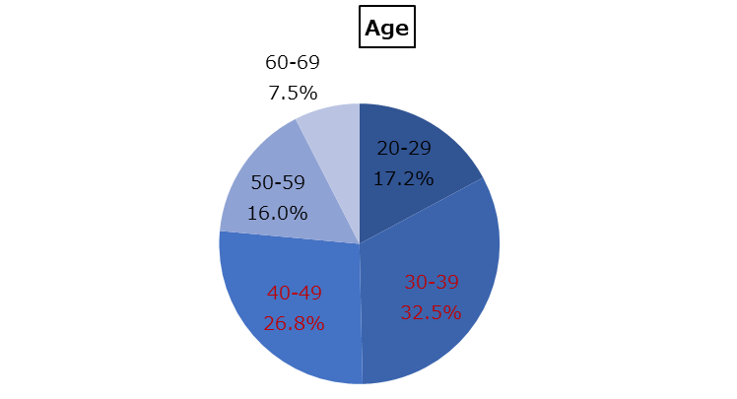
Ⅰ Outline
Purpose | A survey was conducted to understand the needs for international schools for highly skilled international professionals. The survey results will be used as the basic information to invite foreign capital financial businesses to Osaka and to establish living conditions.
Target | We surveyed those earning JPY15,000,000 or higher per annum, assuming highly skilled professionals are mostly likely to work with foreign financial businesses. We selected countries/regions (UK, Hong Kong, India, Singapore and China) which have developed as international financial cities where a number of highly skilled professionals are considered to live and many businesses have potential to be invited to Osaka. Then we surveyed those living in the countries/regions.
Method | Online surveys were conducted for those registered with the web survey company（GMO research＆AI, Inc.）to answer the questionnaire. Language: English only
Period | March 21, 2024 – March 29, 2024
Number of responses | 425（Target number: 300）
Ⅱ Summary of Survey Results
1．Attributes of Respondents
Age | Age brackets “30-39” and “40-49” account for 60% of all respondents.
Sex | “Male” accounts for 60% and “Female” 40%.
Employer one works for | “Other” accounts for 40% which is the largest group and “Finance, Insurance” for 20%.
“30-39” and “40-49” account for 60% of all respondents.

Slide 4
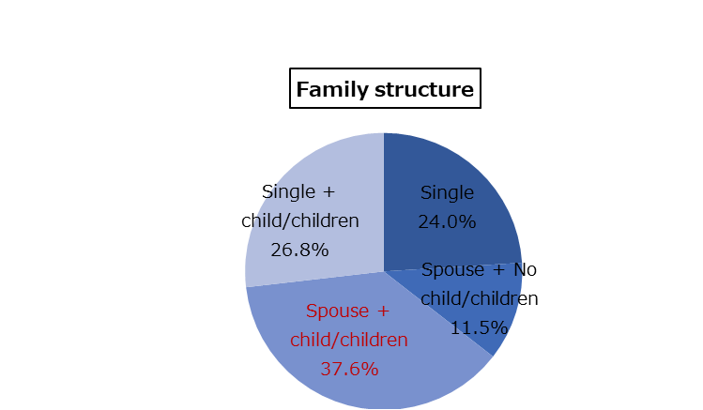
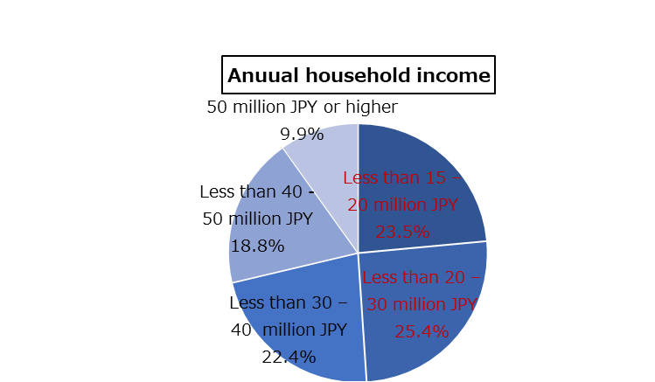
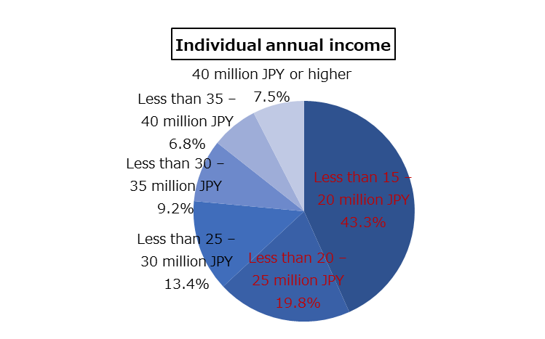
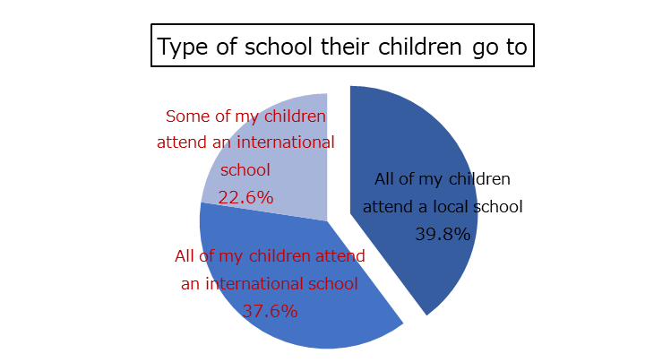
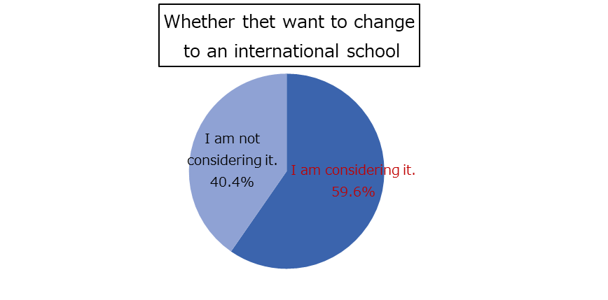
1．Attributes of Respondents（continued）
Individual annual income | “Less than 25,000,000 JPY” accounts for 60% of all respondents.
Annual household income | “Less than 30,000,000 JPY” accounts for 50% of all respondents.
Family structure | “Spouse and Children” is the largest group (40%).
“Less than 25,000,000 JPY” accounts for 60%.
“Less than 30,000,000 JPY” accounts for 50%.
2．Respondents’ preference to send their children to an international
school
As for the question regarding the “types of school your children go to” (asked only to those with children, n-274) , “All of my children attend an international school” or “Some of my children attend an international school” account for 60%.
Among households which send their children to local schools (n=109), 60% are “considering” “changing to an international school”.
60% answered “All or some of my children attend an international school”.

Slide 5
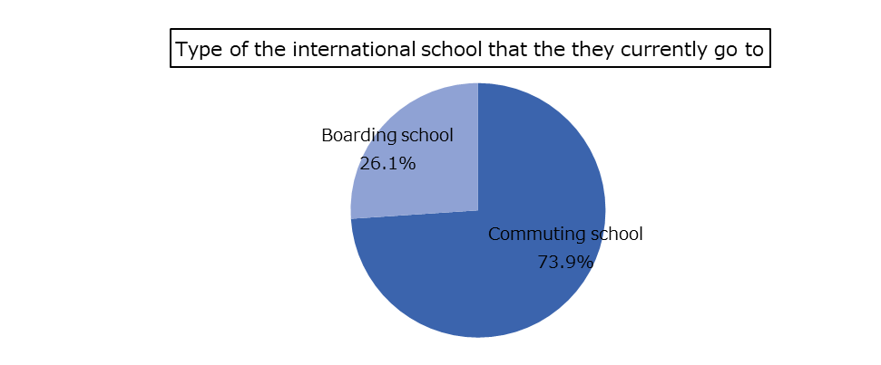
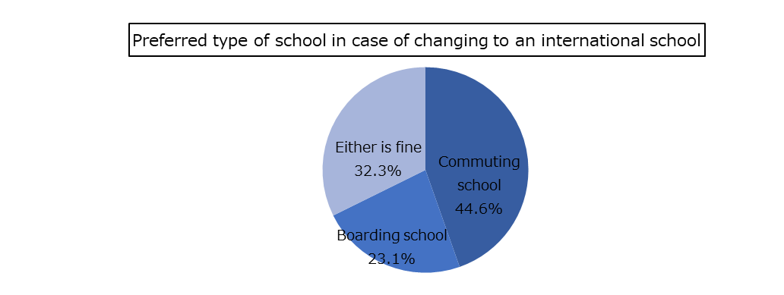
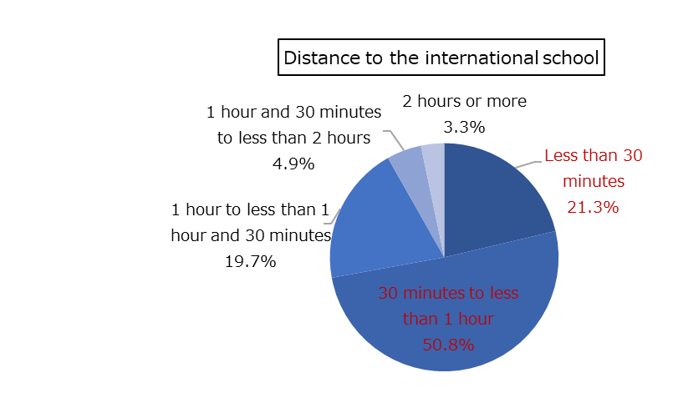
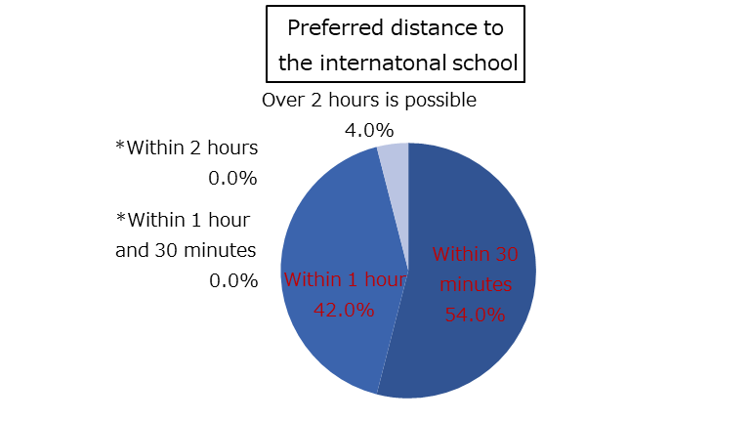
３．Facts about international schools and their future needs
 | Facts about the international schools their children currently go to 〔n=165〕 | Needs in the case they send their children to an international school 〔n=65〕
Commuter/boarding school | “Commuter school” accounts for 70% and “Boarding school” 30%. Among the households using a boarding school (n=43), the largest group use a boarding school from “Elementary school equivalent” (40%) and the second largest group use one from “High school equivalent”. | Half of them like to use a “Commuter school”, 20% a “Boarding school”, and 30% answered “Either is fine”. Among the households that want to use a boarding school (n=15), the largest group want to use one from “High school equivalent” (60%) and the second largest want to use one from “Junior high school equivalent” (30%).
Distance to international schools | Among households that send their children to a commuting school (n=122), 70% answered “less than 1 hour” for commuting. | Among households that want to send their children to a commuting school or answered “Either is fine” (n=50), 70% answered “less than 1 hour” for commuting.
Main opinion of the respondents
「Location of school and home are near not far.」（India/in her 40s）
「It should be close to home so that it does not take long to commute.」（UK/in his 50s）
「Well, proximity is a factor that I'll consider.」（UK/in his 20s)
70% answered “less than 1 hour” for commuting
90% answered “less than 1 hour” for commuting

Slide 6
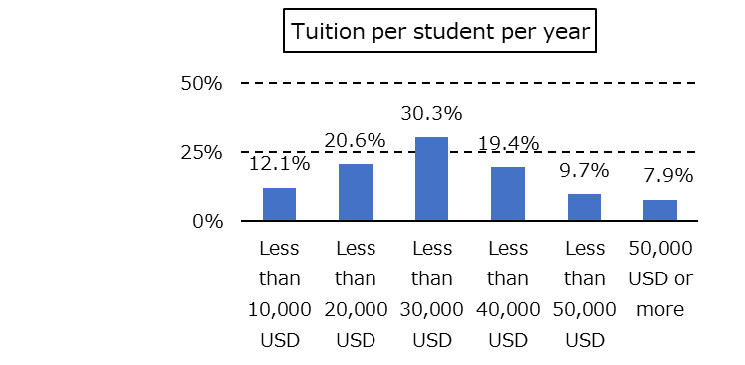
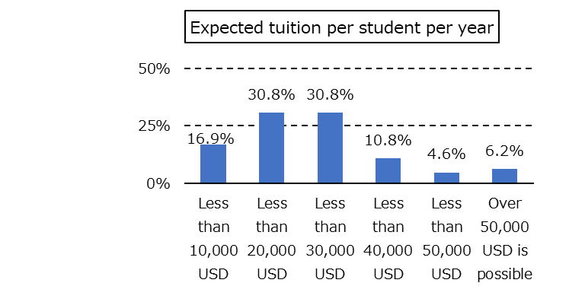
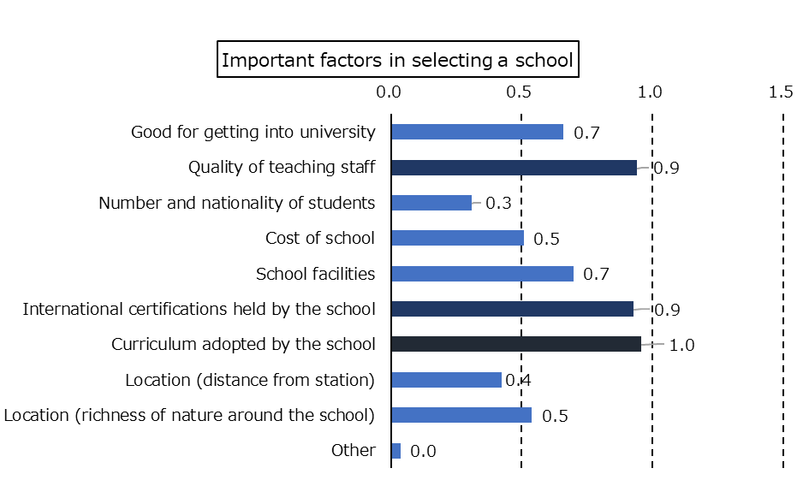
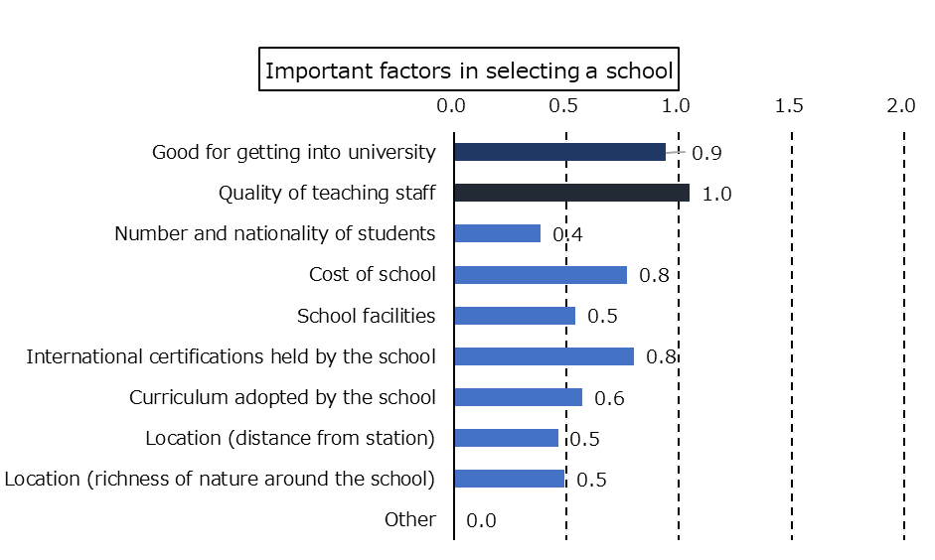
３．Facts about international schools and their future needs (continued)
 | Facts about the international schools their children currently go to 〔n=165〕 | Needs in case they send their children to an international school 〔n=65〕
Tuition per student per year | The largest group answered “Less than 30,000 USD” (30%) followed by “less than 20,000 USD” (20%) | 30% answered “Less than 20,000 USD” and another 30% answered “Less than 30,000 USD”.
Important factors in selecting a school^{１} | “Curriculum adopted by the school” and “International certifications held by the school” are the factors chosen by the most respondents. | “Quality of teaching staff” is the most important factor for the respondents, followed by “Good for getting into university”.
Main opinion of the respondents
“I hope the fee is affordable.”(Singapore/in his 50s)
“Good value for money”(China/in her 20s)
“Price is low.”(Hong Kong/in his 40s)
Main opinion of the respondents
“Good quality of education great teachers.” (UK/in his 20s)
“A world class school with state of quality teachers.”(India/in his 50s)
“Provide the path to other colleagues and university overseas.”(Hong Kong/in his 30s)
2nd
2nd
1st
2nd
1st
Main opinion of the respondents
“It all depends on the quality of knowledge and skills the school imparts.”(Singapore/in his 40s)
We used the weighted average method, where points were weighted for the top 3 factors in each question of “important factors in selecting a school” and the points for each option were divided by the number of respondents. Points allocation rule is: to give 3 points for “the top” option, 2 points for “the second” and 3 points for “the third”.

Slide 7
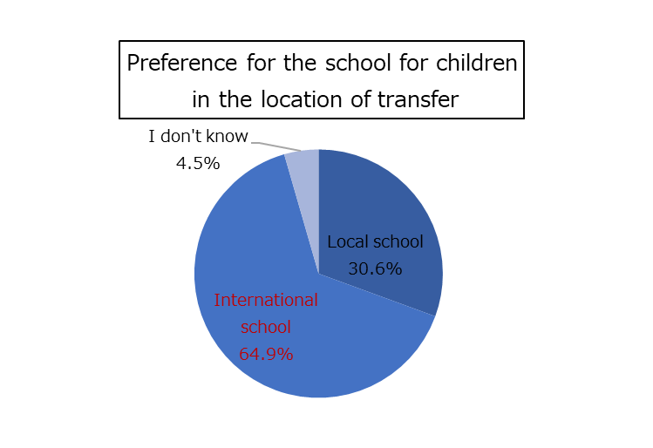
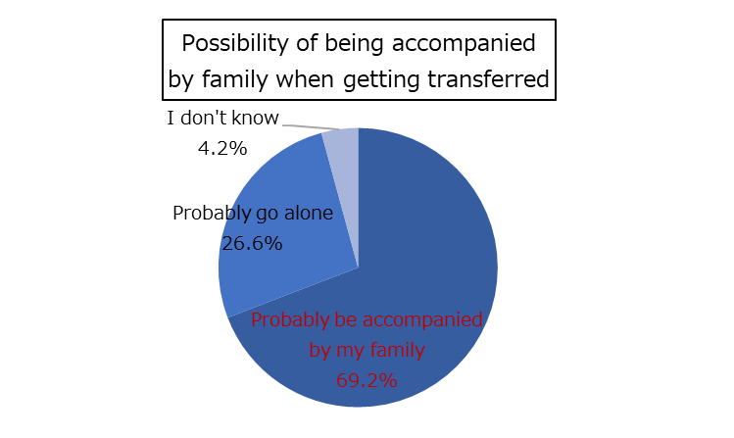
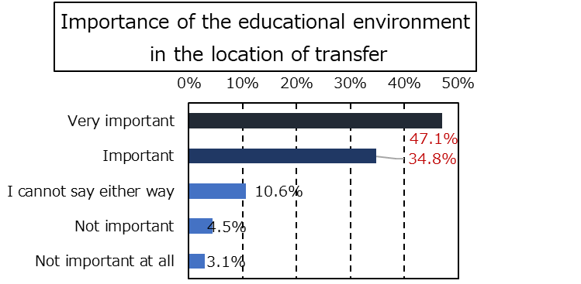
４．Preference for working overseas 〔n=425〕
As for the question “Please tell us where you would like to work”, 40% answered “Europe” and another 40% “other Asian countries than Japan”. UK is the most preferred location in “Europe” (80%). In Hong Kong and Singapore, the most respondents answered “other Asian countries than Japan” (60% for each).
As for the question “Who has the authority to make decisions about work transfers within the family?”, 90% answered “If I had to choose, I do”.
As for the question “If you were to work abroad, would you be accompanied by family or go alone?”, 70% answered “I would probably be accompanied by my family”. In India, more respondents answered they would be “probably accompanied” by their family which account for 80%.
As for “What is the most important to you about living environment of your overseas working place?”, the most respondents answered “Residential environment” (60%), followed by “Medical treatment environment” (20%). In UK, “educational environment” was chosen by many respondents (20%) while in China “Medical treatment environment” accounts for a high percentage (50%).
As for “How important is the educational environment of the place you are transferring to?”, “very important” and “important” account for 80% of all respondents. In UK, more respondents answered either “very important” or “important” (90%).
As for “Assuming you would like your child to attend school at your overseas workplace, would you prefer a local school or an international school?”, 60% answered “International school”. In India, an even higher percentage answered “International school” (80%).
As for “Does your employer provide any assistance for international school attendance?”, many answered “Yes” (60%) and the number of respondents answering “No” is smaller. In China, the percentage of respondents answering “Yes” is larger (90%).
５．Preference for universities 〔Answered by households with children, n=274〕
As for “preferred universities to go to”, the most respondents answered “Prestigious universities in Europe/U.S.” (70%) followed by “Other public universities in Europe/U.S.” (40%). In UK, the percentage of “Prestigious universities in Europe/U.S.” is larger. In India, "Prestigious universities in Europe or the U.S." (70%) accounts for the largest proportion, followed by "Other public universities in Europe or the U.S." (50%) and "Prestigious Japanese universities" (45%).
Main opinion of the respondents
“I would choose a reputed international school for my child's education in case of an international job transfer. I'll ensure my child's future is in good hands.”(India/in his 40s)

Slide 8
III Conclusion
Based on the survey results, we reached the following conclusion for the needs relating to international schools for highly skilled international professionals:
1. Demands for international schools in case of getting transferred
As seen in the survey, many households of highly skilled international professionals send their children to international schools. Even among those who currently send children to local schools, more than half of them are considering changing to an international school.
As for preference for the type of schools they want their children to attend in case of working overseas, more than half want them to attend an international school.
For the reasons mentioned above, we consider international schools will be in high demand if more highly skilled international professionals come to live in the Kansai area.
2. Preferences in selecting international schools
（１）Type of commute and location
More households prefer commuting schools. A certain number of households prefer boarding schools.
For the length of commute, less than 1 hour is preferred.
Locations with good transportation access and safe environment are preferred.
（２）Cost
As for tuition, 30,000 USD or lower is preferred per year.
（３）Contents of services
High quality curriculum and international certifications are necessary. At the same time, there is a demand for Japan’s own educational contents such as discipline, politeness, good manners, consideration to others, respect for traditional cultures, as often seen in Japanese people’s behavior, and multicultural education including interaction with local communities, etc.
Quality of teaching staff and the number of students entering universities are also considered important. Disseminating information on these factors is also important.
As for the language mainly used in class, most respondents prefer “English”. However, we also need to consider “introduction of foreign language education other than English”. What we found out in their remarks is they seem to prefer promotion of multilingual education so they can meet the needs of students with various backgrounds. Schools are also expected to introduce Japanese and other languages of students with different cultural background in addition to English.
“Prestigious universities in Europe/U.S.” are strongly preferred for higher education. It is important to make sure that there is a course of advancing to a higher education at universities in Europe/U.S..
【Reference】
Quality of teaching staff is the factor that caregivers consider important (according to the survey results). According to International Schools Database, placement of “native teaching staff” is also very important as well as specialty and experience of teaching staff. “Native teaching staff” here means being a native speaker of the curriculum provided at school. For example, if a British curriculum is provided in Osaka, native English speakers are preferred.
URL: https://www.international-schools-database.com/articles/most-important-features-of-international-schools
6

