Slide 1
Toward the “Global Financial City OSAKA”
＜Purpose of this document＞
This is a summary of my scheme at this point as one of the proposers of the Promotion Committee, as the draft of proposal for our future discussion.
December 23, 2020
Yoshimura Hirofumi
Governor of Osaka Prefecture

Slide 3
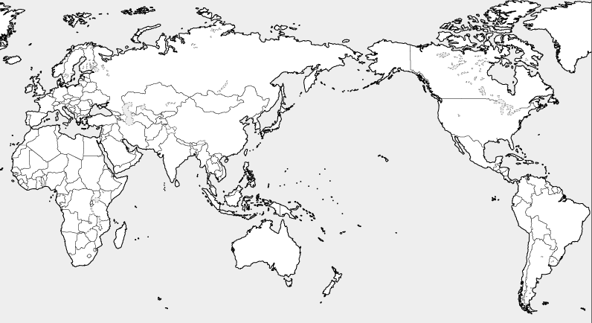
World Situation Around International Finance
◆ A global financial city means a hub of international financial trading, with headquarters of global banks, stock brokerage firms, etc
◆ The most renowned cities of its kind are New York and London, which have headquarters of prestigious financial institutes.
◆ The international financial situation shows a sign of change amid increasing geopolitical risks such as Brexit and enforcement of the
National Security Law in Hong Kong.
Tokyo
・Supporting Japan’s business activities by the foreign exchange/stock markets
Singapore
・Showing its presence as a financial center of Southeast Asian nations
Edinburgh
Boston
Shanghai
・Finance market based on
a growing Chinese
economy and gathering of
businesses
New York
・The world’s largest stock market based on the US economy and US dollar credibility
London
・International financial market with less regulations for non-residents
・The world’s largest derivative trading volume
Los Angels
Chicago
Hong Kong
・The world’s largest yuan offshore market
・Gateway function to mainland China
・Hub of the asset management- business in the Asia-Pacific region
Value of foreign
exchange transactions
Total stock market value
Derivative trading volume
〔unit：1billion USD〕
London
Tokyo
Singapore
London
New York
Tokyo
Singapore
Hong Kong
Shanghai
London
Tokyo
Source： Japan Center for International Finance “September, 2020 Market data sheet”
New York
Hong Kong
Shanghai
New York
Singapore
Hong Kong
Shanghai
1

Slide 4
Japan’s Current Situation of International Finance
◆Japan’s transactions are concentrated in the Tokyo Stock Exchange(Tosho), but the COVID-19 pandemic has visualized the risk of overconcentration in Tokyo at the time of crisis.
◆Looking around the world, every major country contains several financial cities with different functions.
◆Amid global inter-city competition, Japan needs other internationally-competitive financial cities adding to Tokyo, to strengthen its growth.
Japan’s current situation
▽The negative impact of unipolar concentration in Tokyo
〔 Global Financial Centre Index 〕
▽Transactions are concentrated in Tosho
 | September, 2020
1st | New York | USA
2nd | London | UK
3rd | Shanghai | China
4th | Tokyo | Japan
5th | Hong Kong | China
6th | Singapore | Singapore
- | - | -
13th | Edinburgh | UK
- | - | -
20th | Chicago | USA
- | Osaka（39th） | Japan
〔Ratio of markets in stock exchanges〕
日本
米国
・ Estimated maximum damage when an earthquake hits directly Tokyo metropolitan area ➡ Approx. 95 trillion yen
・Natural Disasters Risk Index of world big
cities ➡Tokyo-Yokohama is the worst among the major big cities in the world
*Other…Matching transactions, etc. by stock
brokerage firms
ＮＡＳＤＡＱ…a stock exchange market for
emerging companies in the US
Source：Nikkei shimbun（Oct.2, 2020)
Japan: Japan Securities Dealers
Association
US: Chicago Board Options Exchange
Source： Cabinet Office, final report by Working Group on the
earthquake centered directly under the capital（2013）
Munich Reinsurance Company Annual Report(March, 2003）
Financial cities with different functions
USA
New York
World’s largest stock market
Chicago
World’s largest derivative exchange
【Assessment items】
①Business environment
②Human resources ③Infrastructure
④Development level in the financial field
⑤International evaluation
UK
London
Financial market with the world’s largest stock exchange volume
Edinburgh
Home to international asset management businesses
2
Source： UK Think-Tank Z/Yen Research

Slide 5
Trend of the National Government to Realize a Global Financial City
◆ Changes in the world situation including COVID-19 are making Japan’s trend toward realization of a global financial city more active
this year.
◆ Along with the change from an “over-concentrated global financial city” to the “multi-polarized ones with collaboration,” the national
government announced the importance of competition and complement among each city while having its own characteristics
Major activities of the national government（in ２０２０）
July | Basic Policy on Economic and Fiscal Management and Reform 2020 | “Aim to establish international financial cities that will serve as international financial hubs for Asia and the world”
Aug. | Financial Service Agency 2020 Financial policy | “It is likely that an international financial city moves on to the multi-polarized type from the over-concentrated one. It is important that each core city compete and complement one another while having its own characteristics.” “We will comprehensively consider specific measures to improve the environment to accept overseas financial institutions, etc.”
Oct. | Newspaper interview remarks by Prime Minister Suga | ”I hope Tokyo’s further development, but I would like to create an environment where financial functions can be enhanced in other regions as well. The entire government will swiftly tackle the issues such as taxation measures, administrative English service, and status of residence."
 | Policy speech by Prime Minister Suga | “We will accept overseas financial personnel and aim to become an international financial center in Asia and even in the world. We will swiftly proceed with discussion about the tax system for that purpose, administrative English services, and relaxation of status of residence requirements."
Dec. | Action plan （Growth strategy meeting） | “Japan has room to further expand market. In order to accept overseas financial businesses, we will proceed with the improvement of an environment for foreigners to easily start or open businesses and lead comfortable lives.”
 | Comprehensive economic measures for peace and ease to protect people’s lives and livelihoods | Toward the realization of a global financial center open to the world, measures such as simplifying procedures for overseas asset management businesses to enter the market, strengthening English response ability in financial administration, and relaxing the status of residence requirements were announced.
 | FY 2021 Large package of tax revision | Measures for corporate tax, inheritance tax, and personal income tax were announced from the viewpoint of attracting businesses, human resources, and funds from overseas.
３

Slide 6
Revision of Tax and Status of Residence by the National Government
◆ The national government’s initiatives to attract businesses, human resources, and funds from overseas are in progress, aiming to establish Japan’s
position as a global financial center.
◆ The government has reviewed corporate, inheritance, and income taxes which were major barriers for overseas businesses to enter the Japanese
market, and relaxed the status of residence requirements
Tax policy revision （FY 2021 large package of tax revisions）
After revision
Private, non-family companies which mainly operate asset management business , etc. should be able to deduct its performance-based compensation if certain conditions are met.
Assets outside Japan that a foreign national who entered Japan for working holds should be exempt from Japanese inheritance tax regardless of his/her years of residence in Japan.
When a profit distribution of a carried interest has an economic rationality, that profit should be taxed as a capital gains tax(20%)
 | Current status
Corporate tax | Performance-based compensation of directors Listed companies: Deductible Private companies: NOT deductible
Inheritance tax | Foreign residents such as a fund manager Living in Japan over 10 years: Heirs living outside Japan are imposed inheritance tax for worldwide assets
income tax | Carried interests - distribution allocated returns in excess of their capital contribution ratio: Unclear if it is a capital gain or not
Relax residence status requirements(the Comprehensive Economic Measures December, 2020）
 | Current status
Short-stay | When a foreigner entered Japan with a “short-stay visa” to prepare for company setup: Required to return to his/her home country before starting business.
Domestic helpers/ nannies | You can hire a domestic helper only when he/she is a highly-skilled professional; or you can accompany from overseas only one domestic helper.
After revision
They are enabled to obtain residential status without returning to their home country before starting business under certain conditions
You can hire a domestic helper; and the maximum number you can accompany from overseas should be increased from one to two.
４

Slide 7
Osaka’s Strengths and Potential as an International Hub
◆Osaka is a commercial metropolis, also known as the “nation’s kitchen.”
◆It developed by people’s independent activities and unique ideas, and the world’s first futures contract was traded here. Full of new business chances, it’s an attractive place for both domestic and foreign entrepreneurs and investors.
◆Utilize the impact of Expo 2025, a national project joined by people throughout the world, to realize a global financial city.
Osaka’s Strengths
How to utilize the impact of Expo 2025
１．Historical background
＜Expo 2025 Osaka-Kansai aims to:＞
・Demonstrate new technologies and systems as a “people’s
living lab for future society“
・Present the world what a carbon-free society should be
through innovative technologies.
・Showcase a new style of the World Expo fully using the
digital technology
・Co-create solutions with people worldwide to achieve SDGs in 2030
and to construct a society vision thereafter.
・Showcase the world how Japan is finding solutions to challenges,
accelerating development and innovation of Japan’s advantageous
technologies.
▽Birthplace of the futures trading (derivatives)
２．Well-organized urban infrastructure
▽The only general exchange market that deals with derivatives ▽Developed transportation network and an international trading port ▽Higher education facilities and life science-related industries
Osaka’s Potential
Developing big projects that attract investments from
Japan and the world
▽ 2025 Expo Osaka-Kansai ▽ The highest level growth in the world
＜The World Expo encourages to:＞
・Promote various people’s exchanges, including excellent
human resources, from around the world by its attractions and
transmitting capacity.
・Create innovation by collaboration of various human resources
in Japan and the world
２．Acting as home to new innovation
▽ Promoting a smart city and a super city ▽ Creating a global hub for startup-ecosystem ▽ Creating Umekita Ⅱand an international hub for the future of medical care (Nakanoshima)
Processes of holding Expo 2025 and making Osaka a global financial city have a lot in common, and synergistic effects can be also expected.
５

Slide 8
Osaka’s Vision for the Global Financial City (Images)
Make Osaka a cutting-edge global financial city that has different identity and functions from Tokyo, utilizing Osaka's strengths, potential, and the impact of holding Expo 2025.
Thus, Osaka will lead Japan’s entire economic growth
Global Financial City that Osaka Aims for (Image)
Innovative Financial City OSAKA
▽ Promote ※ESG investment to achieve SDGs with entirety of Osaka, as the venue of Expo 2025 ▽ Realize an innovative financial city home to operating funds and financial human resources from Japan and throughout the world, by the drastic deregulation ▽ Conduct social implementation of cutting-edge technology in the financial business and create a new market by financial digital transformation
※ESG investment: The investment that has Environmental, Social and Governance elements, which means investments seeking positive returns and long-term impact on society
Asian Derivative City OSAKA
▽ Create the leading hub of the Asian derivative market to take in the growth of derivative transactions
６

Slide 9
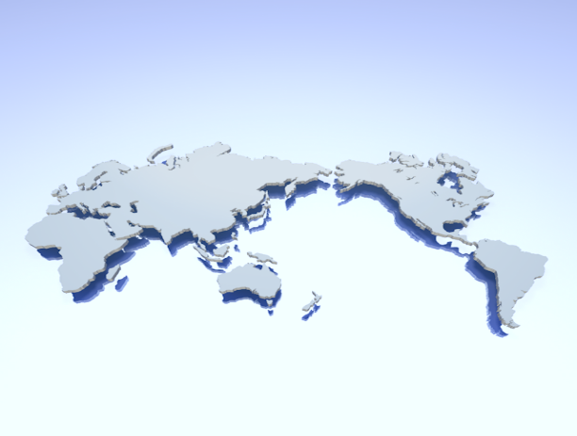
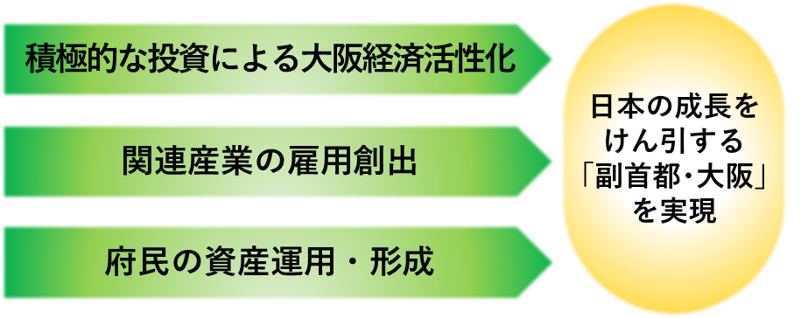
Significance and Positive Impact of Aiming for a Global Financial City
◆ It is crucial for Osaka to aim for a global financial city, in order to further develop and to win global intercity competition
◆ The realization of a global financial city is deemed to have a great impact on the revitalization and growth of the Osaka economy.
Significance of aiming for a global financial city
I wouldn’t be surprised if the client preferred the world “global”
▽ While the situation around international finance has been drastically changing,
the national government’s movement aiming to establish a global financial city has gained momentum
▽ Enhancing financial functions, which are called the “blood of the economy,” will be one of the
new factors to inspire the revitalization and growth of Osaka toward the post COVID-19 world.
▽ In Japan many financial facilities are concentrated in Tokyo. Making Osaka a global financial city
is a key policy of great significance to soften the economic centralization to Tokyo.
▽ Processes of holding Expo 2025 and making Osaka a global financial city have a lot in common,
and synergistic effects can be also expected.
▽ Osaka will encourage its further development by making Osaka an advanced global financial city
utilizing Osaka's strengths and potential, and by attracting investment throughout the world to create
business opportunities.
Realize a city that has functions of an international financial hub in the world and Asia
Realizing
“Second Capital
Osaka” to lead
Japan’s growth
Positive impact of realization of a global financial city
Osaka’s economic vitalization by vigorous investment
▽ Attract excellent human resources, funds, and information from Japan and overseas, which lead to:
- Raise motivation to invest in the fields of Osaka’s strengths such as health and medical-related industries
- Supply funds to startups in the prefecture.
▽Together with the above, ripple effects such as employment creation in the related industries can be expected, which will have a great impact on the revitalization and growth of the Osaka economy.
Creation of employment in the related industries
Residents’ asset management and formation
７

Slide 10
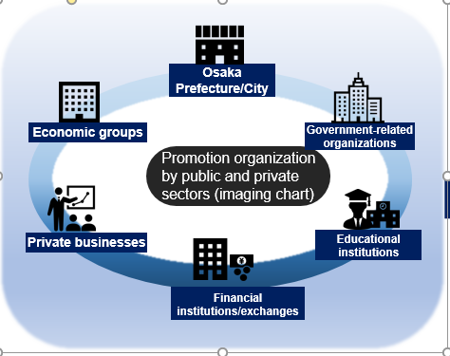
Specific Initiatives in Osaka (Draft Proposal)
◆ Collaboration between the local governments and energetic private businesses is essential to realize a global financial city
◆ Public and private sectors will promote together this project by calling on private businesses, which agree to our purpose, for their participation, utilizing the network between Osaka Prefecture/City and the economic community
Projects conducted by the Promotion Committee (image)
▽ Each participant in the promotion organization proceed with initiatives according to their respective role to realize the goal
▽ The Committee will propose further revision of the taxation system and regulations as necessary, based on the opinions from the Committee members
Promote to improve business and living environments in Osaka | ＜Business＞ 〇Grant various incentives to companies expanding their business into Osaka 〇Make a system aiming to promote ESG investment, etc. 〇Issue digital securities (security tokens) using the blockchain technology and create a secondary market 〇Strengthen exchange functions (ex. transfer energy-related products to Osaka, support to develop private exchanges, cooperate with overseas exchanges, etc.)
 | ＜Daily lives＞ 〇Attract international schools（Number of international baccalaureate-designated schools ： as of June, 2020: Tokyo 21, Osaka 7） 〇Secure medical institutions where English is available（Number of medical institutions accepting international patients：as of the end of June, 2020;Tokyo: 392, Osaka: 70) 〇Increase railway/road English signs, etc.
Attract/develop those who participate in the market | 〇Set up a promotion organization comprised of the public and private sectors（promotion activities to attract overseas businesses, etc.） 〇Establish a one-stop support center（concierge function to support procedures for overseas businesses to expand into the prefecture), etc. 〇Develop highly-skilled financial human resources, promotion of financial literacy education 〇Public relations of Osaka through issuance of the Green Bond, etc.
※The actual business details will be scrutinized based on the opinions of the members of the Promotion Committee, which is scheduled to be established within this fiscal year.
８

Slide 11
Future Schedule
◆ Considering the current international situation, etc., we will start to implement feasible policies in sequence toward the post COVID-19 world, while calling on private businesses which agree to our intent, for participation
FY2020 | 〔November〕 -Announce our decision to challenge ourselves to “Make Osaka a Global Financial City” -Position this policy as the “key area” amid the “New strategies toward Osaka’s revitalization and growth” 〔December〕 ・Hold a preparatory session to establish the promotion organization by Osaka Prefecture, Osaka City and economic groups ・Call on private businesses, which agree to our intent, for participation
 | 〔Within the fiscal year〕 -Set up a promotion organization comprised of the public and private sectors, an advisory board, etc. -Start to implement feasible policies in sequence
After FY2021 | Public and private sectors will work together to implement following activities: -Attract more domestic and overseas financial-related businesses -Develop financial human resources -Promote ESG investment -Consider creation of a new market through financial digital transformation.
By 2025 | Realize the “Global Financial City OSAKA”
※Specific performance indexes, etc. are to be set based on the opinions of private businesses and financial experts in the public-private joint promotion organization scheduled to be established within this fiscal year.
９

Slide 12
10

Slide 13
-Reference Materials-

Slide 14
ー Table of Contents ー
＜International finance-related materials＞
１ The Global Financial Centre Ranking
２ Volume of Exchange Transactions a Day
３ Stock Market（market capitalization, number of listed-
companies, number of IPOs）
４ Amount of Over-the-Counter Derivative Transactions
（one-day average）
５ Outstanding Debt Securities in Major Countries
６ Tax Rate in Each Country
７ Characteristics of Personal Financial Assets
８ Trend in FinTech Investment
９ City Ranking in Terms of Fin Tech
＜Japan’s finance-related materials＞
10 Personal Financial Assets in Japan
11 Competitive Situation of Main Financial
Commodities
＜Japan’s living environment-related materials ＞
12 Number of International Schools
13 Number of Medical Institutions Accepting
International Patients

Slide 15
１ Ranking by the Global Financial Centre
●Tokyo ranked 4th , Osaka 39th in the latest ranking by the Global Financial Centre
 | September 2019 | March 2020 | September 2020
１st | New York | New York | New York
２nd | London | London | London
３rd | Hong Kong | Tokyo | Shanghai
４th | Singapore | Shanghai | Tokyo
５th | Shanghai | Singapore | Hong Kong
６th | Tokyo | Hong Kong | Singapore
7th | Beijing | Beijing | Beijing
8th | Dubai | San Francisco | San Francisco
9th | Shenzhen | Geneva | Shenzhen
10th | Sydney | Los Angeles | Zurich
11th | Toronto | Shenzhen | Los Angeles
12th | San Francisco | Dubai | Luxembourg
13th | Los Angeles | Frankfurt | Edinburgh
14th | Zurich | Zurich | Geneva
15th | Frankfurt | Paris | Boston
16th | Chikago | Chikago | Frankfurt
～ | Osaka（27th） | Osaka（59th） | Osaka（39th）
11
Source：Made by Osaka Prefecture based on the research by Z/Yen, a think-tank of the UK

Slide 16
2 Volume of Exchange Transactions a Day
●The UK has by far the largest exchange transaction volume, followed by the United States.
Japan, Singapore, and Hong Kong are competing at even lower levels.
●Japan's exchange transaction volume has been sluggish, being surpassed by Singapore and Hong
Kong in recent years.
（ $ 1 billion ）
UK
Hong Kong
Japan
Singapore
UK
United States
United States
Singapore
Hong Kong
Japan
1２
Source: Made by Osaka Prefecture based on the “Bank for International Settlements”

Slide 17
３ Stock Market（market capitalization, number of listed companies, number of IPOs)
●The New York Stock Exchange (NYSE) and Nasdaq (US stock market for start-ups) stand out regarding the market capitalization.
●Japan has a large number of listed companies, among which the domestic ones account for most of them while the number of foreign companies is small. In the UK and the US, the number of foreign companies account for 10% to 20% of listed companies.
●IPO (Initial Public Offering) at Hong Kong Exchanges & Clearing Ltd. is ranked the first in the world not only in terms of the number but also in the fundraised amount (2019)
（ $ 1 billion ）
Market Capitalization （End of 2019）
Euronext
Hong Kong
Exchanges
JPX
LSE
Nasdaq
NYSE
Shanghai
Exchanges
Shenzhen
Exchanges
Number of listed companies（End of 2018）
Number of IPOs（in 2019）
Euronext
Hong Kong
Exchanges
JPX
LSE
Nasdaq
NYSE
Shanghai
Exchanges
Shenzhen
Exchanges
Euronext
Hong Kong
Exchanges
JPX
LSE
Nasdaq
NYSE
Shanghai
Exchanges
Shenzhen
Exchanges
1３
Source: Made by Osaka Prefecture based on the “world Federation Exchange”

Slide 18
４ Amount of Over-the-Counter Derivative Transactions（one-day average）（in 2019）
〇The UK has the largest amount of over-the-counter derivative transactions, followed by the United States. In Asia, Hong Kong's amount is the largest.
（ $ 1 billion ）
UK
United States
Hong Kong
Singapore
Japan
China
Source: Made by Osaka Prefecture based on the “Bank for International Settlements”
14

Slide 19
５ Outstanding debt securities in major countries（as of the end of 2019）
●The debt securities market in the United States is overwhelmingly large in terms of the size (outstanding debt securities) in the world.
●The size of debt securities market is large in China and Japan in Asia; and very small in Hong Kong and Singapore.
（ $ 1 billion ）
United States
China
Japan
UK
France
Germany
Hong Kong
Singapore
1５
Source: Made by Osaka Prefecture based on the “Bank for International Settlement”

Slide 20
６ Tax Rate in Each Country
●Japan's tax rates (corporate tax, income tax, inheritance tax) are higher than those of major Asian financial cities such as in Hong Kong and Singapore.
Tax category |  |  | Japan | Hong Kong | Singapore | Shanghai (China) | USA | UK
Corporate tax |  |  | 29.74％ | 16.5％ (8.25％ up to profit of 2 million HKD ) | 17％ | 25％ | 27.98％ | 19.0％
Income tax※１ |  |  | 5 - 45％ | 2 - 17％ | 0 - 22％ | 3 - 45％ | 10 - 37％ | 20 - 45％
 | Finance -related tax ※２ | capital gain | 20％ |  |  |  | 0 - 20％ | 10 - 20％
 |  | dividend | 10 - 55％ |  |  |  | 0 - 20％ | 7.5 - 38.1％
 |  | interest | 20％ |  |  |  | 10 - 37％ | 10〜45％
Inheritance tax |  |  | 10 - 55％ | No tax ※Abolished in 2006 | No tax ※Abolished in 2008 | No tax | 18 - 40％ | 40％
No tax
No tax
20％
※1:Some countries impose local taxes (resident tax, etc.) in addition to the stated taxes.
※2:In some countries local taxes are included in the listed tax rates; or local taxed are imposed separately.
Source：Websites of relevant organizations (Ministry of Finance, National Tax Agency,
Japan External Trade Organization, etc., as of Dec., 2020)
Note: The above figures are just extracted from those which are posted on the websites of each related organization, and cannot be unconditionally compared.
1６

Slide 21
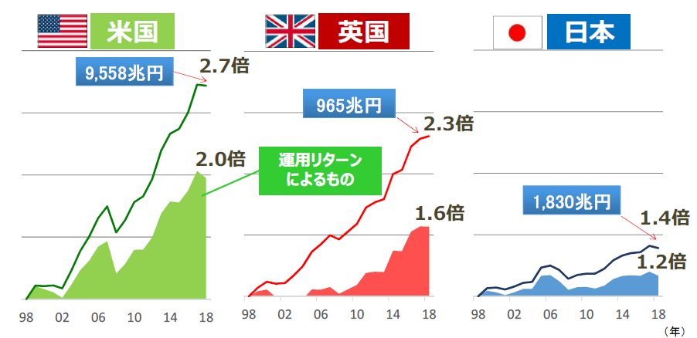
７ Characteristics of personal financial assets
●In the 20 years since 1998, household financial assets in a macro level have increased by 2.7 times and by 2.3 times in the US and in the UK respectively, but only by 1.4 times in Japan.
The increasing rate of returns from securities, etc., also remains low in Japan compared to the US and the UK.
Trend in the household financial assets （ comparison between Japan, US, and Europe)
United
States
UK
Japan
9,558
trillion yen
2.7times
965
trillion yen
2.3times
2.0times
returns from securities
1,830
trillion yen
1.6times
1.4times
1.2times
1７
８
Source: Made by the Financial Services Agency, based on the materials of FRB, BOE, and Bank of Japan

Slide 22
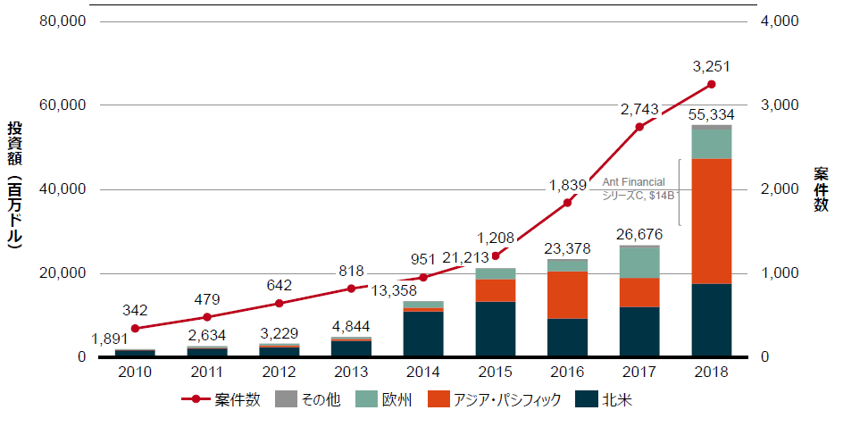
８ Trend in FinTech investment
●FinTech investment is accelerating in "Asia Pacific," "North America," and "Europe."
investment amount
（million dollars）
number of projects
number of
projects
other
Europe
Asia Pacific
North America
Source: Analysis of CB Insights data by Accenture
1８
９

Slide 23
９ City ranking in terms of Fin Tech
●San Francisco, which is ranked the 8th in the world by the Global Financial Centre ranking, has Silicon Valley in its region and is ranked the first in the FinTech city ranking.
Rank | City
１ | San Francisco（USA）
２ | London(UK）
３ | New York（USA）
４ | Singapore（Singapore）
５ | Sao Paulo（Brazil）
６ | Los Angels（USA）
7 | Bengaluru （India）
8 | Boston（USA）
9 | Berlin（Germany）
10 | Mumbai（India）
11 | Hong Kong
12 | Toronto（Canada）
13 | Sidney（Australia）
14 | Chicago（USA）
15 | Paris（France）
16 | New Delhi（India）
17 | Tokyo
※Out of ranking | Osaka
1９
Source: Made by Osaka Prefecture based on the FINDEXABLE “The Global Fintech Index 2020”

Slide 24
10 Personal Financial Assets in Japan
〇In Japan, cash and deposits account for the majority of household financial assets while the ratio of investment trusts and stocks is low compared to that of Europe and the US.
Comparison of household financial asset composition between Japan, the US and Europe（as of the end of March, 2020）
Debt securities (1.4%)
Japan
Cash, Deposits
(54.2%)
Stocks,
etc.
(9.6%)
Insurance, Pension, Standardized Guarantee Scheme (28.4%)
(1.845 trillion JPY)
Investment trusts(3.4%)
Total of the rest (2.9%)
The United States
Cash, Deposits
(13.7%)
Investment trusts
(12.3%)
Stocks, etc.
(32.5%)
Insurance, Pension, Standardized Guarantee Scheme (32.6%)
(87 trillion USD)
Debt securities
(6.0%)
Total of others (3.0%)
Euro zone
Cash & Deposits
(34.9%)
Stocks,
etc.
(17.2%)
Insurance, Pension, Standardized Guarantee Scheme (35.1%)
(25.1 trillion Euro)
Debt securities (2.0%)
Investment trusts(8.7%)
Total of the rest(2.2%)
Ratio of financial assets (%)
Total of the rest: the amount deducting “cash & deposits,” “debt securities,” “investment trusts,” “stocks,” and “insurance, pension, standardized guarantee scheme” from the total of financial assets
２０
Source: August, 2020 Bank of Japan ”Comparison of Flow of Funds between Japan, Europe and the US by Bank of Japan

Slide 25
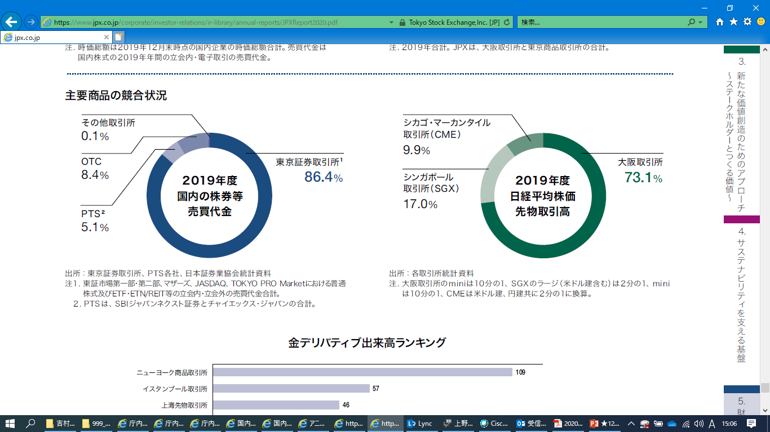
11 Competitive Situation of Main Financial Commodities
●Domestic stock transactions are concentrated in the Tokyo Stock Exchange while Nikkei stock average futures trading in the Osaka Exchange.
Competitive Situation of Main Financial Commodities
Other exchanges
Chicago Mercantile Exchange(CME)
Tokyo Stock
Exchange *1
FY2019 Trading value of domestic stock certificates,
etc.
Osaka Exchange
Singapore Exchange(SGX）
FY2019 Nikkei stock
Average
Futures trading value
*1. Total trading value of common stock, on-floor and off-floor trading such as ETF, ETN/REIT at the First Section and the Second Section of the Tokyo Stock Exchange, Mothers, JASDAQ, and TOKYO PRO Market
2 . PTS: Total of SBI Japannext Co., Ltd. and Chi-X Japan Limited.
(Note) Mini of the Osaka Exchange : 1/10, SGX Large (including denominated in USD): 1/2, mini: 1/10
CME: Both USD and JPY are converted to 1/2
※OTC… done directly between two parties, without the supervision of an exchange
２１
Source: JPX Report 2020

Slide 26
12 Number of International Schools（International baccalaureate-designated schools in Japan; as of June 30, 2020）
●The number of international schools: 21 in Tokyo, 7 in Osaka
Tokyo
Aichi
Yamanashi
Kyoto
Miyagi
Nagano
Hiroshima
Fukuoka
Saitama
Okinawa
Hokkaido
Gunma
Gifu
Shiga
Kanagawa
Kanagawa
Osaka
Hyogo
Shizuoka
Ibaraki
Okayama
2２
Source: Compiled by Osaka Prefecture based on the relevant website of the Ministry of Education, Culture, Sports, Science and Technology

Slide 27
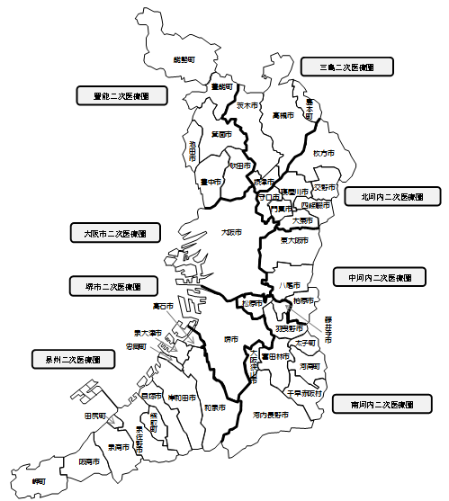
13 Number of Medical Institutions Accepting International Patients（※）（as of June 30, 2020）
●Tokyo: 392 institutions; Osaka: 70 institutions
*secondary medical service area:
It consists of multiple
municipalities and provides
general inpatient treatment, including emergency medical care, which can be completed within the region.
Mishima secondary
medical service area
※Aggregation method:
1).Hub medical institutions that accept international patients selected by each prefecture
[1]Category 1: Medical institutions that can accept emergency patients who need to be hospitalized
[2]Category 2: Medical institutions that can accept international patients, including clinics and dental clinics
2).Other than [1] and [2], institutions which are willing to extend cooperation in medical treatment for international patients and are judged to be eligible for the medical institution list by the prefecture.
＝4か所
Toyono secondary
medical service area
= 4 institutions
＝７か所
7 institutions
Kitakawachi secondary
medical service area
＝7か所
Osaka City secondary
medical service area
= 7 institutions
＝35か所
= 35 institutions
Nakakawachi secondary
medical service area
Sakai City secondary
medical service area
＝5か所
＝3か所
= 5 institutions
= 35 institutions
= 3 institutions
Senshu secondary
medical service area
＝6か所
= 6 institutions
Minamikawachi secondary
medical service area
＝3か所
= 3 institutions
Tokyo
Mie
Kagawa
Ibaraki
Osaka
Saitama
Yamanashi
Gifu
Kanagawa
Tokushima
Akita
Hokkaido
Gunma
Aichi
Fukui
Fukuoka
Shimane
Ishikawa
Kyoto
Kumamoto
Chiba
Tochigi
Tottori
Kagoshima
Toyama
Niigata
Hiroshima
Shizuoka
Hyogo
Nara
Yamaguchi
Nagano
Okayama
Yamagata
Ehime
Iwate
Nagasaki
Fukushima
Okinawa
Kochi
Miyagi
Shiga
Oita
Wakayama
Miyazaki
Aomori
Saga
2３
Source：Compiled by Osaka Prefecture based on the relevant materials of the Ministry of Health, Labour and Welfare

