Slide 1
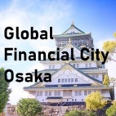

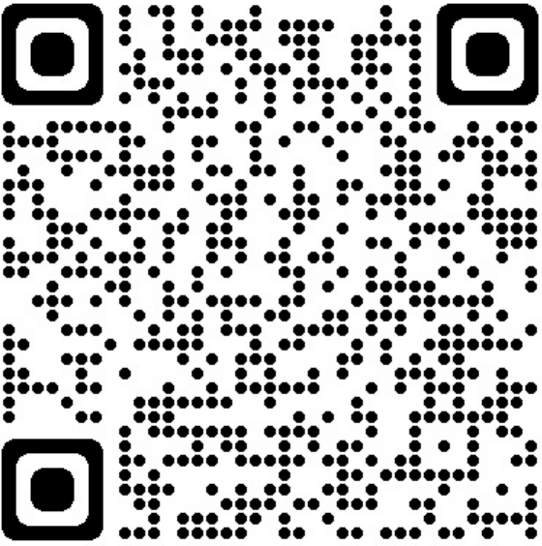

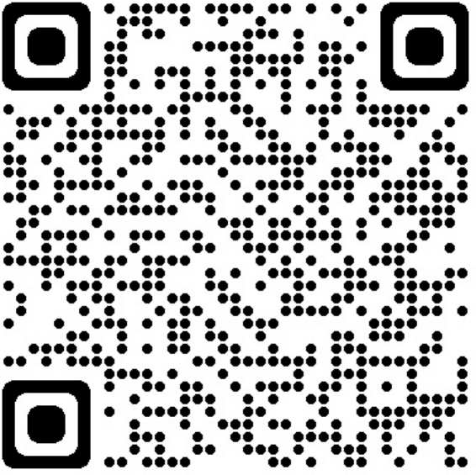


“Special Zones for Financial and Asset Management Businesses”
Proposals
February 2024
Osaka Prefecture ・ Osaka City

Slide 2
1.Concept 1
Special Zone for Creating a Future Society
2.Background of the proposal
Ⅰ.Osaka’s industrial potential 2
Ⅱ.Osaka’s foundation that supports industries 3
3.What we should aim for 4
4.Major proposals to the national government 5
List of deregulation to be requested from the government 6
List of tax measures to be requested from the government 9
5.Local government initiatives 10
6.Local government promotion systems 13
Table of contents

Slide 3
1. Concept
Special Zone for Creating a Future Society
In April 2025, the Osaka-Kansai Expo will open in Osaka under the theme “Designing Future Society for Our Lives.” The legacy of the Expo will be the realization of a "future society" where innovations, especially in sectors such as life sciences, carbon neutrality, and business start-ups, will be consistently generated, leading to solutions for global issues.
To this end, it is essential to enhance the financial system, the lifeblood of the economy, enabling companies, universities, and research institutes to foster innovation. Growing and nurturing a strong investment infrastructure can also serve as a backup for the Tokyo metropolitan area in case of emergency.
To help achieve this goal, "Special Zones for Financial and Asset Management Businesses" is an indispensable mechanism. There, regulatory reforms will be implemented to accumulate and expand financial and asset management services and develop growing fields.
Through this special zone system, Osaka Prefecture and City will implement global-standard regulatory reforms to attract overseas investment funds, asset managers, and fintech companies from Japan and abroad, aiming to create the internationally competitive “Global Financial City OSAKA.
As a result, funds will be allocated to companies in Osaka and the Kansai region based on their growth stage. By enhancing an environment conducive to new and existing businesses such as digital transformation, Osaka aims to contribute to the local economy’s sustainable growth, improve residents’ lives, and address challenges in Japan and the rest of the world.

Slide 4
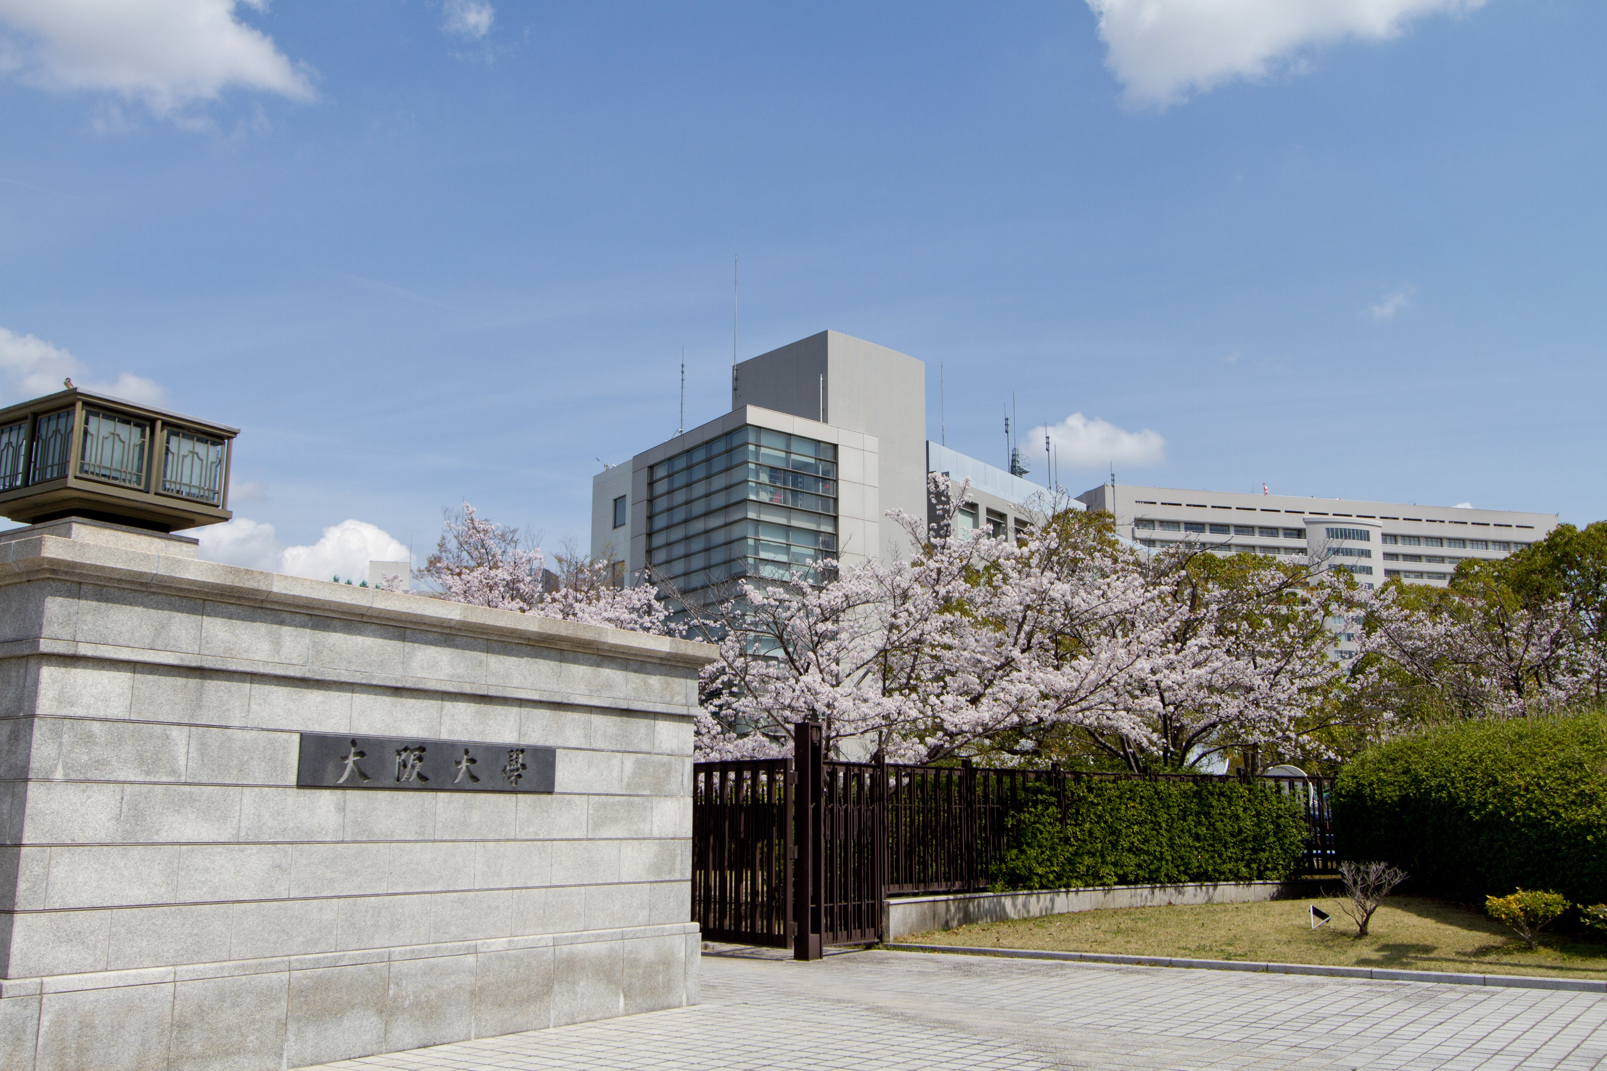
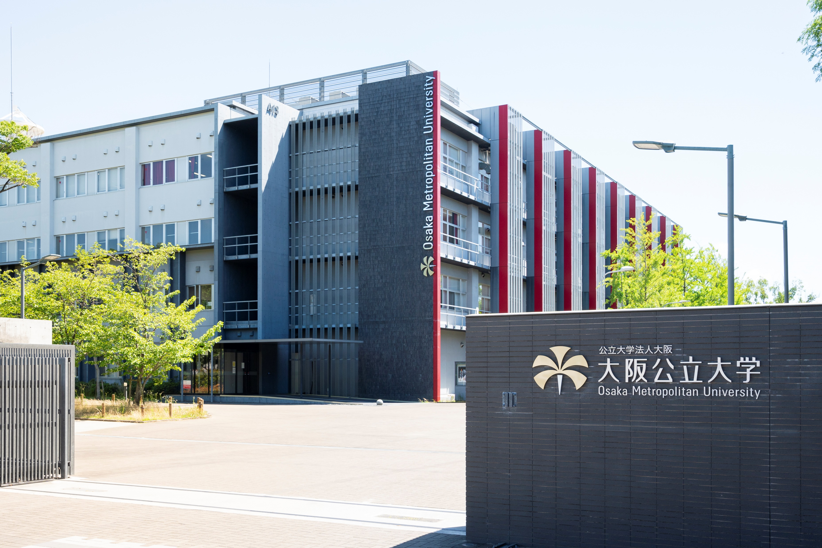
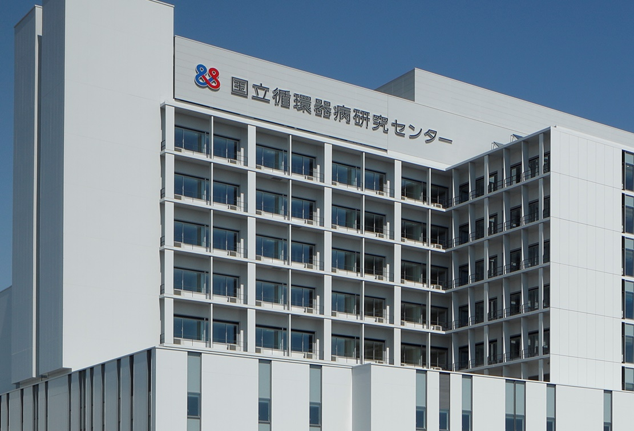
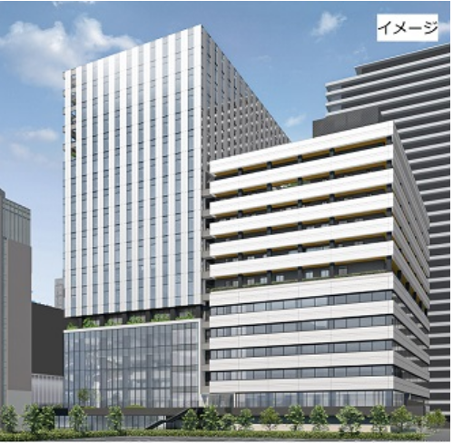
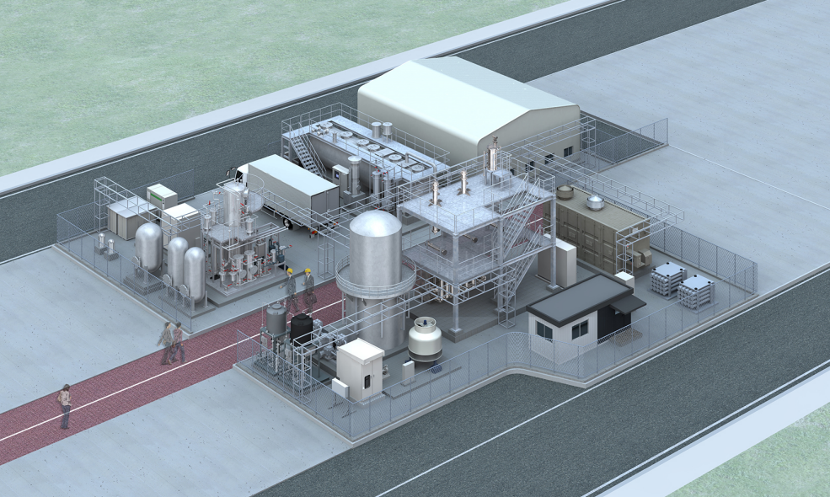
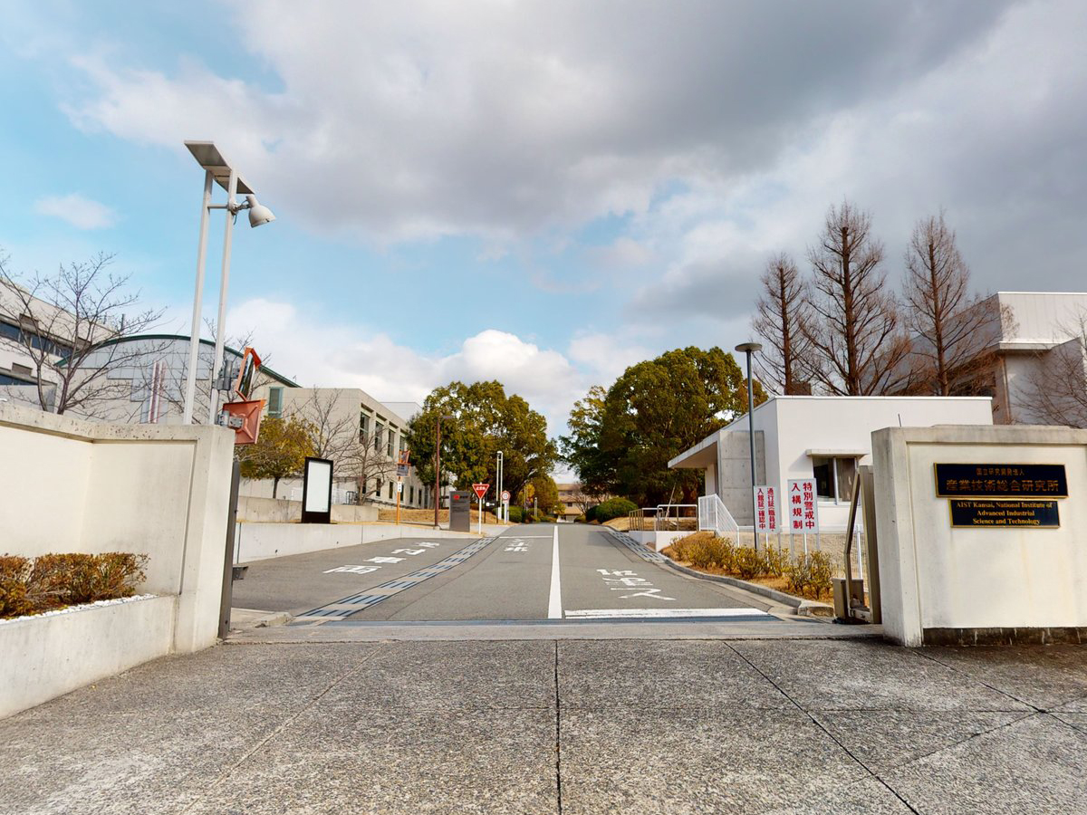
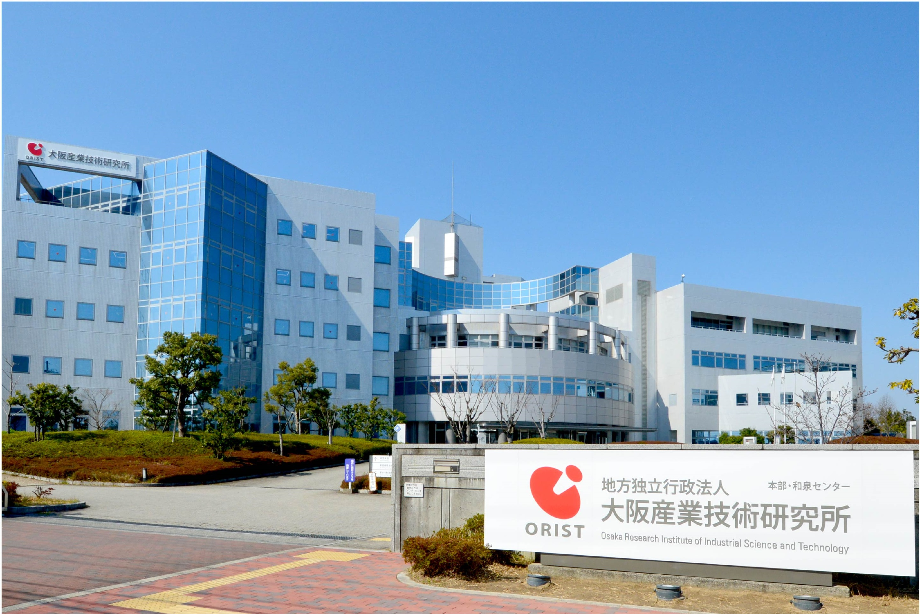
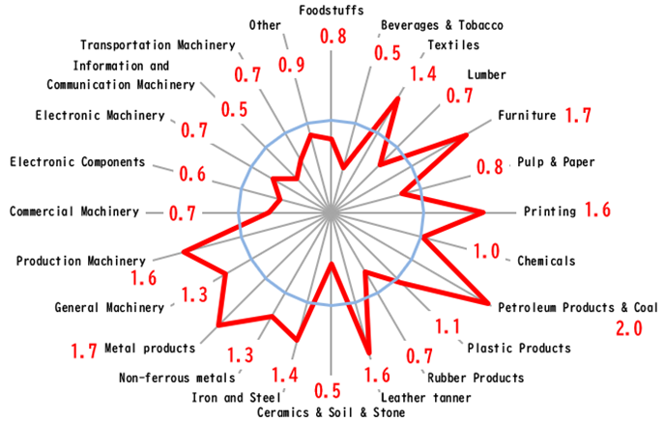
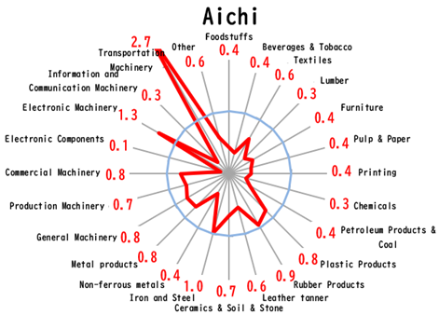

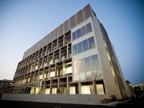
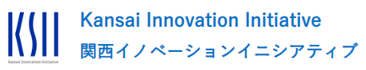
2. Background of the proposal
Ⅰ.Osaka’s industrial potential
◇In the life science field, there is a concentration of pharmaceutical companies engaged in innovative drug discovery as well as health and medical-related companies. In the carbon neutral field, there is a concentration of world-class companies engaged in research and development, and big projects are underway in both fields.
◇Osaka is a “city of manufacturing,” which was once known as the "Manchester of the East." Osaka now boasts one of the largest number of business establishments in Japan and a market share of approximately 10%. Osaka is home to a concentration of small and medium-sized manufacturing companies with superior technology, such as those that supply parts and materials to the aerospace industry and global tech companies.
◇Many excellent universities and research institutes that support these industries are located in Osaka, and start-ups such as Deep Tech are being produced one after another.
➡Osaka also has strengths in industrial fields that help solve social issues such as the declining birthrate, aging population and global warming.
Excellent universities and research institutions in Osaka
１
Industries in which Osaka has strengths
２
Osaka, “City of Manufacturing”
３
Major project examples
in the life science field
Major project examples
in the carbon neutral field
1st | Aichi | 18,248
2nd | Osaka | 18,020
3rd | Tokyo | 14,861
Osaka University
Osaka Metropolitan University
National Cerebral and Cardiovascular Center Hospital
Manufacturing
Number of establishments
◇Well-balanced industrial location
©Osaka University
© Osaka Metropolitan University
© National Cerebral and Cardiovascular Center
The National Institute of
Advanced Industrial
Science and Technology
National Institute of Biomedical Innovation, Health and Nutrition
Osaka Research Institute of Industrial Science and Technology
International Center for Future Medical Care
“Nakanoshima Qross”
(Opening around spring 2025）
Methanation demonstration using food waste (garbage) and atmospheric CO2 at the Expo venue
Special coefficients for manufactured goods shipments, etc. (2020)
【Osaka】 【Aichi】
◇Startup ecosystem already exists.
Keihanshin is selected by
the Cabinet Office as a
“Startup Ecosystem Global Hub City”
(Secretariat: Osaka Industrial Bureau)
©AIST KANSAI
Source: National Institute of Biomedical Innovation, Health and Nutrition pamphlet
© Osaka Research Institute of Industrial Science and Technology
The Center for Information and Neural Networks (CiNet)
Numerous locations including the above
Selected for METI program to
promote the formation of
a start-up ecosystem
originating from universities
© The Center for Information and Neural Networks (CiNet)
（the National Institute of Information and Communications Technology (NICT), Osaka University
◇Kyoto University (55th), Osaka University (175th) and
18 other universities from Kyoto, Osaka and Kobe were
ranked in the "World University Ranking 2024 ".
（2021 Economic Census Activity Survey）

Slide 5


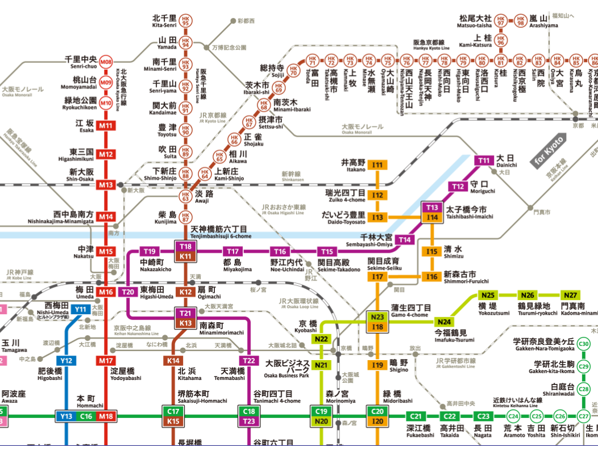
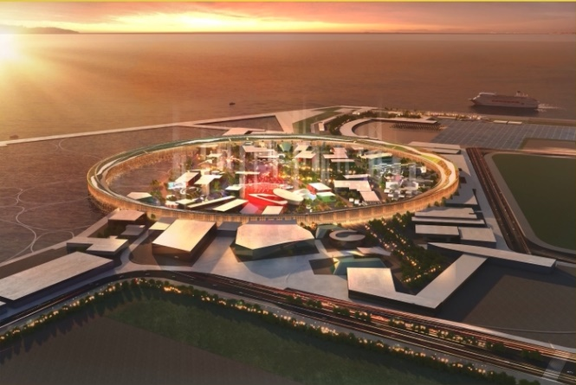
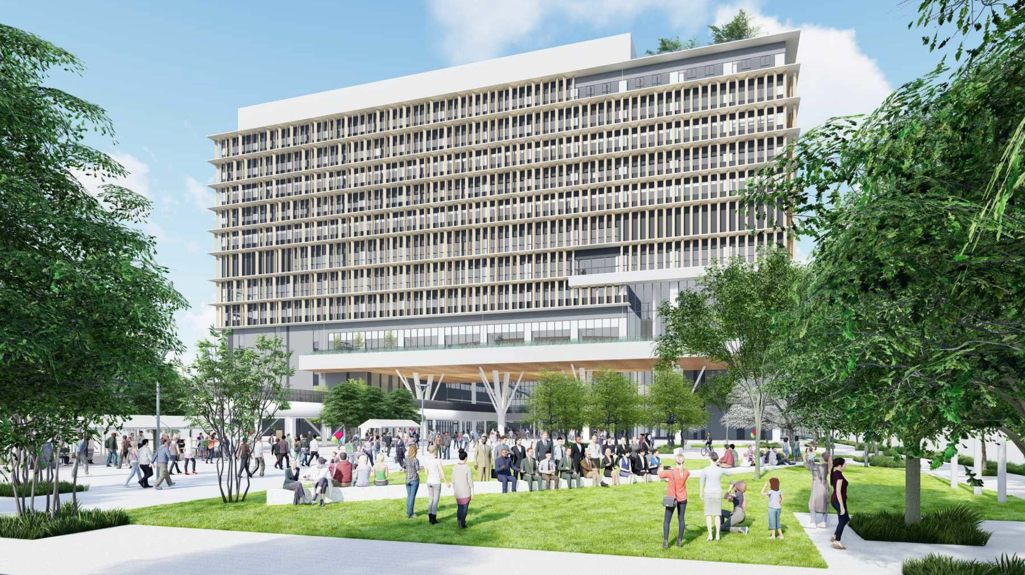
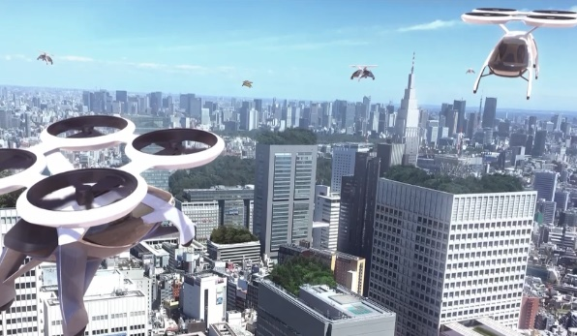


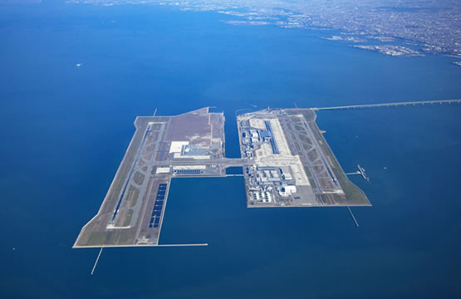
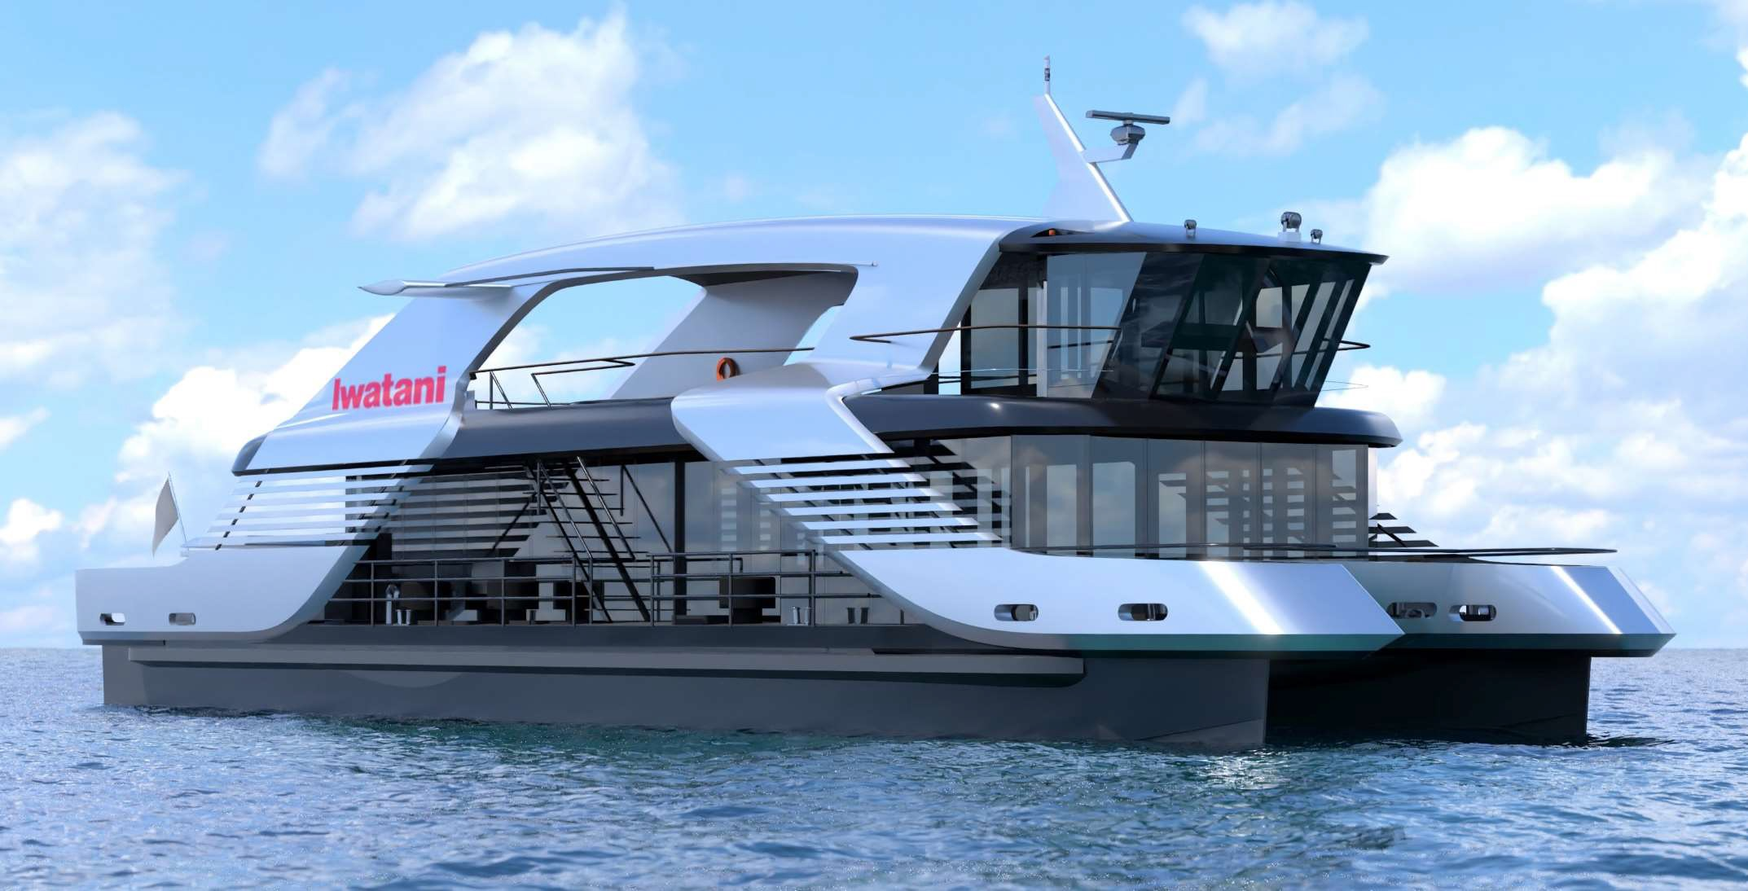

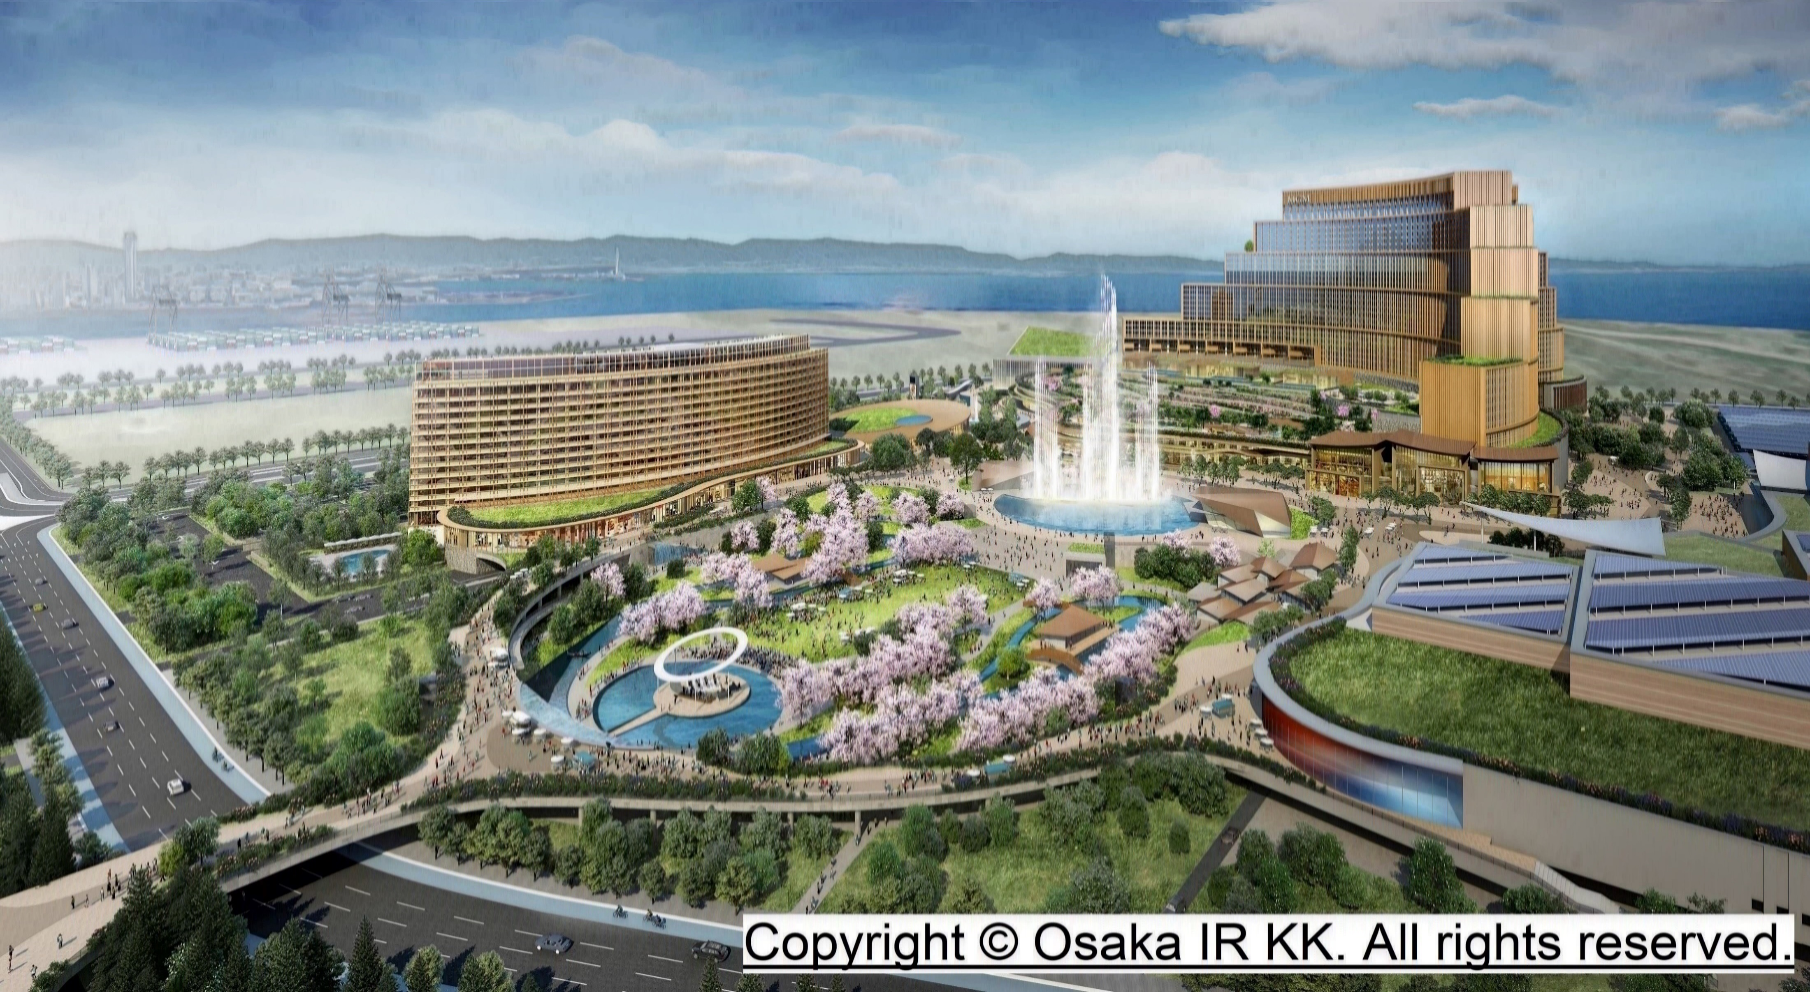
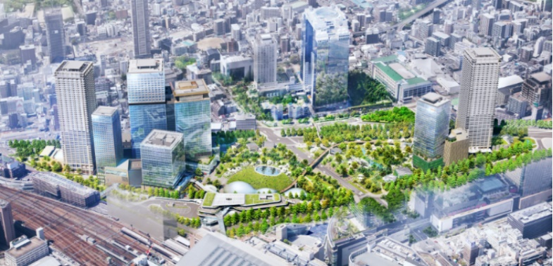

2. Background of the proposal
Ⅱ. Osaka's foundation that supports industries
◇ Expo 2025 Osaka-Kansai, held in Yumeshima, and other projects such as Umekita Phase 2, Osaka Public University Morinomiya Campus, and an
Integrated Resort (IR), are attracting attention as catalysts for the Osaka-Kansai economy.
◇ Osaka is a global city with a national-size population and a developed-country-size economy. It has a well-developed transportation infrastructure.
The network includes expressways, subways, JR, private railway lines, and Shinkansen bullet trains. Osaka also has two airports: Kansai
International Airport, the gateway to the world and Asia, and Osaka International Airport, the main domestic airport.
【Big projects attracting worldwide attention】
Domestic and international transportation infrastructure
EXPO2025 Osaka-Kansai
From April 13 to October 13, 2025 Venue: Yumeshima
Osaka Metropolitan University Morinomiya Campus
“People’s living Lab”
Flying Cars
Hydrogen fuel cell ships
「Kansai International Airport」
「Osaka International Airport」
Source: Ministry of Economy, Trade and Industry website（https://www.meti.go.jp/policy/mono_info_service/mono/robot/181220uamroadmap.html）
🄫 University Public Corporation Osaka, TAKENAKA CORPORATION, and Yasui Architects & Engineers, Inc.
Global City Osaka
Expo 2025 Official character
MYAKU-MYAKU
©Expo 2025
Provided by: Japan Association for the 2025 World Exposition
Provided by: Iwatani Corporation
Note: This is an image rendering and may be subject to change in the future.
Integrated Resort(IR)
Umekita Phase 2
Scheduled to open in Fall, 2025
Osaka’s Population
8.79 million people
Scheduled to open in Fall, 2030
Osaka’s Economic size
September 2024: Advance opening
Spring 2025:
Full opening
Approx. 41 trillion yen
(Yumeshima）
Economic Size of the Kansai Area
Approx. 94 trillion yen
Provided by: Grand Green Osaka Development Company

Slide 6









3. What we should aim for
“Special Zone for Creating a Future Society” Proposal details -Outline-
◇ To attract investment, companies, and human resources from around the world to Osaka, and to facilitate their business activities, regulatory
reforms will be implemented in line with global standards to address barriers to entry. By promoting the supply of risk money and the introduction
of financial technology to support Osaka’s advantageous growth industries, a finance-centered ecosystem will be created where investment
attracts investment.
◇ This will realize a "future society" where continuous innovations drive sustainable growth of the local economy and improve the residents’ lives,
while also contributing to solving global issues.
［Image of Ecosystem］
Global Standards
Concept
Ⅰ．Facilitate entry from abroad
Ⅱ． Facilitate business start-up and
daily life
Ⅲ． Facilitate business development
Ⅳ．-Vitalize business activities of Osaka
companies
- Improve residents' asset building
Attracting Investment, human resources, and companies
Overseas
Asset
Manage-ment
Companies
Foreign Financial Companies
Overseas
Fintech
Companies
Solution for Social Issues
Return
Investment, collaboration
Innovation
Future Society
Growing
Industries
Business
Expansion
Improved Residents’ Asset Building
and
Quality of Living
Life Science
SMEs with Excellent Manufacturing Skills
Carbon Neutrality
Financial
Institution,
Financial Companies in Osaka
Supply of Risk Money and Financial Skills
Start-up

Slide 7
“Special Zone for Creating a Future Society” Proposal details -Outline-
4. Major proposals to the national government
◇ Major proposals to the national government
Deregulation, etc.（23 items）
Taxation measures （7 items)
Ⅰ. Facilitate entry from abroad (3 items)
・Establish investor visa
・Make an exception to the "Highly-Skilled Professional" point system etc.
Ⅱ．Facilitate business start-up and
daily life (4 items)
・Promote the opening of bank accounts for companies entering
the market
・Cooperation in financial consultation services and procedures
・Simplify and digitalize administrative procedures
・Enhance English language support
etc.
Ⅲ. Facilitate business development
(10 items)
・Relax requirements for compliance personnel
・Relax requirements for outsourcing other than investment
management business
・Demonstrate experiment for financial licenses
・Simplify financial license notification
etc.
Ⅳ.-Vitalize business activities of Osaka companies
- Improve residents' asset building (6 items)
・Improve financial literacy of asset owners
・Relax requirements for national university faculty members to
hold concurrent positions
・Expand the scope of investment in public universities
etc.

Slide 8
4. Major proposals to the national government
List of deregulation to be requested from the government ①
No. | section | Proposals | Deregulation details
Ⅰ. Facilitate entry from abroad (3 items)
1 | Business Life Environment | Establish Investor Visa | (Challenge) Investor visas exist in major overseas cities that grant permanent residency if a certain size of investment is made. (Deregulation) Establish an investor visa that conforms to the design of foreign countries, such as an investor visa that grants permanent residence to those who establish a base in the region and make an investment of a certain size (approximately ¥120 million) in a growing industry in Osaka within three years or deposit money with the government for a certain period.
2 | Business Life Environment | Make an exception to the "Highly Skilled Professional" point system | (Challenge) FinTech companies, which are driving the sophistication and DX of corporate services, are concentrated in Tokyo, and Osaka needs to attract FinTech companies to create innovation in Osaka. Osaka needs to attract fintech companies in order to create innovation. (Deregulation) The Ministerial Ordinance should be amended to allow foreign nationals engaged in "fintech" business, which is recognized by Osaka Prefecture, to receive 10 points in the calculation of their "highly skilled professional" status of residence.
3 | Business Life Environment | Relax requirements for "Designated Activities (No. 33) | (Challenge) When the spouse of an overseas investor (highly skilled professional human resources) comes to Japan accompanied by his/her spouse, it is difficult for the spouse to continue working in Japan through remote work even if he/she is working in his/her own country. (Deregulation) Only the spouse of the investor should be allowed to continue working in Japan under a remote work contract with an overseas company as if it were a contract with a domestic company.
Ⅱ. Facilitate business start-up and daily life (4 items)
1 | Finance | Promote the opening of bank accounts for companies entering the market | (Challenge） It is difficult for companies expanding from overseas and foreign nationals to open bank accounts due to language barriers and length of residence requirements that vary depending on the financial institution. (Deregulation) Through notices from the authorities, etc., banks and other institutions with branches in Osaka City are encouraged to open bank accounts for companies that are expanding with the support of Osaka Prefecture and the City of Osaka.
2 | Finance | Cooperate in financial consultation services and procedures | (Challenge) The one-stop counter for financial licenses is concentrated in Tokyo. (Government Support) In order to facilitate the entry of foreign financial companies into Osaka, a "Support Office for Establishing a New Business Location", which serves as a counter for financial license procedures and a "Financial Start-up Support Network", which provides mediation and financial support for professionals, etc., should be established in Osaka, and collaborate with the " Osaka Global One-Stop Support Center" established by Osaka Prefecture and Osaka City.
3 | Business Life Environment | -Simplify and digitalize administrative procedures digitalization -Enhance English language support, etc. | (Challenge) When fund managers and others want to do business in Japan, they first need to complete the necessary procedures to set up a living environment and then go through the procedures to establish a company, etc. However, the contact points for these procedures are diverse and not all of them have been translated into English or digitally transformed. (Government support) (1) The government will establish a portal site that consolidates various procedures so that foreign nationals can understand the sequence of procedures for business and living environment, and (2) the government will request that all procedures be translated into English and digitally transformed so that they can be completed on the site.
4 | Business Life Environment | Stop disclosing commercial registrations | (Challenge) In commercial registration, although the system where the name and address of the representative are becoming increasingly non-disclosable, the system can be viewed by anyone is not applicable except for joint-stock companies. (Deregulation) In commercial registration, the address of the representative of not only joint stock companies but also general incorporated associations, etc. should be undisclosed.

Slide 9
4. Major proposals to the national government
List of deregulation to be requested from the government ②
No. | section | Proposal title | Contents of deregulation, etc. requested
Ⅲ. Facilitate business development (10 items)
1 | Finance | Relax requirements for compliance personnel | (Challenge) In order to receive a license, a company expanding from overseas needs to have compliance personnel on staff, but it is difficult to secure such personnel. (Deregulation) ・When an overseas asset management firm conducts the same type of business in Japan, the required compliance officer should be allowed to concurrently serve as a compliance officer with the personnel of the relevant overseas headquarters, subject to certain requirements, such as when the Financial Services Agency recognizes the equivalence and safety of the compliance officer's duties. ・In addition, under the guidance of the compliance manager who has been approved for concurrent duties as described above, the outsourcing of compliance work in Japan to a person (lawyer, etc.) who is familiar with compliance work in Japan is permitted.
2 | Finance | Relax requirements for outsourcing other than investment management business | (Challenge) One of the reasons why the number of new investment management firms has not increased is the heavy burden of developing a system to meet registration requirements for businesses other than the core investment management business. (Deregulation) ・Establish a registration system for middle and back office operations. ・Relax the requirements for registration as an investment management business (e.g., system development) when operations are outsourced to registered firms.
3 | Finance | Demonstrate experiment for financial licenses | (Challenge)In order to promote the entry of new asset managers and fintech companies into the market, Osaka needs to create an environment in which they can conduct demonstration experiments. However, the current sandbox system is not being used. (Deregulation) The FSA should be bold enough to grant or waive provisional licenses for a certain period within a certain region, as it does in other countries, subject to conditions such as safety and other factors that are approved by the FSA.
4 | Finance | Simplify financial license notification | (Challenge）When a business operator with a license for asset management business overseas establishes an office in the region and conducts the same business, it is necessary to obtain a Japanese license after entering the region, which requires a considerable amount of time to complete the procedures, and is a factor that hinders new entrants. (Deregulation) Simplify the procedures so that a business operator with a certain amount of investment experience overseas can immediately start business by simply notifying the regional finance bureau of a provisional license, etc. only when establishing an office in the region and conducting the same type of business.
5 | Finance | Relax requirements for individual qualified institutional investors | (Challenge) The requirement for individual qualified institutional investors is to hold at least 1 billion yen in securities, which makes it difficult for them to manage funds by starting up, etc. (Deregulation) The amount of assets held (around 140 million yen) should be lowered for the notification requirement for qualified institutional investors.
6 | Finance | Relaxed leasing requirements for bank-owned real estate | (Challenge) It is necessary to meet the requirements of the supervisory guidelines in order to lease bank-owned real estate to other types of businesses, etc. (Deregulation) Relax requirements for leasing of bank-owned real estate to other types of businesses, etc., so that excess space in bank-owned real estate can be effectively utilized for concentration and expansion of financial and asset management services, etc.
7 | Finance | Relaxation of restrictions on voting rights for venture companies | (Challenge) There is a special exception for investment in venture companies through specialized investment subsidiaries that exempts them from the restriction on holding voting rights if the following conditions are met. 【Conditions】 (1) Unlisted companies or companies issuing non-OTC traded securities, (2) Small and medium-sized companies, (3) Less than 10 years since establishment or the start of new business activities (Deregulation) Relax the condition of "less than 10 years after establishment or start of new business activities" for deep tech startups in life sciences and other fields in which Osaka has strengths, such as drug discovery, because it may take more than 10 years to grow.

Slide 10
4. Major proposals to the national government
List of deregulation to be requested from the government ③
No. | section | Proposal title | Contents of deregulation, etc. requested
8 | Finance | Centralize Equity Investment Crowdfunding (CF) Shareholders | (Challenge) As the number of individual investors to manage increases due to equity investment type CF financing, there is a risk that administrative work will become complicated. (Deregulation) In order to allow CF business operators to centrally manage equity investment-type CF as syndicate-type CF, a special exception should be made for so-called target-type funds, such as making the asset management business license that such business operators should originally obtain unnecessary by including it in the scope of Type 1 Small Amount Electronic Offering Handling Business.
9 | Finance | Revitalize unlisted equity secondary trading | (Challenge) In principle, solicitation of secondary transactions to general investors is not permitted, and investors need to create their own trading opportunities in order to conduct such transactions. (Deregulation) In order to promote the entry into the intermediary business of trading unlisted securities, the registration requirements for Type I Financial Instruments Business should be relaxed for specified investors only if they do not receive deposits of money, etc.
10 | Finance | Relax the maximum amount of remittance for Type II Funds Transfer Business | (Challenge) Type Ⅱ Funds Transfer Business is limited to remittance of up to 1 million yen, and is not able to meet the needs of B-to-B high-value remittances. (Type 1 Funds Transfer Business was established to handle high value remittance services, but under strict regulations, only two operators have been registered.) (Deregulation) The maximum amount of remittance for Type Ⅱ Funds Transfer Business should be raised to 2 million yen in light of the need for high-value remittance services.
IV. Revitalization of activities of companies in Osaka and improvement of asset formation of prefectural residents (6 items)
1 | Finance | Improve financial literacy of asset owners | (Challenge) Efforts to improve asset management capabilities are not sufficient, as asset owners lack expertise and human resources compared to those overseas. (Government Support) In order to promote further asset formation of prefectural residents, asset owners of corporate and public pensions, etc. need to improve their investment sophistication, and the Government seeks support and other efforts to contribute to the improvement of investment sophistication, including human resource development through training and provision of information on asset management for those in charge of managing corporate and public pensions, etc.
2 | Finance | Relax requirements for solicitation of financial products in English | (Challenge) We are aware that there are no laws or regulations that prohibit this, but it is not necessarily clear that it is possible to solicit using foreign-language documents, etc. for foreign customers. (Deregulation) In the Supervisory Guidelines, it should be clearly stated that solicitations for financial products, including pre-contract documents, etc., can be completed in English if prior consent is obtained from foreign customers.
3 | Growth industry | Relax requirements for national university faculty members to hold concurrent positions | (Challenge) The requirement for dual employment is only for cases that utilize research results created by the researcher, and even if the research results are from his/her own university, the researcher cannot engage in dual employment unless the research results are created by the researcher himself/herself. (Deregulation) Relaxing of the requirement to engage in cases that utilize research results created by the university to which the researcher belongs.
4 | Growth industry | Expand the scope of investment in public universities | (Challenge) Public university corporations are unable to invest in venture capital and funds because the scope of investment is narrower than that of national university corporations. (Deregulation) Expand the scope of investment by public university corporations so that they can invest in venture capital, funds, etc.
5 | Growth industry | Rationalize safety regulations, etc. related to hydrogen utilization | (Challenge) Regulations on hydrogen, etc. are not based on the premise of large-scale utilization of hydrogen and need to be reviewed, including rationalization and optimization, which is a disincentive for the creation and expansion of related businesses. (Deregulation) On the premise of ensuring safety, establish an environment that encourages the use of hydrogen and other resources, including rationalization and optimization of regulations, such as handling based on the characteristics of hydrogen.
6 | Growth industry | Promote the establishment of incubation facilities | (Challenge) Incubation facilities equipped with R&D facilities are essential for the creation and growth of deep tech startups, but there are no facilities in Osaka for new startups to move into, and startups that have grown can move out of the university. There continues to be a situation where there are no facilities, and people are leaving the prefecture in search of facilities. (Government Support)In order to prevent the outflow of startups from moving out of the prefecture, we request the establishment of a subsidy system for the development of incubation facilities.

Slide 11
4. Major proposals to the national government
List of tax measures to be requested from the government (7 items)
Proposal items | Details of tax measures requested
Reduce corporate income tax (national tax) on foreign financial companies, etc. | ◇In order to improve international competitiveness with other countries/regions, provide reduced national tax rates for foreign financial companies such as asset managers and fintech companies, etc., in competition with Singapore, Hong Kong, and other countries. ※Effective corporate tax rate in each country/region Japan 29.74% ⇒In Osaka, the effective tax rate is 27.48% (-2.26%) due to reduced corporate inhabitant tax and corporate enterprise tax. Singapore 16.50%, Hong Kong 17.00%, U.K. and France 25.00%, U.S. 27.98%
Reduce individual taxation of fund managers, etc. | ◇Further reduction measures should be taken for profits distributed to fund managers, in light of the fact that Singapore and Hong Kong are tax-exempt. ※Profits distributed to fund managers‘ fund holdings reflecting investment results are subject to separate taxation (a flat rate of 20%) as “capital gains, etc.” under the recent tax reform.
Exempt Tuition Tax for International Schools | ◇International schools attended by children of expatriates shall be exempted from tuition fees if the company to which the expatriate belongs donates an amount equivalent to the tuition fees to the school. In such a case, the amount equivalent to the tuition is not subject to taxation as a salary of the expatriate, but is allowed to be fully deductible as a donation.
Reduce measures for international schools and financial institutions to establish BCP bases, etc. | ◇The tax incentives for international schools and BCP bases of financial institutions should be included in the areas eligible for the tax incentives for capital investment promotion. ※Current tax incentives for capital investment promotion. ・Target Fields: "Medical," "International," and "Agriculture ・Eligible equipment: Buildings, auxiliary equipment, and structures (with an acquisition cost of 100 million or more) ・Special depreciation rate: 45% of the acquisition price (23% of the acquisition price for buildings) ・Tax credit rate: 14% of the acquisition price (7% of the acquisition price for buildings)
Offer tax incentives to companies for translating their business into English | ◇Allow deductible expenses for English language training and information dissemination in English conducted by SMEs and start-ups in order to facilitate business with foreign countries.
Offer Tax incentives to individual investors investing in VC funds | ◇To deduct a certain percentage of the amount invested by individual investors in venture capital funds in order to facilitate the supply of funds to startups.
Revise requirements for investment in startups | ◇Angel taxation: A system that provides tax benefits to individual investors who invest in venture companies. (Proposed details) In order to promote investment in venture companies, the maximum amount of income deduction for the amount of investment is increased from 8 million yen to 10 million yen. ◇Open innovation taxation: When an eligible domestic corporation conducts an M&A of a start-up company, 25% of the acquisition price of the outstanding shares acquired will be deducted from taxable income. (Proposal details) (1) Expand the scope of application of the tax system to domestic limited liability companies (LLCs), not just overseas corporate venture capital (CVC). (2) Lower the maximum amount of capital contribution for small and medium-sized companies from 10 million yen to 5 million yen for the capital contribution requirement in the case of new stock issuance.

Slide 12
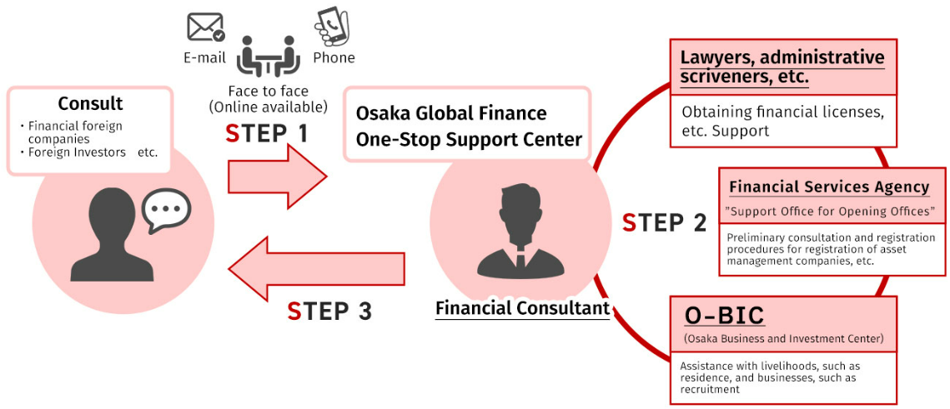
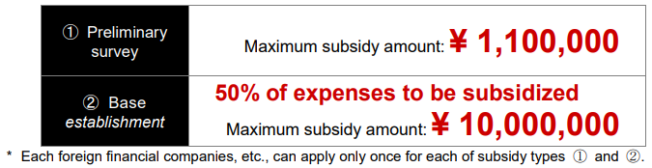
5. Local government initiatives
Local government initiatives
Attracting Businesses
  Comprehensive management by specially appointed advisor
  (April 2023)
  (2) Comprehensive outsourcing of business attraction activities
  (July 2023)
  (3) Mass promotion activities
    Promotion
    ●Overseas Top Promotion by Governor and Mayor
    （Dec. 2022: U.K. ; July to Aug. 2023: U.S.）
    ● Participation and exhibition in overseas financial
    events
    （Nov. 2022, Nov. 2023: Singapore Fintech Festival;
    Jan. 2024: Asian Financial Forum）
    ● A business matching event hosted by Osaka
    Prefecture and Osaka city
    （Nov. 2023: over 200 companies' participation and
    over 100 individual business meetings)
    Information dissemination
    ● Information dissemination through portal sites
    （Since Oct. 2022）
    ● Information dissemination through social media
    （Since Aug. 2023, LinkedIn・X)
    Start of the “Ambassador" system （Since Dec. 2023)
    - Distinguished individuals are asked to share
    information.
    - Currently there are 20 participants.
(4) Strategic Approach to Individual Targets
International Finance One-Stop Support Center Osaka
Incentives for attracting foreign companies to Osaka
● Subsidy Program for Foreign Financial companies, etc., Establishing
a Base in Osaka City
● Local tax reduction system -First in Japan-
Support administrative procedures
- Prepare an investor's guidebook (in English)
Support foreign financial companies entering Osaka by preparing a unique financial
license registration guidebook that includes an introduction to the attractiveness of
investing in Osaka
Corporate inhabitant tax and corporate enterprise tax will be reduced for up to 10 years for foreign financial companies that are engaged in asset management (asset management business or fintech business) and are new to Japan and Osaka City.
This is Japan’s first system limited to foreign financial companies!
◆Reduced Tax items and Tax rates
Tax items: Corporate prefectural inhabitant tax (per capita and per capita corporate tax),
corporate enterprise tax
Tax rate: Deduction of an amount equivalent to the percentage of asset management business,
etc. (maximum deduction in full) Maximum deduction: approximately 2%.
◆Reduction period: Up to 10 years (extended every 2 years)
10

Slide 13
5. Local government initiatives
Local government initiatives
２. Improve living environment for foreign residents
(1) International schools (hereinafter referred to as “int’l schools)
    ●Survey on int’l schools in Osaka, Hyogo, and Kyoto Prefectures(Dec.2021)
      ・Target：24 inter schools in the three prefectures
      ・Content: Survey through questionnaires and school websites Academic achievements, attributes and numbers of teachers and students,
      adopted curriculum, tuition, etc.
    ● Needs assessment survey on int’l schools (scheduled for February 2024)
      ・Target : Highly-skilled professionals living abroad (parents/guardians)
      ・Content: Survey through questionnaires
      Commuting and boarding, Access, Tuition
      Language in the classroom, University placement rates, etc.
    ➡ Based on needs, consider attracting “int’l schools, etc.
(2) Medical information for foreign nationals
  ●Osaka Medical Net for foreign nationals
  ＊A website has been established to provide useful information for foreign
    nationals who visit a medical institution for a sudden illness or injury.
  URL：https://www.mfis.pref.osaka.jp/omfo/
  ＊The site is available in English, Chinese, Korean, Spanish, and
  Portuguese.
  ●Selection of medical institutions as Osaka Prefecture's base and Osaka
  regional base medical institutions for accepting foreign patients
  ＊Establish a medical system in Osaka Prefecture that allows foreign
  residents to receive medical care with security.
(3) Housework support service (National Strategic Special Zone)
  Through the use of the project for accepting foreign nationals for housework support, establish an environment where services by foreign housework support personnel who have been admitted under certain requirements can be used in Osaka Prefecture.
(4) Advanced international medical care
(Super-city-type National Strategic Special zone)
  Establish a medical environment where all people, including foreign patients, can access advanced medical care provided by medical institutions in Osaka Prefecture.
  *Under consideration
  ① Involvement of foreign doctors
  (use of bilateral agreements, national examinations for doctors
  in English)
  ② Online medical services to those in foreign countries
  ③ Use of drugs approved overseas but not in Japan
11

Slide 14
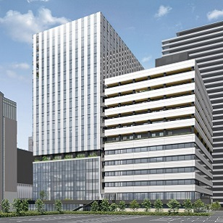
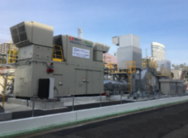

5. Local government initiatives
The realization of a " future society" on the occasion of Expo.
Life Science
Carbon Neutrality
Start-ups
□Promote the formation of a center
for regenerative medicine
・The International Center for Future Medical Care
(Nakanoshima Qross) is scheduled to open in Nakanoshima
(Osaka) in the spring of 2024.
・In order to accelerate the practical application and industrialization of regenerative medicine, the Nakanoshima Qross will promote exchanges among medical institutions, companies, start-ups, support organizations, etc., and support the creation of co-creation projects.
・Capitalizing on the Expo, Japan's cutting-edge medical technologies and initiatives to industrialize regenerative medicine will be strongly promoted both domestically and internationally.
□Research and develop cutting-edge technologies and demonstrate practical application
・Supporting the development and demonstration of cutting-edge carbon-neutral technologies will be showcased at the Expo
・R&D of next-generation storage batteries, etc., is being conducted at the Osaka Industrial Technology Research Institute and other facilities.
・Demonstration experiments (hydrogen production and generation, commercial/industrial fuel cells, etc.) are being conducted by businesses participating in the H2Osaka Vision Promotion Conference.
・R&D on CO2 capture, next-generation solar cells, etc. is being conducted using the government's Green Innovation Fund.
・From FY2024 to FY２０２５, the prefectural and municipal governments will jointly study strategies to effectively promote the formation of CNP (Carbon Neutral Port) in Osaka "Minato" (Port of Osaka, Port of Sakai-Senboku, and Port of Hannan).
□Create global star-ups and accelerate their growth
・A consortium made up of industry, academia and local government in Osaka implements support programs seamlessly from the pre-seed stage to the later stage.
・ We support for startups that are expanding overseas and creating and nurturing deep tech startups through acceleration and the formation of communities.
・We support overseas startups entering Osaka-Kansai by providing individualized support for entering the Japanese market and offering business matching opportunities with Japanese companies.
・Focusing on R&D startup (deep tech) support, we create contacts and promote exchanges between supporters in the Tokyo metropolitan area and Osaka's deep tech and university seeds.
・We foster momentum by holding events in conjunction with the Global Startup Expo 2025 to be held by the government.
▶Nakanoshima Qross Image
(Source: HP of Organization for Advanced Healthcare Innovation)
▲Next-generation solar cells
▲Hydrogen CGS
demonstration plant
▲Osaka Startup Ecosystem Logo

Slide 15
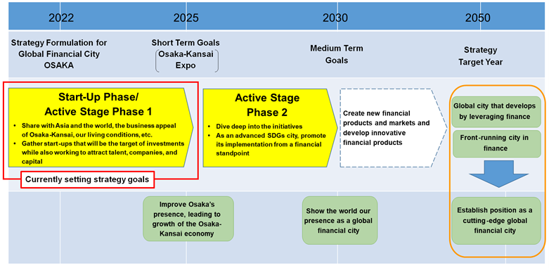
6. Local government promotion systems
Background
・In March 2021, the “Global Financial City OSAKA Promotion Committee" was established as the collaborative efforts of all of Osaka’s local governments, including Osaka Prefecture and Osaka City, the business community, financial institutions, and related organizations. (As of February 2024, 33 member organizations and seven observer organizations.)
・The committee also includes highly specialized academic experts (10 advisors).
・In March 2022, the Promotion Committee formulated the “Global Financial City OSAKA Strategy.
・The committee is also promoting efforts to achieve the goals of the strategy under the overall management of 5 specially-appointed advisors who have knowledge of global finance and strong overseas networks.
Promotion System Flow Chart
＜Global Financial City OSAKA Promotion Committee＞: Strategy development, progress management, etc.
Comprehensive management by specially appointed advisors
<Secretariat>
Osaka Prefecture, Osaka City
・Guidance and advice on strategy
promotion
・Provision of information on
companies to be attracted
Committee Structure
Committee members（33 Corporations/Organizations）
・Local Government ：Osaka Prefecture, Osaka City
・Economic Groups ：KANKEIREN,OCCI,DOYUKAI
・Financial institutions：24 companies in banking, securities, insurance, etc.
・Related Organizations：JETRO, Osaka Business Development Agency,
Osaka Metropolitan University, Fintech Association of Japan.
Observers（7 Corporations/Organizations)
・Local Government：Hyogo Prefecture
・Related Organizations：Osaka Bankers Association,
Financial Futures Association of Japan, Japan STO Association,
Japan Securities Dealers Association,
Japan Commodity Futures Industry Association(JCFIA),
The Commodity Futures Association of Japan
President/Vice-presidents
President：Chairperson of Kansai Economic Federation
Vice-presidents：
Chairperson of Osaka Chamber of Commerce and Industry,
Representative Director of Kansai Association of Corporate Executives
Governor of Osaka Prefecture, Mayor of Osaka City
Implementation of projects to realize a global financial city
Period of Strategy Efforts
All of Osaka Promotion with 2050 as the Final Stage

