Slide 1
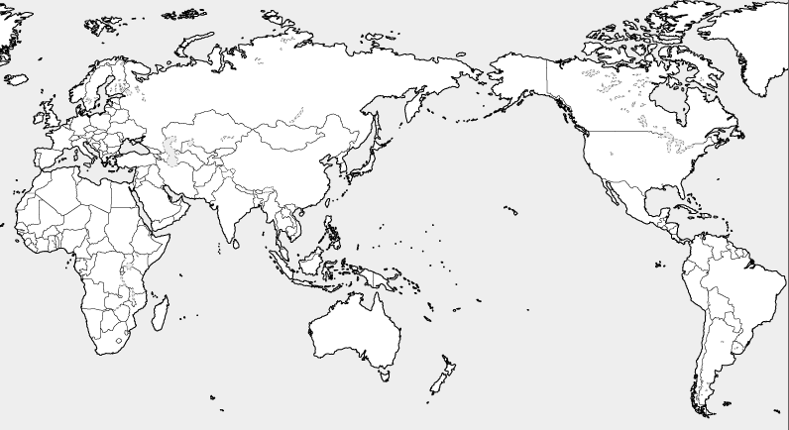
World Situation Around International Finance
◆ An international financial city means a hub of international financial trading, with headquarters of global banks, stock brokerage firms, etc
◆ The most renowned cities of its kind are New York and London, which have headquarters of prestigious financial institutes.
◆ The international financial situation shows a sign of change amid increasing geopolitical risks such as Brexit and enforcement of the
National Security Law in Hong Kong.
Singapore
・Showing its presence as a finance center of Southeast Asian nations
Tokyo
・Supporting Japan’s business activities by the foreign exchange/stock markets
Edinburgh
Boston
New York
・The world’s largest stock market based on the US economy and US dollar credibility
London
・International financial market with less regulations for non-residents
・The world’s largest derivative trading volume
Shanghai
・Finance market based on
a growing Chinese
economy and gathering of
businesses
Los Angels
Chicago
Hong Kong
・The world’s largest yuan offshore market
・Gateway function to mainland China
・Hub of the asset management- business in the Asia-Pacific region
Value of foreign
exchange transactions
Total stock market value
Derivative trading volume
〔unit：1billion USD〕
London
Tokyo
Singapore
London
New York
Tokyo
Singapore
Hong Kong
Shanghai
London
Source： Japan Center for International Finance “September, 2020 Market data sheet”
New York
Hong Kong
Shanghai
New York
Tokyo
Singapore
Hong Kong
Shanghai

Slide 2
Japan’s Current Situation of International Finance
◆Japan’s transactions are concentrated in the Tokyo Stock Exchange(Tosho), but the COVID-19 pandemic has visualized the risk of overconcentration in Tokyo at the time of crisis.
◆Looking around the world, every major country contains several financial cities with different functions.
◆Amid global inter-city competition, Japan needs other internationally-competitive financial cities adding to Tokyo, to strengthen its growth.
Japan’s current situation
▽The negative impact of unipolar concentration in Tokyo
〔 International Financial Center Index 〕
▽Transactions are concentrated in Tosho
〔Ratio of markets in stock exchanges〕
 | September, 2020
1st | New York | USA
2nd | London | UK
3rd | Shanghai | China
4th | Tokyo | Japan
5th | Hong Kong | China
6th | Singapore | Singapore
- | - | -
13th | Edinburgh | UK
- | - | -
20th | Chicago | USA
- | Osaka（39th） | Japan
日本
米国
・ Estimated maximum damage when an earthquake hits directly Tokyo metropolitan area ➡ Approx. 95 trillion yen
・Natural Disasters Risk Index of world big
cities ➡Tokyo-Yokohama is the worst among the major big cities in the world
*Other…Matching transactions, etc. by stock
brokerage firms
ＮＡＳＤＡＱ…a stock exchange market for
emerging companies in the US
Source：Nikkei shimbun（Oct.2, 2020)
Japan: Japan Securities Dealers
Association
US: Chicago Board Options Exchange
Source： Cabinet Office, final report by Working Group on the
earthquake centered directly under the capital（2013）
Munich Reinsurance Company Annual Report(March, 2003）
Financial cities with different functions
USA
New York
World’s largest stock market
Chicago
World’s largest derivative exchange
【Assessment items】
①Business environment
②Human resources ③Infrastructure
④Development level in the financial field
⑤International evaluation
UK
London
Financial market with the world’s largest stock exchange volume
Edinburgh
Home to international asset management businesses
Source： UK Think-Tank Z/Yen Research

Slide 3
Osaka’s Advantages as an International Hub and its Future Visions
◆Osaka is a commercial metropolis, also known as the “nation’s kitchen.”
◆It developed by people’s independent activities and unique ideas, and the world’s first futures contract was traded here.
◆Full of new business chances, it’s an attractive place for both domestic and foreign entrepreneurs and investors.
◆Osaka will lead entire Japan’s economic growth as an international financial metropolis that has different characters
and functions from those of Tokyo.
Osaka’s vision for the international financial metropolis（images）
Osaka’s Advantages
１．Historical background
Innovative Financial Metropolis Osaka
▽Birthplace of the futures trading (derivatives)
２．Well-organized urban infrastructure
▽Promoting *ESG investment to achieve SDGs with entirety of Osaka, as the venue of Expo 2025 ▽Making Osaka an innovative financial metropolis home to funds and human resources by drastic deregulation ▽Societal implementation of cutting-edge technology in the financial business sector ▽Creating a new market through digital transformation in finance
▽The only general exchange market that deals with derivatives ▽Developed transportation network and an international trading port ▽Higher education facilities and life science-related industries
Osaka’s Potential
Developing big projects that attract investments from Japan and
the world
*ESG investment： The investment that has Environmental, Social and Governance elements, which means investments seeking positive returns and long-term impact on society
▽ 2025 Expo Osaka-Kansai ▽ The highest level growth in the world
２．Acting as home to new innovation
Asian Derivative Metropolis Osaka
▽ Promoting a smart city and a super city ▽ Creating a global hub for startup-ecosystem ▽ Creating Umekita Ⅱand an international hub for the future of medical care (Nakanoshima)
▽Creating the leading hub of the Asian derivative market to take in the growth of derivative transactions

Slide 4







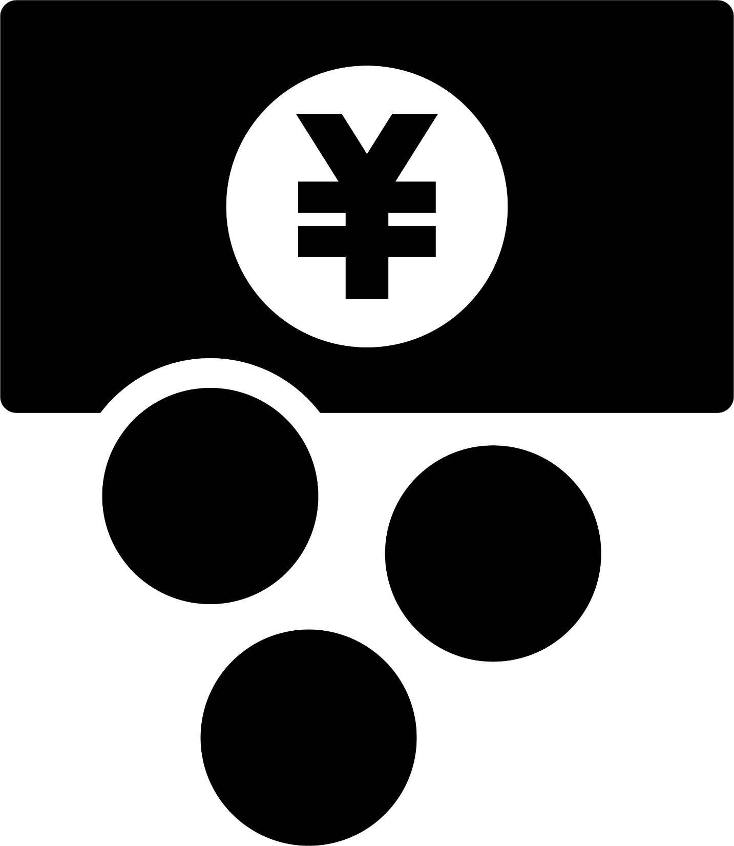
Efforts to Make Osaka an International Financial Metropolis
◆Establishing a preparatory organization that consists of Osaka Prefecture and Osaka City, economic groups, etc.
based on the current international situation (within this year)
◆Starting to implement feasible policies in sequence towards the post COVID-19 world, while calling on businesses,
which agree to our intent, for participation
Schedule
Within 2020 | Establishing a preparatory organization
Within FY2020 | Establishing a promotion organization consisting of both public and private members
From April, 2021 | -Promoting to attract finance-related businesses from inside and outside Japan -Training up financial human resources -Promoting ESG investment -Considering to create a new market of the financial digital transformation
Osaka Prefecture/City
Economic groups
Government-related organizations
Promotion organization
by public and private
sectors (imaging chart)
Positive impact of the realization of an international financial metropolis
Realizing
“Second Capital
Osaka” to lead
Japan’s growth
Private businesses
Educational institutions
Osaka’s economic vitalization by vigorous investment
Financial institutions/exchanges
Creation of employment in the related industries
Residents’ asset management and formation

